Slide 1
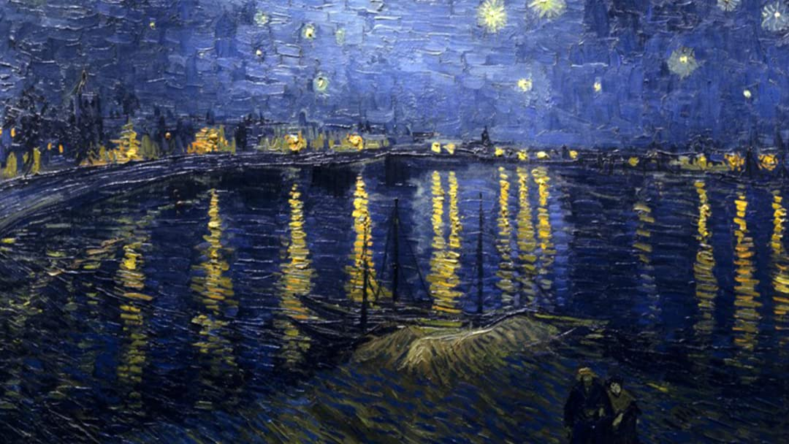
VINCENT
VAN GOGH

Slide 2
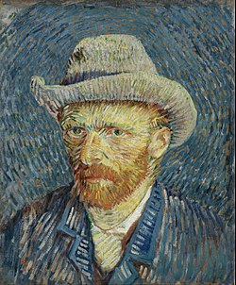
biography
* Holland, 1853 - † France, 1890
Dutch artist
father was a minister
mother from a family of famous art dealers
one of 6 children
languages: Dutch, French, English and German

Slide 3
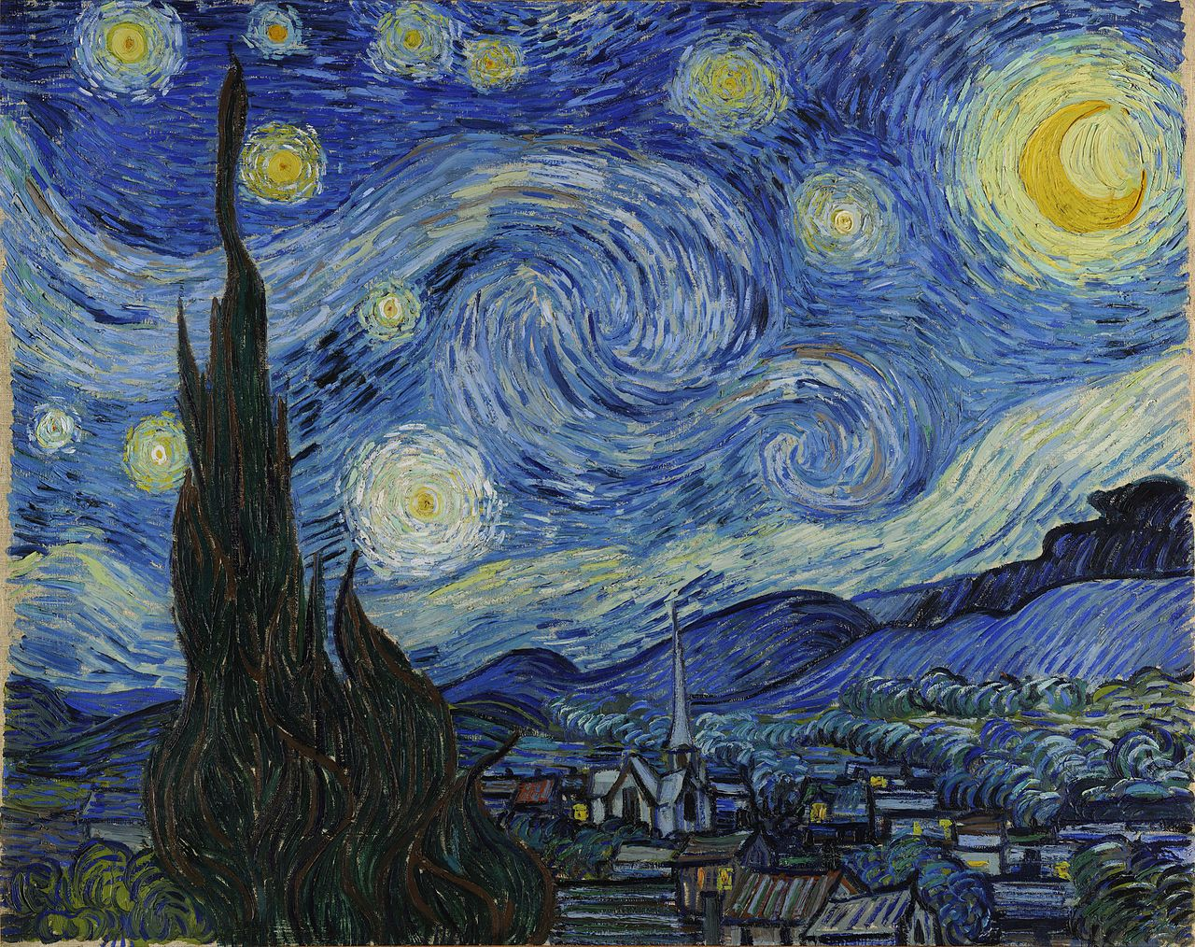
biography
tried many professions…art dealer, teacher, working in a bookstore
painter at age of 27
struggled with mental illness
cut off part of his ear (argument with Paul Gauguin)
wrote over 600 letters to his brother, Theo
influenced by impressionist

Slide 4
Art – the early years
mostly of poor people he helped
colours in his early paintings - dark and brown
portrayed sadness
→ wanted people to know how hard the lives were of the poor people
Early influences: Rembrandt (Dutch painter of light & shade, many self-portraits)
Claude Monet (French impressionist, small brushstrokes to reflect light and depict movement)

Slide 5
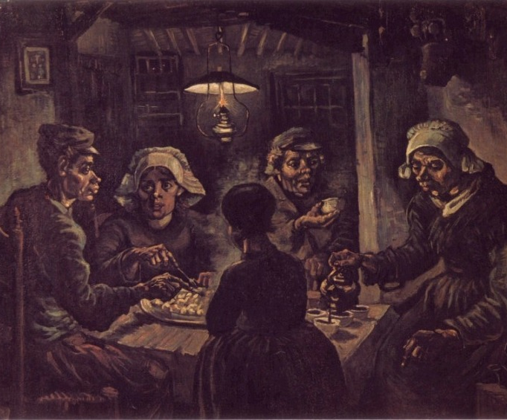
The Potato Eaters 1885

Slide 6
Art – his later years
some of his best work - last 2 years of his life
lighter colors
short brushstrokes of the Impressionists
paintings - happier, brighter and more colorful
sold only 1 painting while he was alive
over 800 paintings

Slide 7
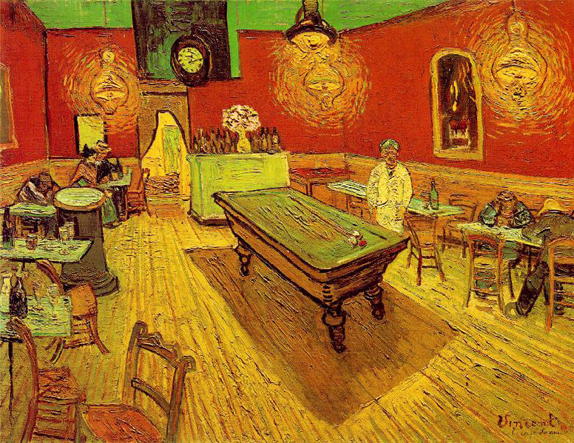
The Night Café
1888

Slide 8
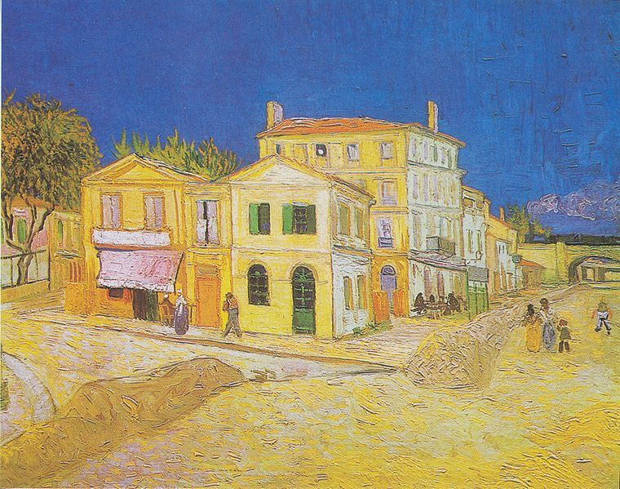
The Yellow House-1888

Slide 9
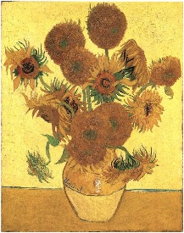
The Sunflowers-1888
- thick paint
- sold in 1987 for
$39 million dollars!

Slide 10
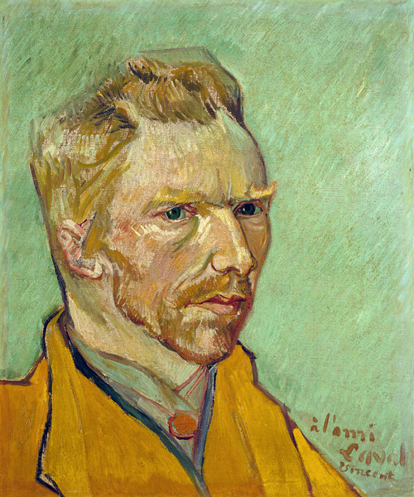
Art style
especially known for:
broad brushstrokes
brilliant colours (no mixing, straight from the tube)
swirling lines to show movement and strong emotion
bring his subjects to life
self-portraits

Slide 11
Thank you for your attention!

