Slide 1
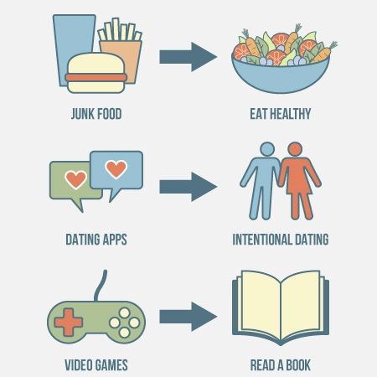
Dopamine Detox
Matěj Pekař
S2.K
Notes:
poopopjnibihnpinpiun

Slide 2
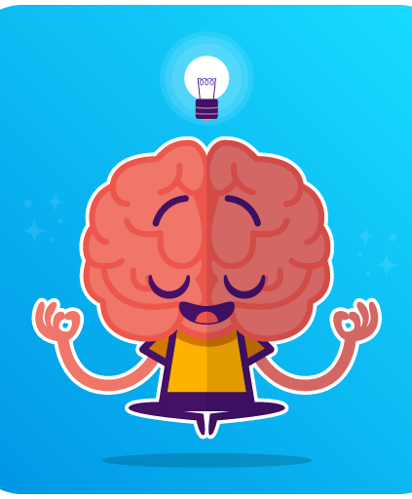
Agenda
What is dopamine?
Why do we need it?
Is necessary to stop?
Benefits of detox?
Dopamine detox techniques
Video

Slide 3
Dopamine
What is dopamine
Why do we need it
Chemical
Makes us happy
”happy hormone”
Produced in brain
Motivation, pleasurable reward/feeling
Needed to mental health BUT in the right amount
Notes:
CHEMICAL produced in BRAIN
Main goal → to MAKE US HAPPY
REWARDING US
Too much → BORED

Slide 4
Is it really problem?
Benefits of detox
Are you addicted?
Be more productive, creative, focused in work
Decrease addiction, impulsivity, cravings, etc.
Always bored
Doomscrolling through social media
Pursuing distractions
Procrastination

Slide 5
Try it by yourself!

Slide 6
Dopamine detox techniques
Journaling/writing down your thoughts (paper only)
Meditation
Mindfulness practices
Keep your phone off
Remove junk food
Avoid caffeine, alcohol, etc.

Slide 7
“THE WAY TO GET STARTED IS TO QUIT TALKING AND BEGIN DOING.”
Walt Disney

Slide 8
Video

Slide 9
THANK YOU
Source of information
Wikipedia.org
Wearesocial.com
Youtube.com
Clevelandclinic.org
Freedom.to

