Slide 1
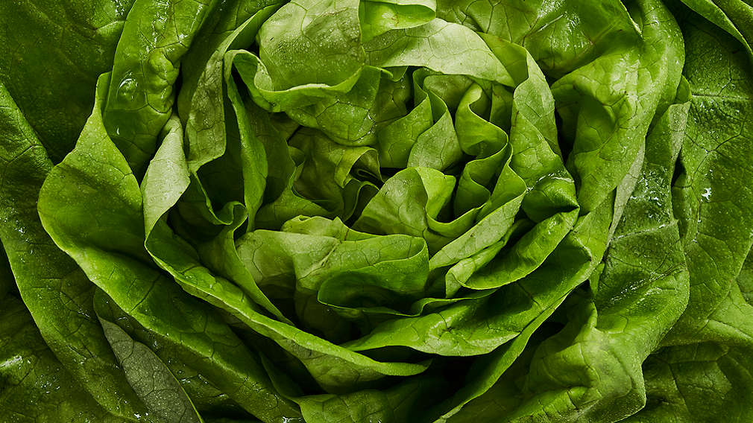
fractals
By František Zápotocký

Slide 2
Wat we will be talking about
Definition of fractal
Examples
Where in nature can fractals be found
What I did by programming

Slide 3
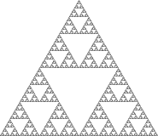
What is fractal
Never ending pattern
infinitely complex patterns
Created by repeating simple patterns
Self similar across different scales
Was first named in 1975 by Benoit Mandelbrot
word comes from the Latin word frāctus
Notes:
A shape does not have to be exactly identical to be classified as a Fractal.
Latin word frāctus which means “broken” or “fractured”

Slide 4
Most known examples of fractals
Koch Curve
Sierpinski Triangle
L-system
Mandelbrot set
Julia set

Slide 5
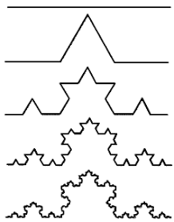
Koch Curve
How it is made
Length of Koch curve is infinite
Length with every nth iteration is (4/3)^{n}
Iteration
(Koch snowflake)
Notes:
Is crated by dividing straight line into 3 equal segments
And replacing middle segment with equilateral triangle of same length as removed line
And repeating that same thing on every newly crated line, continue this to infinity, as well length between 2 points is also infinite
Where n = 0 equals straight line
Iteration by Cambridge dictionary is {an amount that you get when you use a mathematical rule several times} basically amount of repeating of something

Slide 6
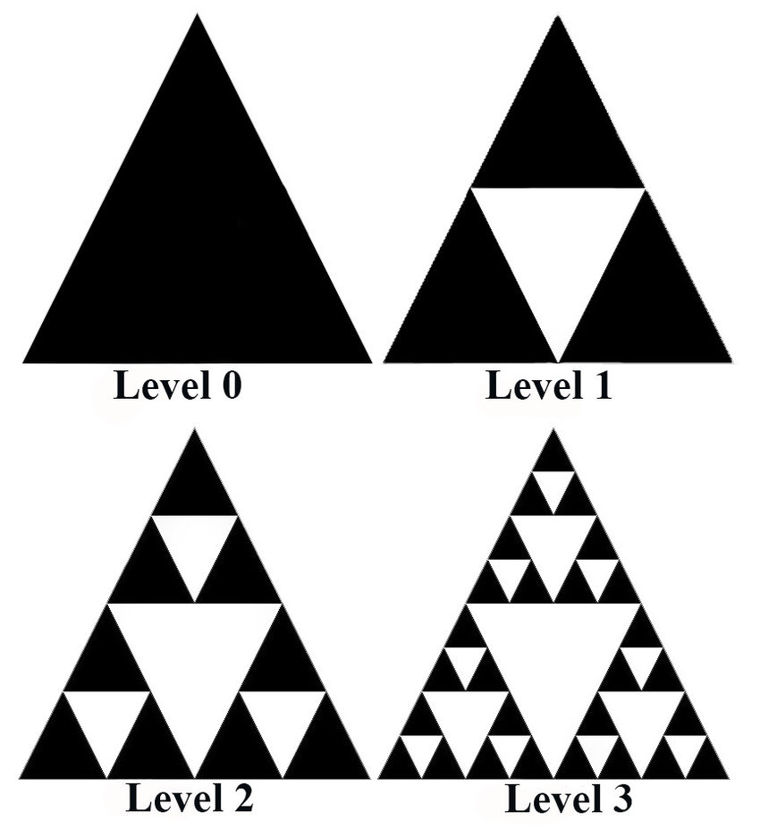
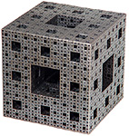
Sierpinski Triangle
How it is created
Although we start with filled triangle, content = 0
Sierpinski carped, pyramid, Menger Sponge
Notes:
Creating: Start with a solid (filled) equilateral triangle. Divide this into four smaller equilateral triangles, and remove the middle one.

Slide 7
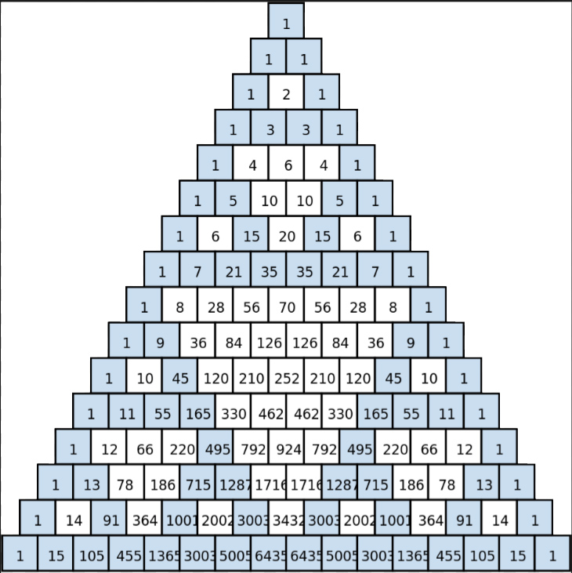
Sierpinski Triangle
Creating by chaos
Colouring Pascal’s tringle
Notes:
Creating: Start with a solid (filled) equilateral triangle. Divide this into four smaller equilateral triangles, and remove the middle one.
By making all odd numbers different colour we will also get Sierpinski triangle

Slide 8
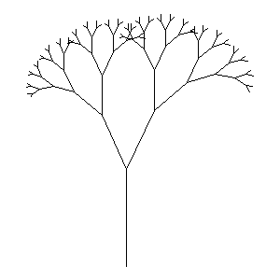
L-systems
How it is made
Tries to emit plant grow

Slide 9
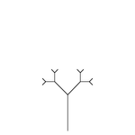
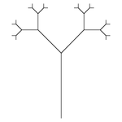
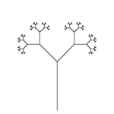
L-systems (for the interested)
axiom: 0
1st recursion: 1[0]0
2nd recursion: 11[1[0]0]1[0]0
3rd recursion: 1111[11[1[0]0]1[0]0]11[1[0]0]1[0]0
0: draw a line segment ending in a leaf
1: draw a line segment
[: push position and angle, turn left 45 degrees
]: pop position and angle, turn right 45 degrees

Slide 10
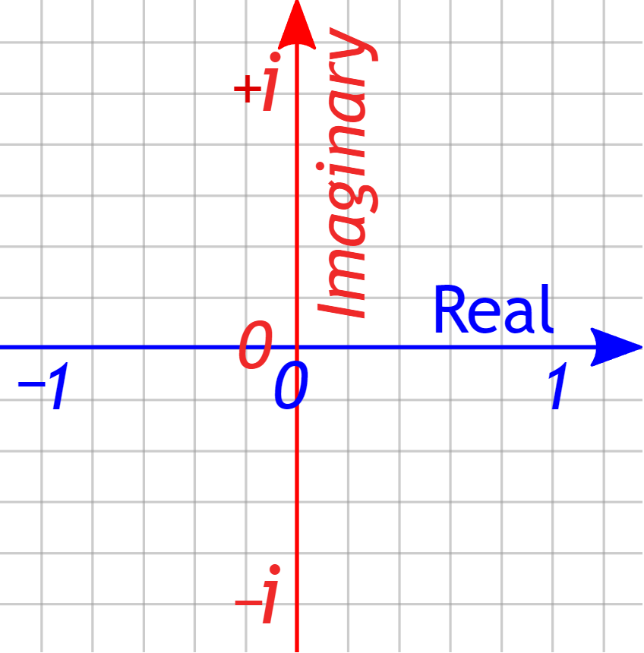
Complex numbers
In real number we don’t have number witch amplified is equal to -1
This where imaginary numbers come and say, what there was a number that amplified I equal to -1
We use i as shortcut for imaginary; √(-1) = i
Complex number is made by adding imaginary and real number like 5 + 2i
Examples of counting:
Z₁ = 5 + 2i Z₂ = 4 – 3i
Z_{a} = Z₁ + Z₂ = (5 + 2i) + ( 4 - 3i) = 5 + 4 + 2i – 3i = 9 – I
Z_{b} = Z₁² = (5 + 2i)² = 5² + 2*5*2i + (2i)² = 25 + 20i – 4 = 21 + 20i
X amplified = X²
Notes:
Before we will continue, we will need to shortly talk about complex numbers

Slide 11
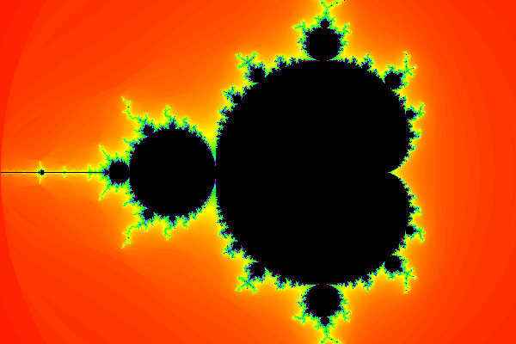
Mandelbrot set
one of the most iconic fractals
Black is the set, edges are fractal, colours are outside
z₀=0 z_{n}+1=z_{n}²+c
c is complex number representing point in complex plane
If z∞ = ∞, than point isn’t in set
colours
Notes:
If |z| > 2, it will be infinite.
If it won’t be infinite, than same values will repeat
Colour represent, how quickly that

Slide 12
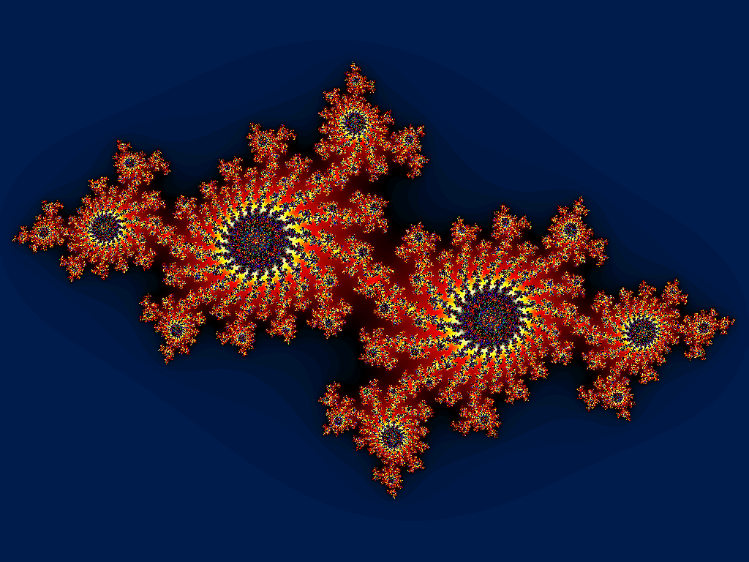
Julia set
c is constant for 1 Julia set
And z₀ is changing
Formula stay same

Slide 13
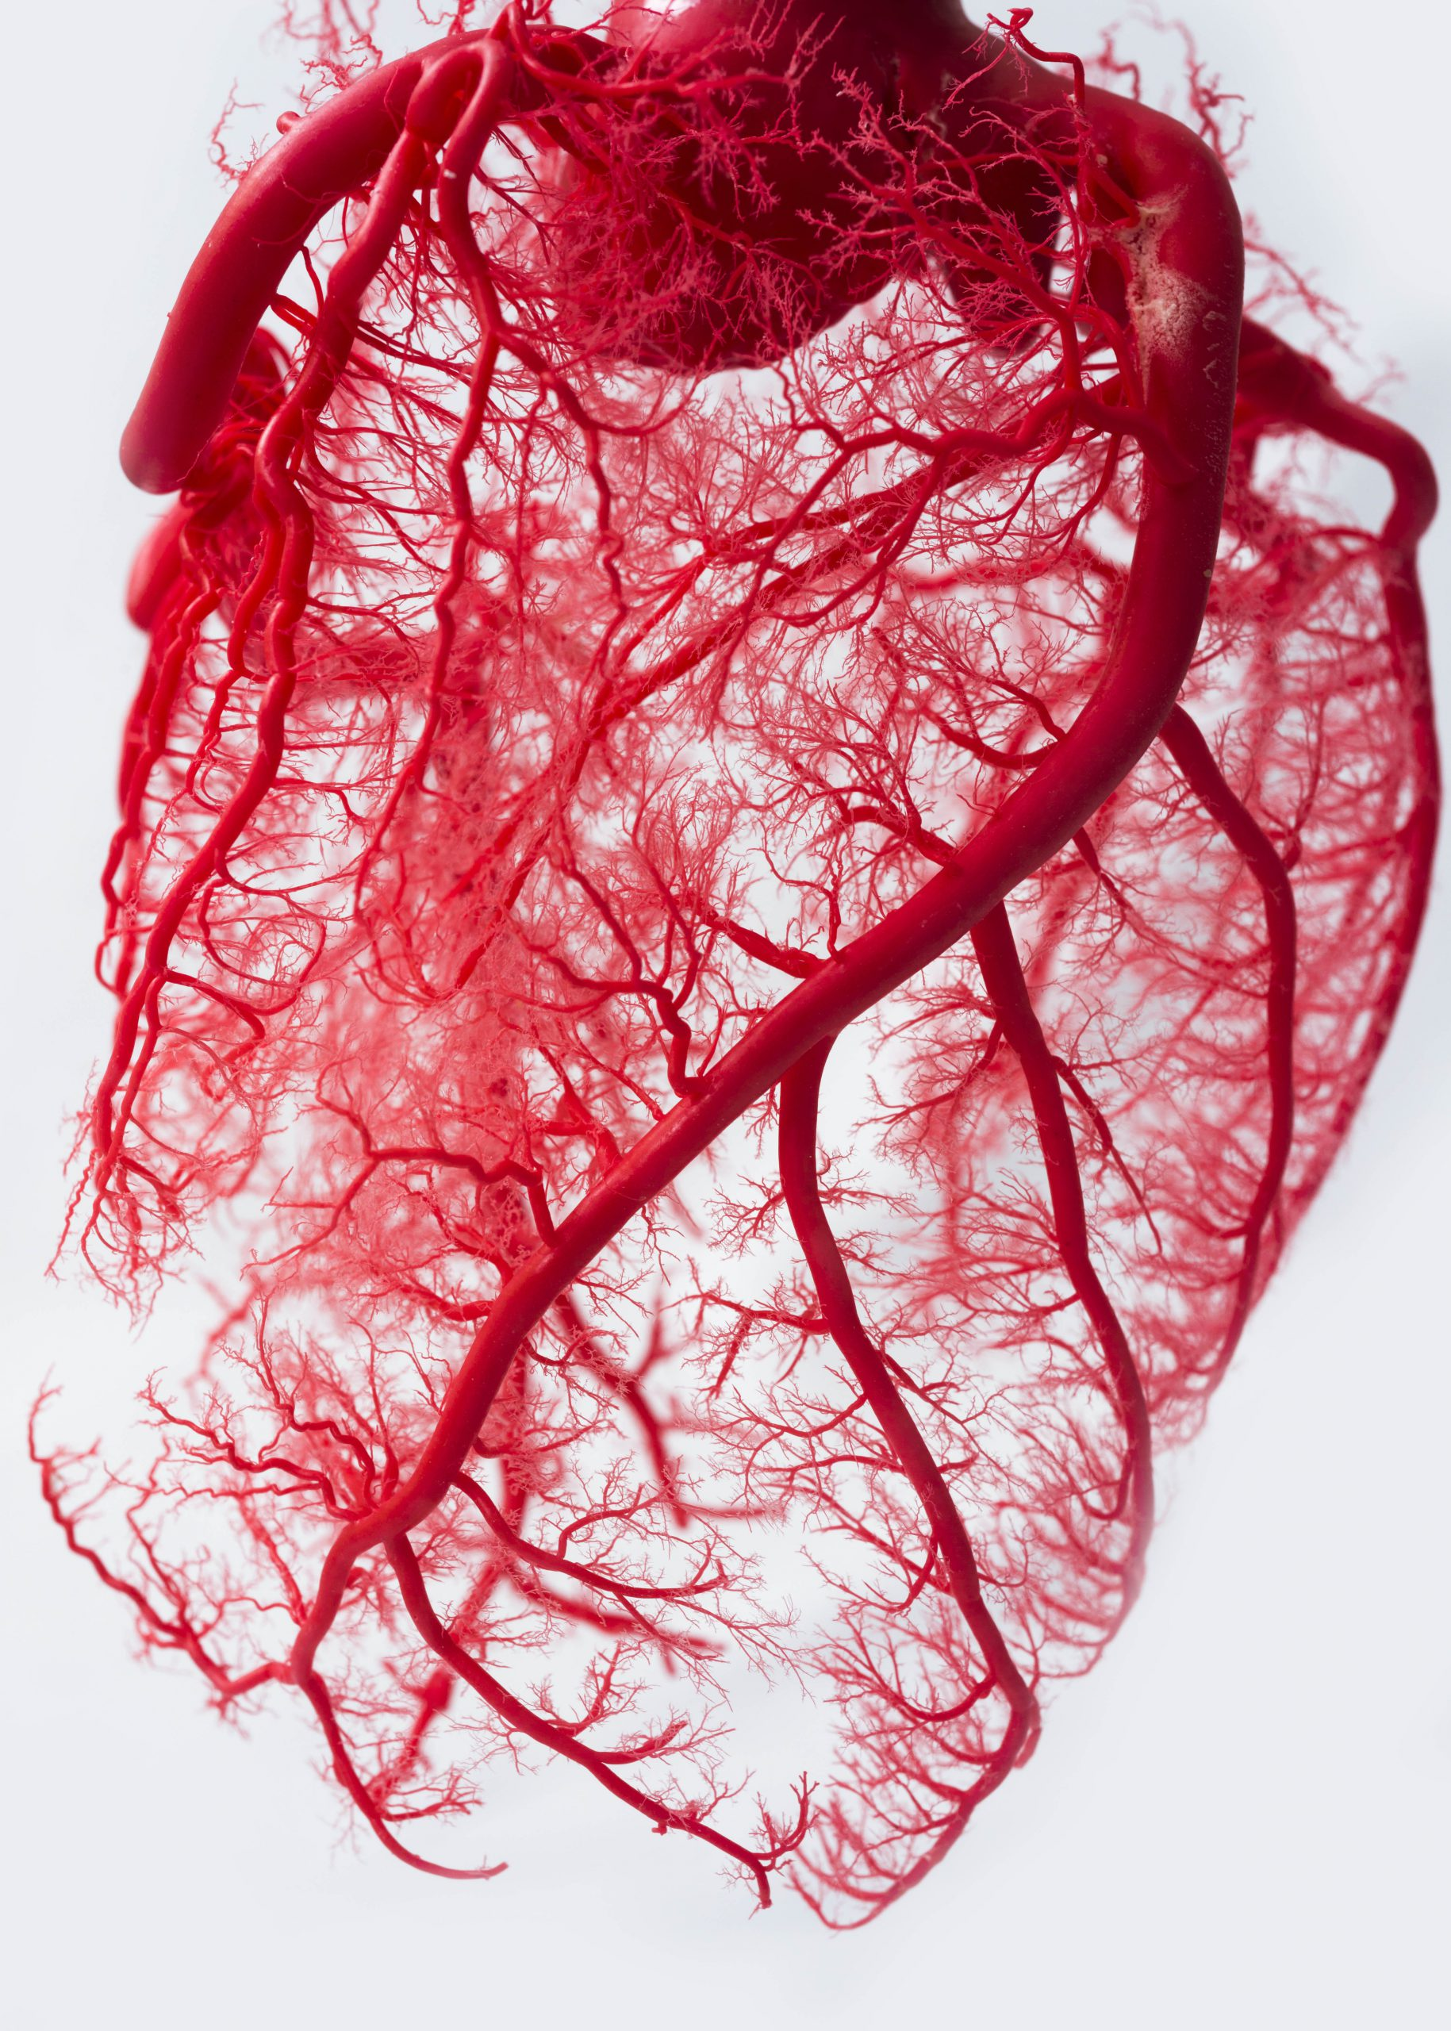
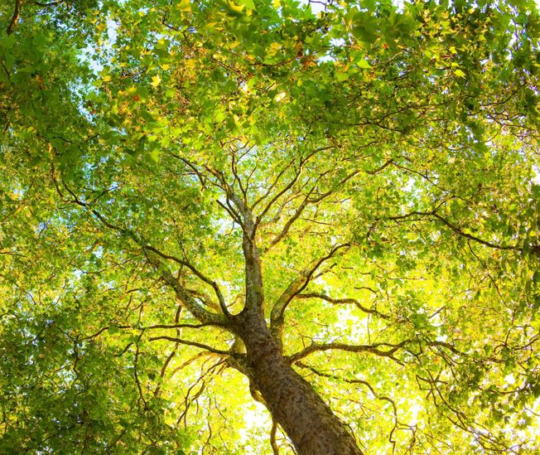
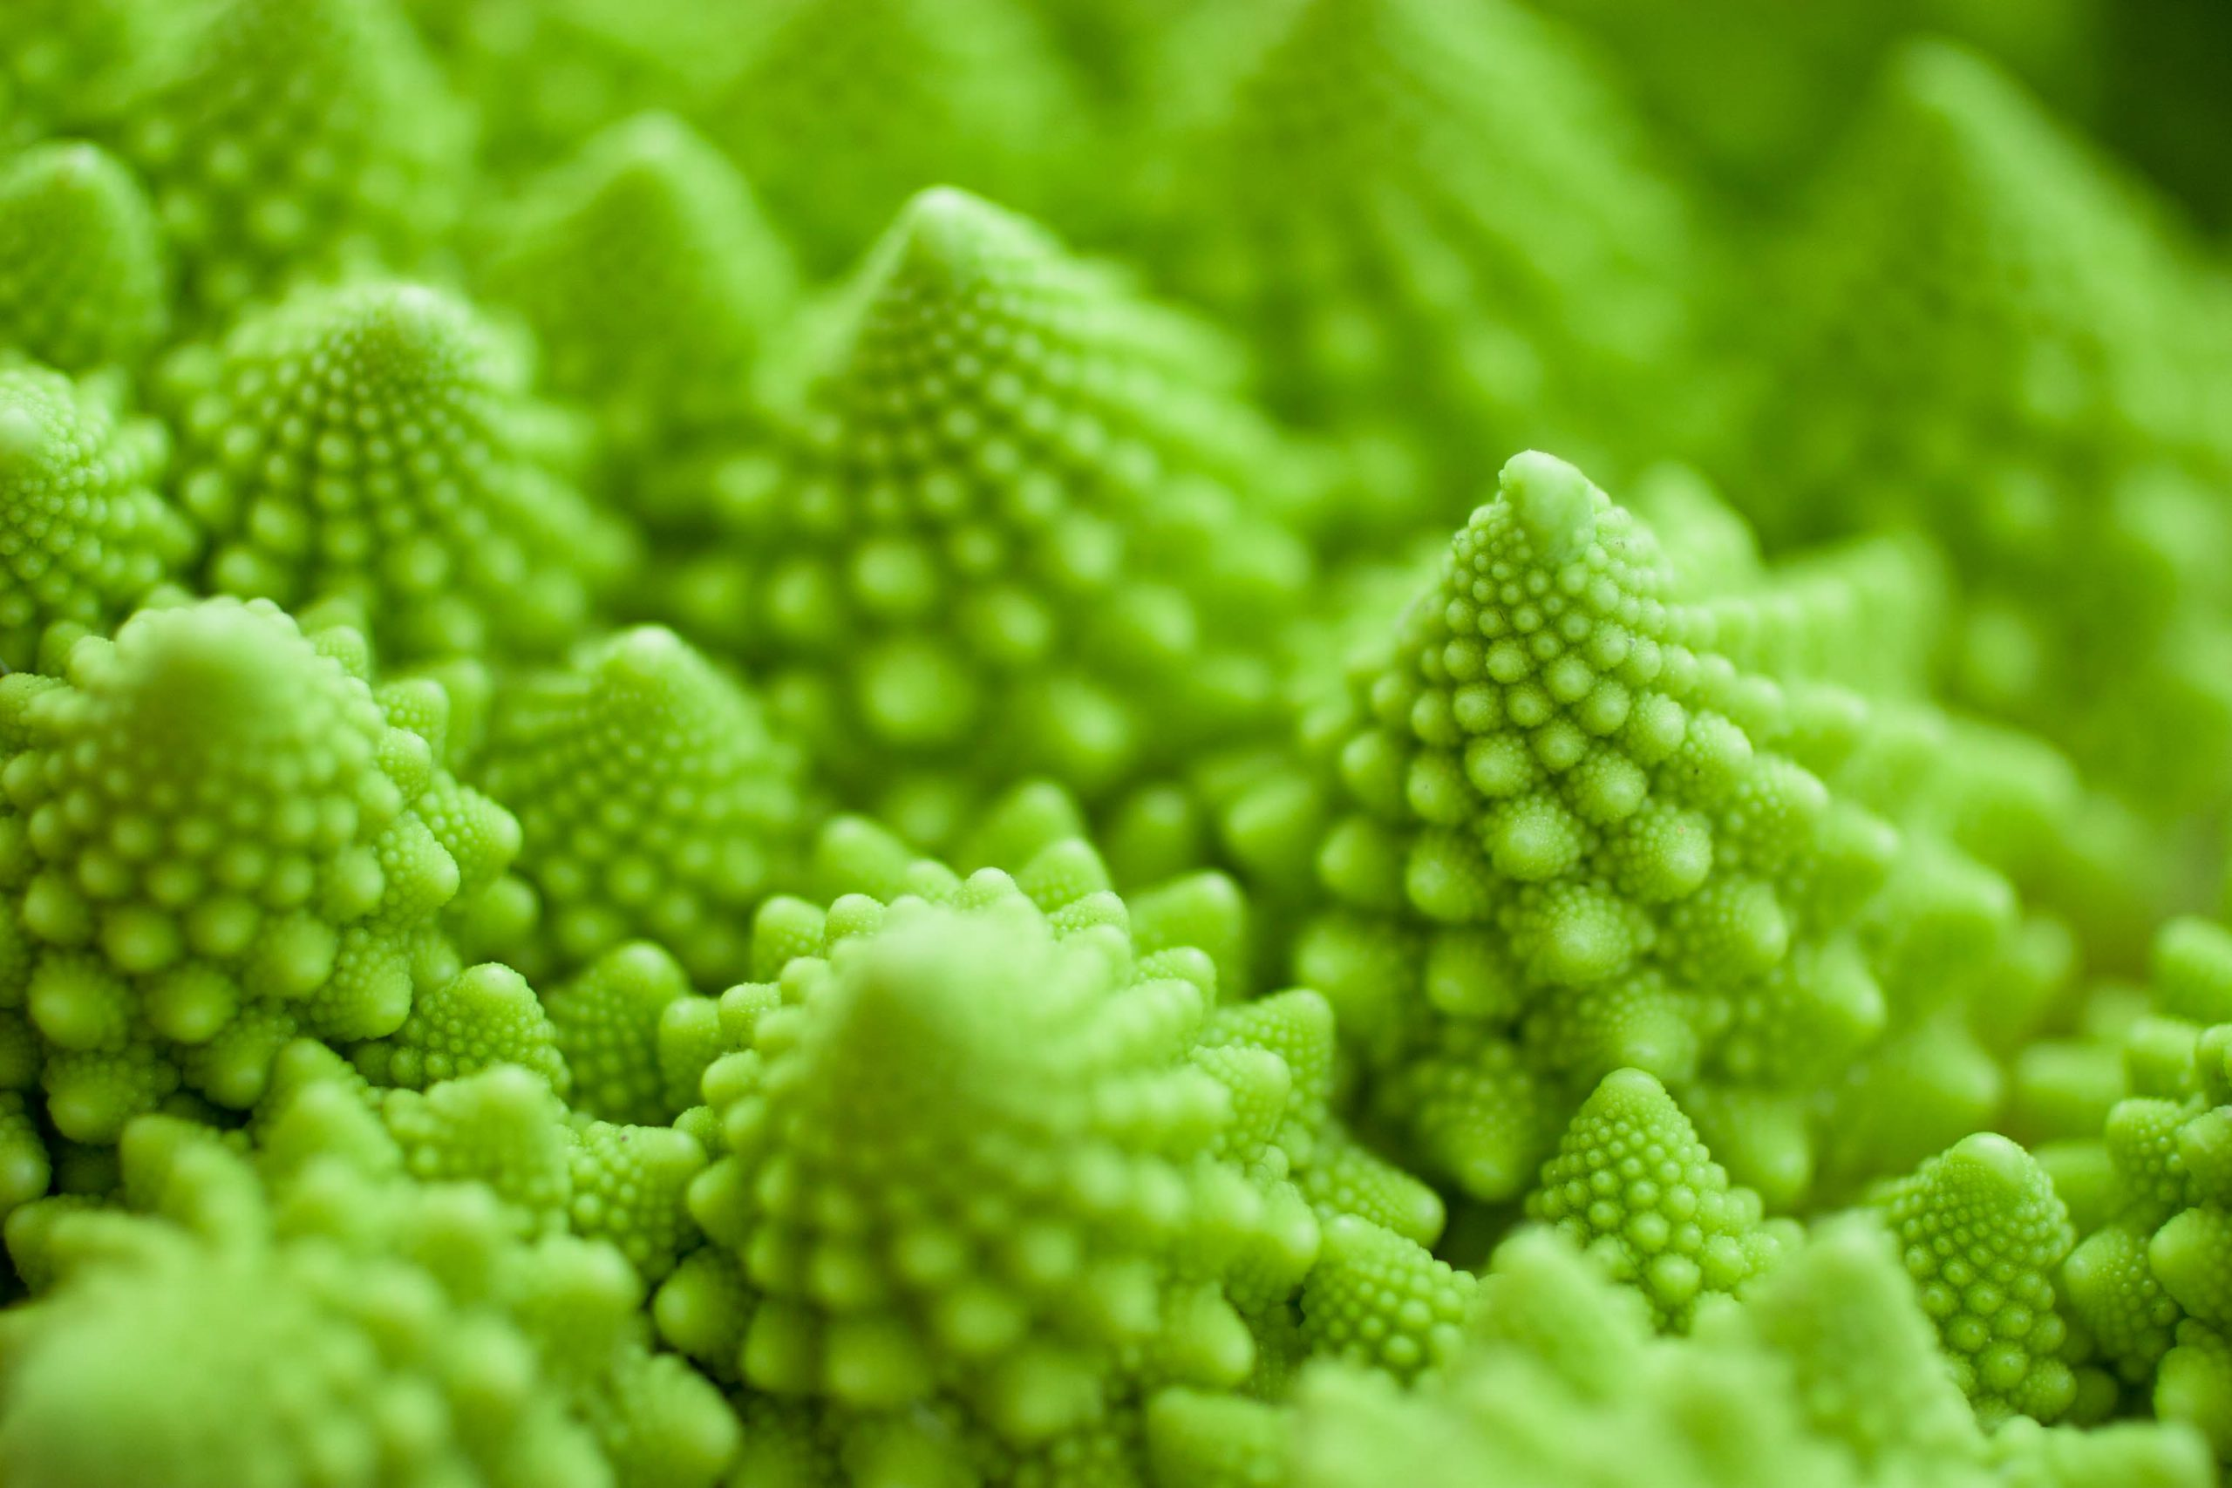
Fractals in nature
Plants, food
circulatory system
Trees
“Clouds are not spheres, mountains are not cones, coastlines are not circles, and bark is not smooth, nor does lightning travel in a straight line.”
― Benoît Mandelbrot
Notes:
The main trunk of the tree is the origin point for the Fractal and each set of branches that grow off of that main trunk subsequently have their own branches that continue to grow and have branches of their own.
These structures allow for easy distribution of liquids and other life sustaining materials to travel through the animal or plant and support the life of every cell.
Next time you eat a salad, a pineapple, broccoli, or a handful of other foods, you are actually eating a Fractal!

Slide 14
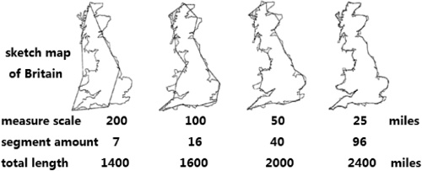
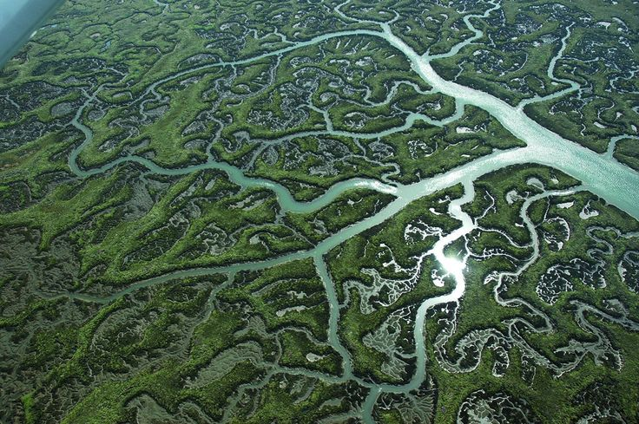
Fractals in nature
Rivers divides like trees
Length of Britain coast
coastline paradox
1 mile = 1.609
Notes:
Rivers can erode ground and form it
Imagine measuring the coast with a giant 50km measuring stick. You may get a total figure of around 3,500 km for your very rough outline of Britain, but you’ve probably had to skip many of the peninsulas and bays during your measurement. Now use a shorter 1km stick and your overall figure will be longer.

Slide 15
Where are Fractals used in technic
Creating model of landscape (fractal landscaping)

Slide 16
References
https://fractalfoundation.org/resources/what-are-fractals/
https://kaufland.media.schwarz/is/image/schwarz/vegetables-leaf-salad-lettuce-detail-1?JGstbGVnYWN5LW9uc2l0ZS00JA==
https://www.techtarget.com/whatis/definition/fractal
https://mathigon.org/course/fractals/introduction
https://en.wikipedia.org/wiki/Sierpi%C5%84ski_triangle
https://iternal.us/what-is-a-fractal/
https://www.youtube.com/watch?v=XMriWTvPXHI
https://en.wikipedia.org/wiki/L-system
https://www.codingame.com/playgrounds/2358/how-to-plot-the-mandelbrot-set/mandelbrot-set

Slide 17
Picture references
http://fractalfoundation.wolfesongs.com/wp-content/uploads/2009/01/sierpinski-zoom41.gif
https://encrypted-tbn2.gstatic.com/images?q=tbn:ANd9GcSkBGg32oqJHSGDLqM3Lnq5MNaEpfjf_h4QW6D0XiGEVddAKETU
https://i.ytimg.com/vi/QK2SJo-AxT4/maxres2.jpg?sqp=-oaymwEoCIAKENAF8quKqQMcGADwAQH4Ac4FgAKACooCDAgAEAEYZSBlKGUwDw==&rs=AOn4CLA6LwN7WA1Bdb66QeSKXr4N-zHg-g
https://encrypted-tbn0.gstatic.com/images?q=tbn:ANd9GcQRKNqwlCUlW9oS4K4CtLMweLbN95DZZV16KLH0Q6j9ys9Qqobl
https://www.codingame.com/servlet/fileservlet?id=13848520651734
https://www.mcgoodwin.net/julia/mcmjul1.gif
https://leadership.ng/wp-content/uploads/2022/07/TREES.jpg
https://iternal.us/wp-content/uploads/2020/03/Fractal-Human-Heart-Vascular-System-600x840.jpg
https://iternal.us/wp-content/uploads/2020/03/Fractal-Broccoli-600x400.jpg

Slide 18
Picture references
https://i.pinimg.com/736x/df/08/3a/df083a6aaa9979c0f550f15f988c1704--fractals-in-nature-salt-marsh.jpg
https://opg.optica.org/getImage.cfm?img=M3cubGFyZ2UsYW8tNTQtMTMtNDAyMy1nMDAx
https://cdn.rucni-naradi.cz/img_product/img-398-3by2/stanley-0-47-011-odpichovatko-s-pruzinou.jpg
https://mathworld.wolfram.com/images/gifs/MengerSponge.jpg
https://fractalfoundation.org/wp-content/uploads/2018/11/PascalsFractalTriangle-Answers.jpg
https://upload.wikimedia.org/wikipedia/commons/thumb/8/81/Graftal2.png/225px-Graftal2.png (Graftal 0 - 5)
https://www.mathsisfun.com/algebra/images/complex-plane.svg

