Slide 1
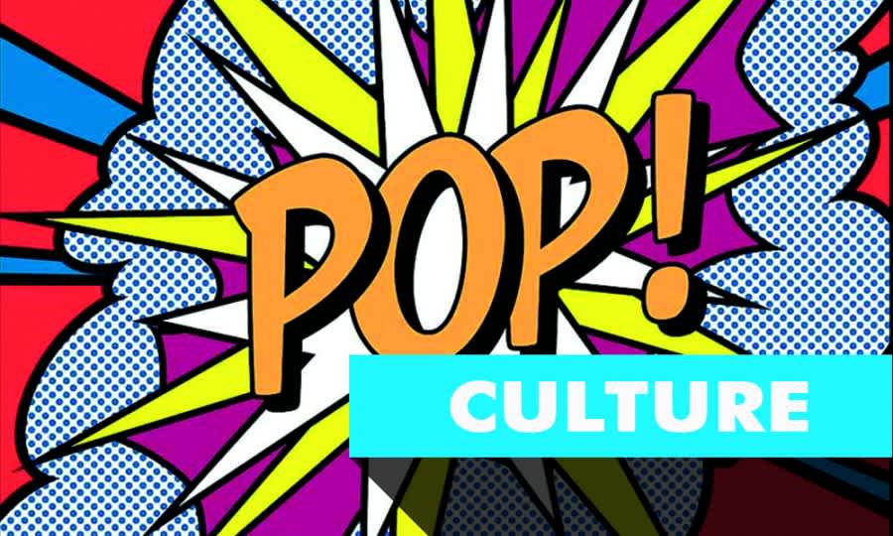
Vojtěch Šolc

Slide 2
How are we going to start?
1. introduce our topic
2. introduce individual parts of pop culture
3. give a short speech about them
4. your personal remarks

Slide 3
What is pop culture?
pop culture = popular culture
refers to the set of ideas, practices, images, objects, and phenomena
widely accepted within a mainstream society
constantly evolving and influenced by a range of factors, including media, technology, fashion, music, sports, entertainment, ect

Slide 4
Individual topics
what is it
requirements – clothing and our behavior
artists introduction of each individual part

Slide 5
Music and dance
concerts and music festivals - Colors of ostrava
entertainment in form of dancing, eating, drinking, meeting new people, ect
Dancing – starting in age of 16
Fire festival, graduation ball
What genres we have – your favourite
Famous Czech musician – J.K Tyl – anthem
Modern – Karel Gott, Ben Cristovao

Slide 6
Cinema and movies
Film industry – USA
How are we going to act in a cinema
Czech – old city – use for filming – Spiderman
What genres we have – your favourite
Famous actors from CZ/world

Slide 7
Literature
Our rich literary history
Introduce genres
Prose x poetry – Fairy tales, horror, fantasy, scifi
Authors Czech x other countries

Slide 8
Culture in Prague
Historically rich downtown
Charles bridge, Prague castle
National Museum, National Opera, National Theatre

Slide 9
Other topics
Painters - Alphons mucha – Andy Warhool
Sculptors – Myslbek
Architects – P. Parléř
Memes – part of modern history pop culture

Slide 10
Thats it ☺

