Slide 1
Mikhail Gorbachev
Laura Růžičková

Slide 2
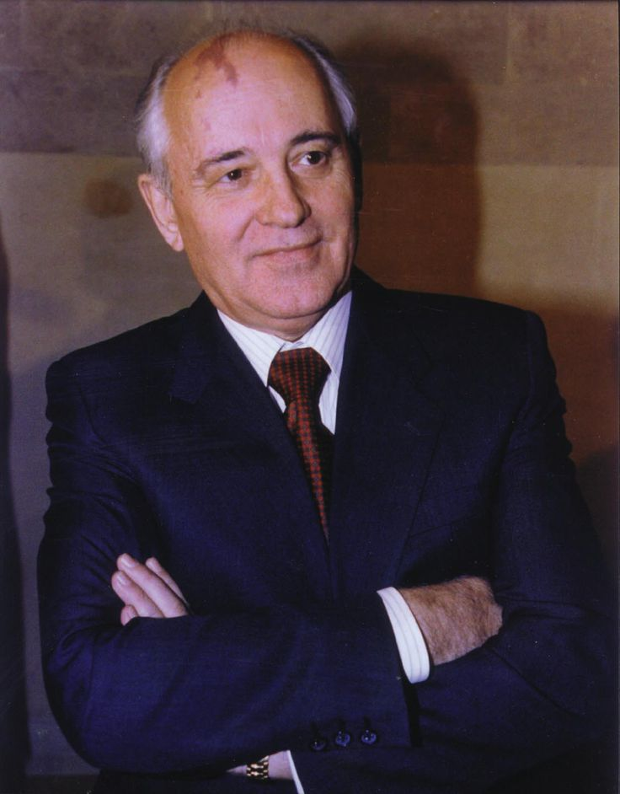
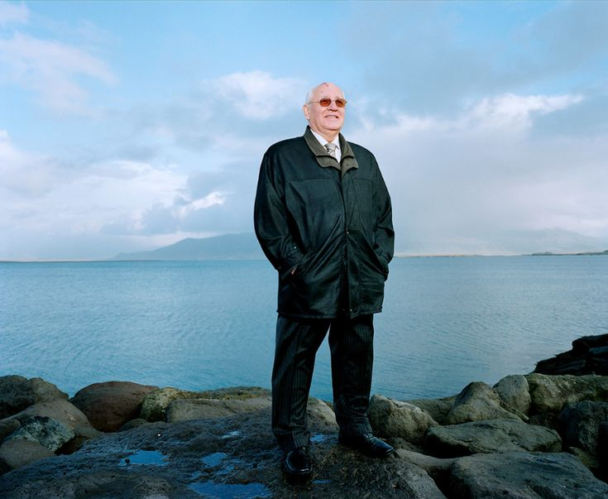
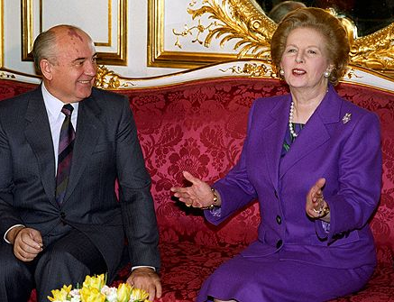
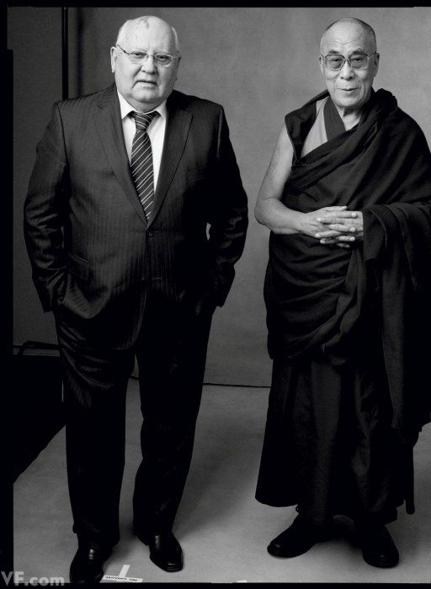
was born on 2nd of March 1931
died on 30th of August 2022
Gorbachev grew up under Stalin's regime
experienced German occupation in World War II. and after the war, he studied law in Moscow and pursued a career in the Communist Party
in 1985 Gorbachev was elected the new leader of the Soviet Union
he sought to reform communism, and introduced the concepts “glasnost” (openness) and “perestroika” (change)

Slide 3
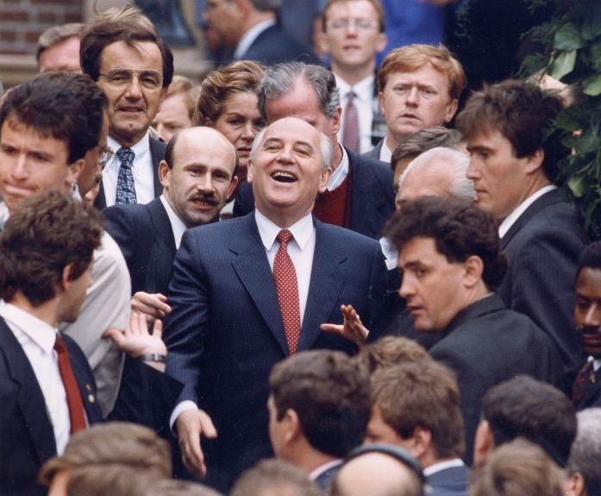
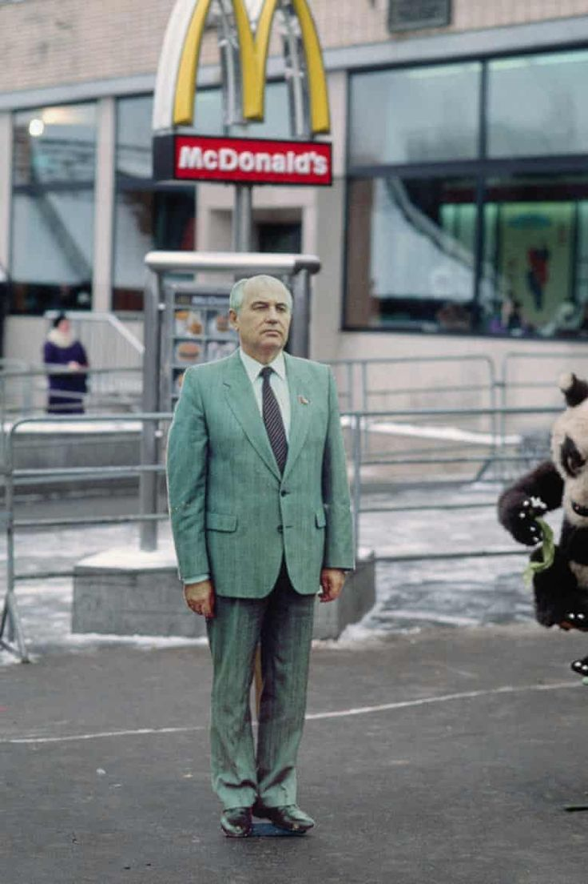
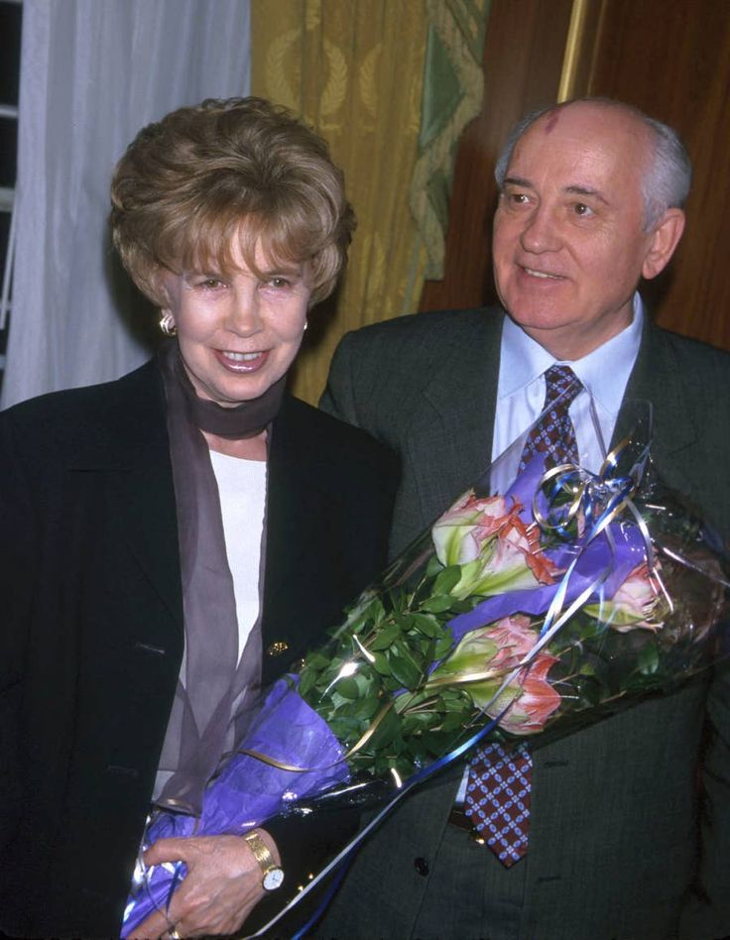
the man who changed the world
he brought the Cold War to a peaceful end
he declared that he would not support communist regimes in other countries if their people were opposed to communist regime
led to a chain reactions and that was the fall of communism in Europe

Slide 4
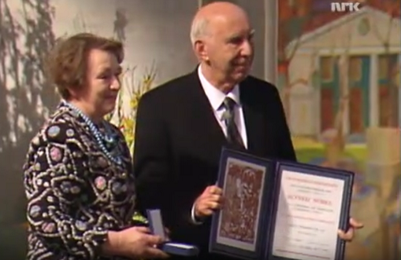
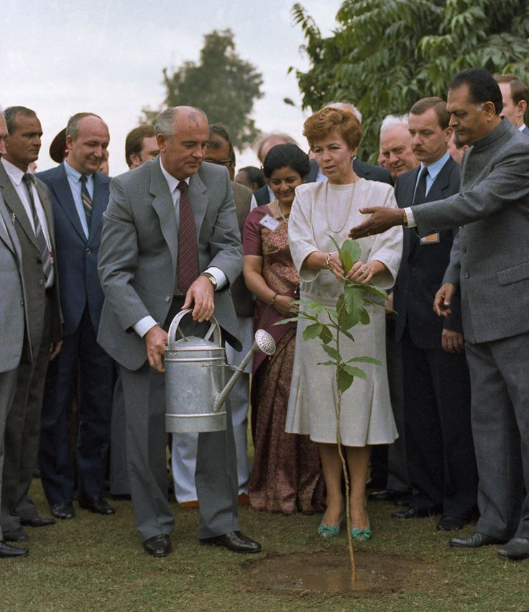
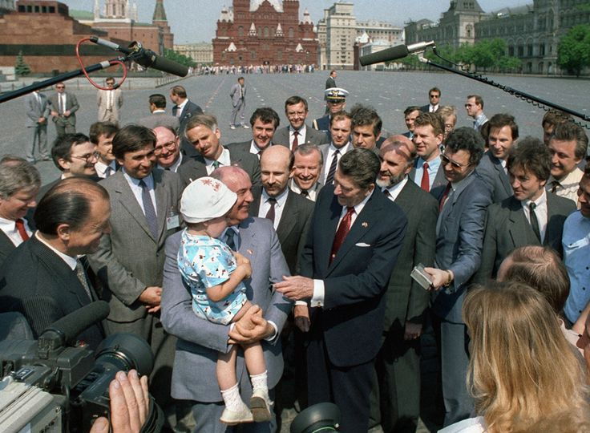
he should have gotten his prize on 10th of december 1990 in Oslo
the medal and diploma were accepted by Mr Andrej Kovaljov, First Deputy Foreign Minister of the Soviet Union

Slide 5
The end

Slide 6
Zdroj
https://www.nobelprize.org/prizes/peace/1990/gorbachev/acceptance-speech/
https://www.nobelprize.org/prizes/peace/1990/gorbachev/facts/

