Slide 1
American history

Slide 2
American History
The American continent was discovered first around the year 1000 by Icelandic Vikings sailing under Leif Ericson. They failed to establish any permanent settlements. Till 1400 native indians were the only inhabitants.
Five hundreds years later - 1492 a great demand for spices , textiles and also a navigation error brought Christopher Columbus ( an Italian mariner under Spanish monarch) to the Caribbean sea instead ti Asia. In the early 1500s Spaniards moved north from Mexico into what is now the South East and West United States

Slide 3
First colonies
The first English colony was founded in Virginia at Jamestown in 1607.
In 1620 the ship named Mayflower brought 102 English men, Women and children to northeastern region (now Massachusetts) where they found the colony called Plymouth.
They were Puritans - members of religious group which wanted to reform the Church of England. They called themselves the Pilgrim Fathers and wanted to build up a colony based on their own religious ideals. The winter was cold and about half of them died. In spring they planted corn and other plants (with help and advice from the Indians with whom they lived in peace). In October 1621 they celebrated good harvest and held a feast with much food ( including wild turkey). They called this day their day of Thanksgiving.

Slide 4
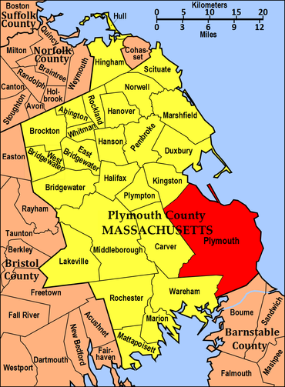

Slide 5
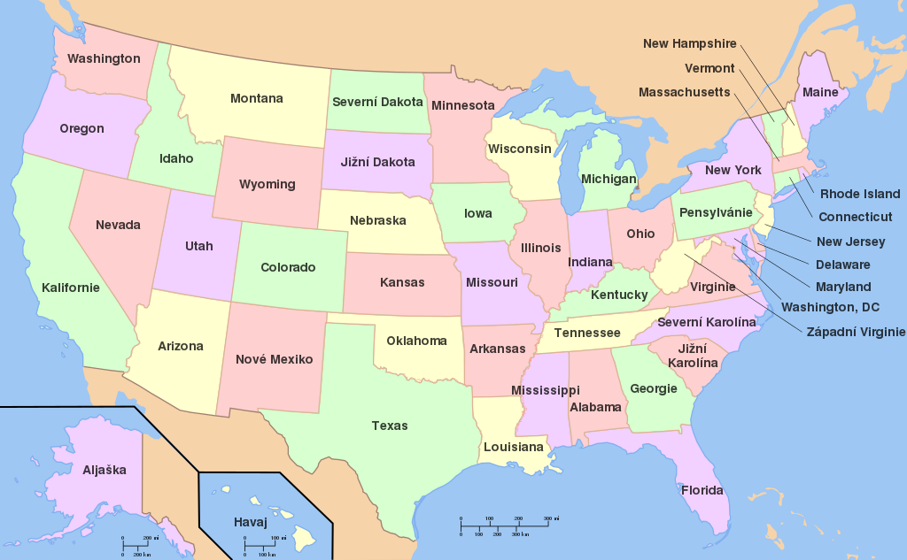

Slide 6
First colonies
After 1600 British settlements were build up in the North. During the seventeenth century many colonists, mostly British but also French, German, Dutch and Irish settled in the country, mainly along the eastern coast. These settlers were seeking land, wealth and religious or personal freedom. Tese settlements became the 13 colonies under British rule.
The French and Indian War of 1754* brought to British control all territory east of the Mississippi except New Orleans which was French and Florida which was Spanish. African slaves were first brought to Virginia in 1619. Between 1619 and 1808 about half a million Africans were brought as slaves (importing slaves became a crime only in 1808.
*https://cs.wikipedia.org/wiki/Francouzsko-indi%C3%A1nsk%C3%A1_v%C3%A1lka

Slide 7
Foundation of the USA, The war of independence (1775-1783)
British government started to charge a new taxes on sugar, coffee, textiles etc. to cover the costs of the war against France. Colonial Americans thought that they could be taxed only by their own colonial assemblies. The colonists refused to pay taxes and so British soldiers were sent to Boston. In 1773 a group of patriots dressed as Indians , threw a cargo of British tea into the Boston Harbor. This event is known as the Boston tea party. Americans began boycotting British trade.
I

Slide 8
Foundation of the USA, The war of independence (1775-1783)
In 1775 at Lexington the War began. Later George Washington ( A Virginia planter ) took over the command of continental Army. The continental Congress began to work as a national government and on July 4th, 1776 they agreed on the Declaration of Independence written mainly by Thomas Jefferson. The Declaration defended the American revolution against the British KIng George III and explained “that all men are treated equal” and have natural right to Life, liberty and the pursuit of happiness. The war of Independence lasted till 1783 when Britain signed the peace treaty and recognized the USA. The new constitution was adopted in 1787 after a long debate in which G. Washington , Benjamin Franklin and JAmes Madison participated.

Slide 9
Expansion and Civil War (1861-1865)
During 1776-1898 the territory of the original states was expanded through purchase of land, treaties or war (e.g. in 1803 Jefferson made a “Louisiana Purchase”, which meant that he bought for about 15 million dollars all central part of the present STates from France, wars with Mexico led to expansion in California, Arizona, Nevada atc. Alaska was bought from Russia in 1867).
In this era of expansion social reforms became important, especially the abolition of slavery. There was a note on Slavery being inhumane in the Declaration Independence (Thomas Jefferson, himself a slave owner, wrote it in 1776), but it was removed from it by souther delegates. Many northern states abolished slavery by early 1880 but souther economy was based on large plantation where slaves were used to grow cotton, rice, tobacco and sugar.

Slide 10
Expansion and Civil War (1861-1865)
About 60 years of never ending disputes led to the Civil War between The North and The South. It was the worst episode in American history. It started after Abraham Lincoln was elected President in 1860 ( Even before in 1859 John Brown had tried to begin a slave rebellion in Virginia, but he was hanged, hile many Northerns hailed him as a martyr). Southern states protested against Lincoln begin the president and wanted to leave the union. Abraham Lincoln issued the Emancipation Proclamation in 1863, which granted freedom to all slaves. During the war the Southern army (Confederates) won some victories, but later , after the battle of Gettysburg and mainly due to Union generals Grant and Sherman, the Union Forces (North) won in April 1865.
The war had two main good results - it put an end of slavery and decided once for all that America was single and indivisible nation. This war however took more American lives than any other (635,000 dead)

Slide 11
The end of the 19th century and the 20th century
Industrial growth started after the Civil war. Major business was around coal mining¨, petroleum, railways, manufacturing of steel goods. Urbanisations was the major trend, especially in the north. During this period the USA became the world's leading industrial power.
The first American military mobilization on foreign soil was not until 1917 when the US entered the World War I against Germany and helped France and England. US president Woodrow Wilson helped negotiate /vyjednat/ a peace treaty in 1918.

Slide 12
The end of the 19th century and the 20th century
The “ Roaring Twenties” /burácející roky/ brought large economic growth until the Great depression started after the stock market crash in 1929. In the next decade unemployment was high and poverty widespread. The depression lasted till the beginning of the WW II.
The war was declared declared against Japan in 1941 and president Harry Truman ordered the atomic bomb dropped on HIroshima and Nagasaki
The Cold War period after WWII saw increasing distrust between the US and the Soviet Union. There were several conflicts e.g.Korean War.
The postwar period was a time of economic expansion. The US continued as world leader in scientific, medical, and technological achievements. The Soviet Union was the first to put a man in space, the US had the first man to walk on the Moon (July 20, 1969, astronaut Neil Armstrong). The Earth could hear his words. “ That's one small step for man, one giant leap for mankind “.

Slide 13
The end of the 19th century and the 20th century
The 60s saw tremendous social change and unrest. American blacks demanded an end to racial discrimination through the civil rights movement - civil rights leader Martin Luther King was assassined in 1968.
The assasssination of president John F. Kennedy in 1963 and Robert Kennedy in 1968 shocked the world.

Slide 14
The end of the 19th century and the 20th century
The Vietnam war brought further internal unrest. This continued till the 70s with the political corruption - The Watergate Scandal *and the resulting resignation of president Richard Nixon ( the first president who was forced to resign). US troops were finally withdrawn from Vietnam in 1975.
*https://sk.wikipedia.org/wiki/Af%C3%A9ra_Watergate
Economic issues dominated the 80s which began with the high unemployment, high inflation and slow economic growth. By the middle of this decade this recession had ended and the US continues to have one of the highest standards of living in the world.

