Slide 1
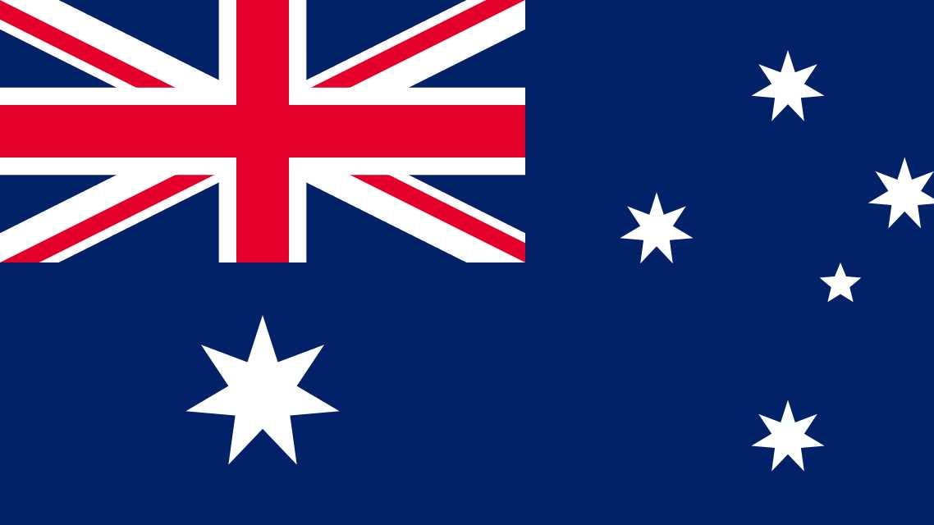
AUSTRALIA

Slide 2
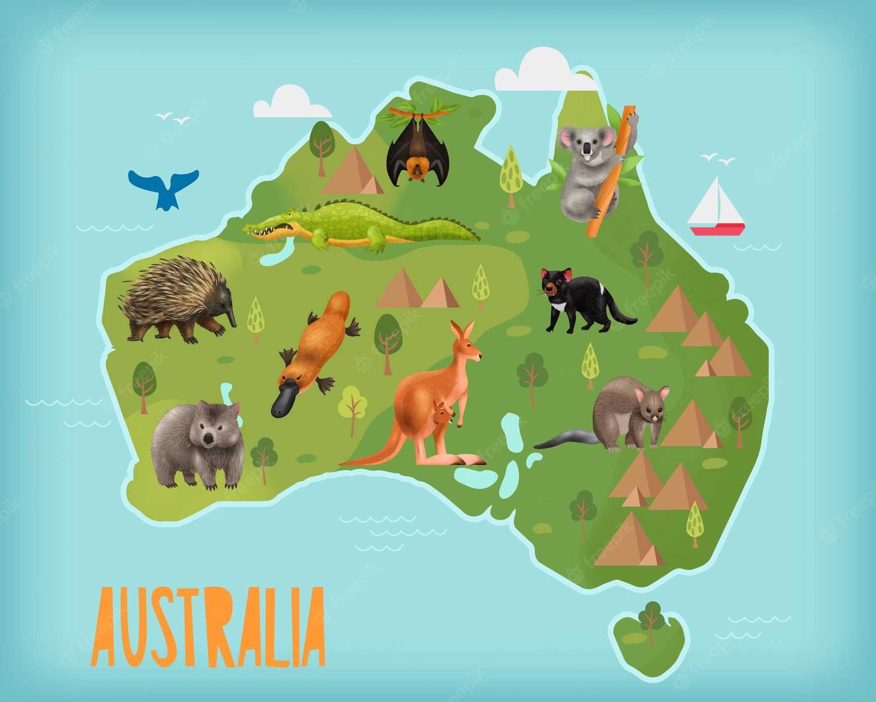
General information!
sixth largest country
The Australian dollar is the currency of Australia
Official language is English

Slide 3
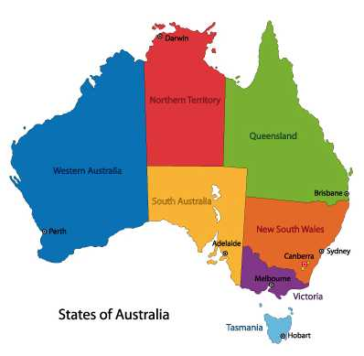
The Commonwealth of Australia is a federation of six states and two self-governing territories.

Slide 4
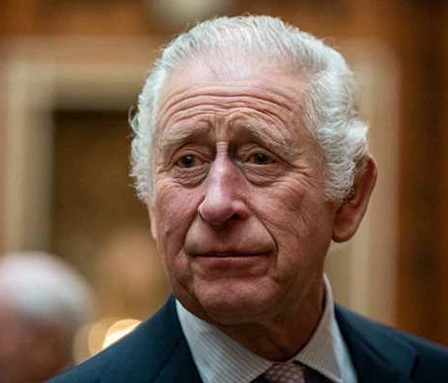
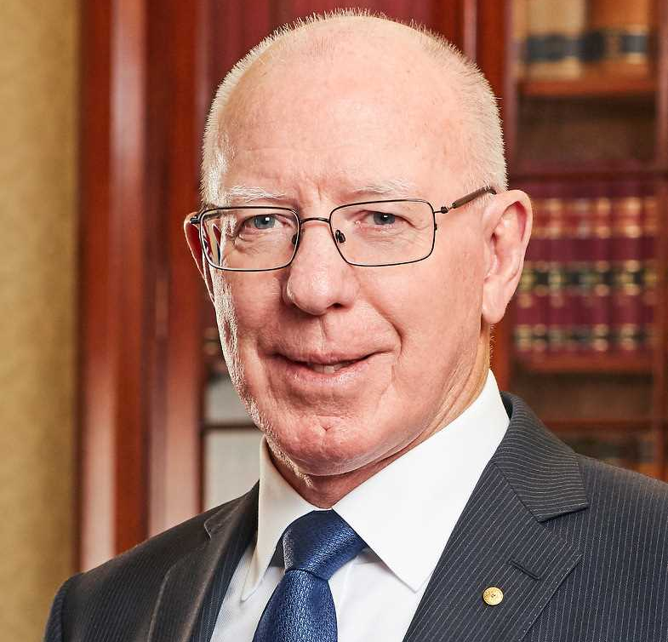
Australia's Head of State is the King of Australia- His Majesty King Charles III
Executive power is exercised by the Governor‑General as the King's representative – 2022 David Hurley

Slide 5
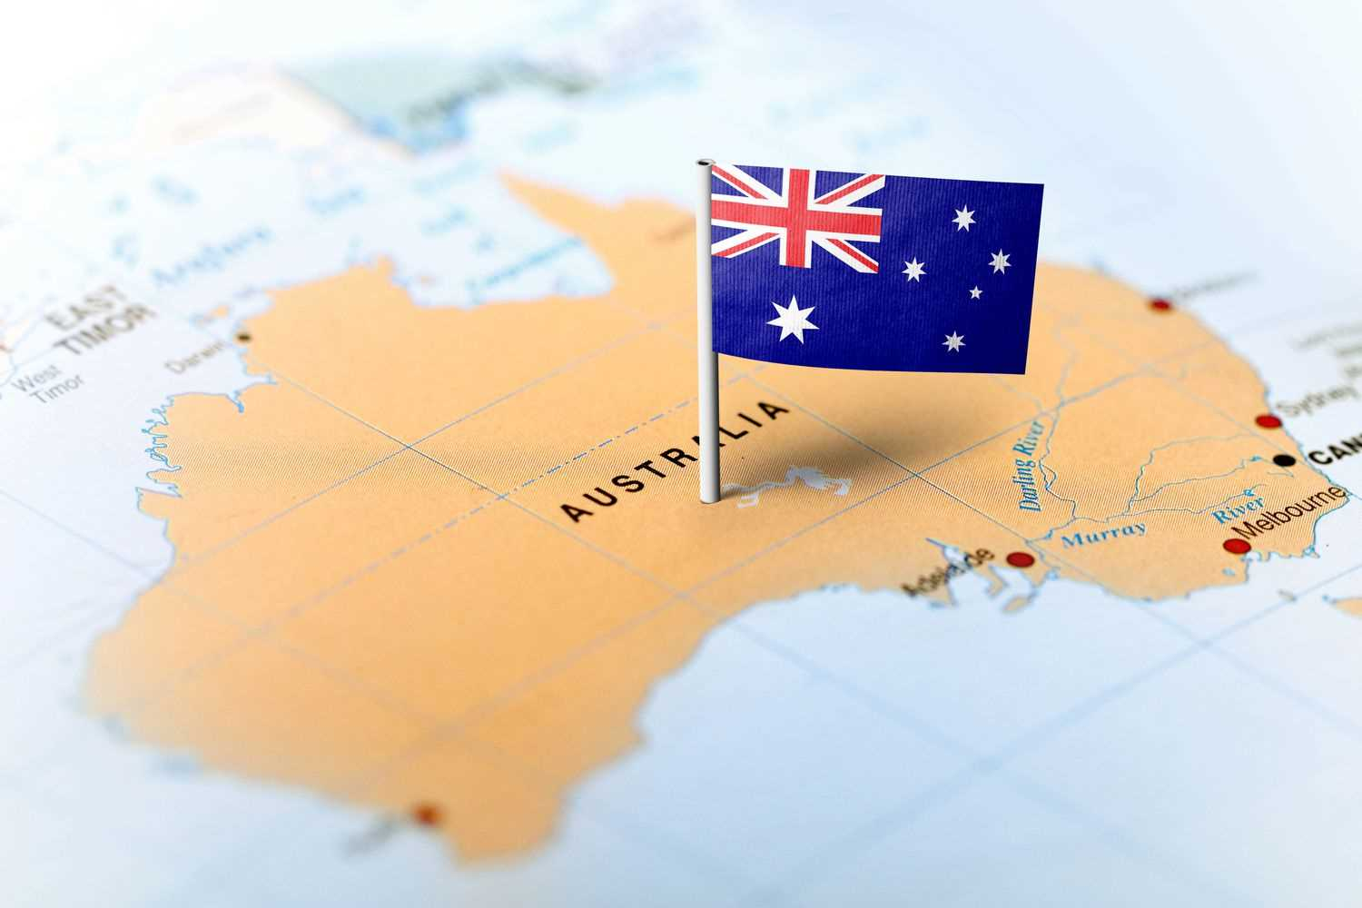
Australia is split into 8 states
Australia is a continent and a country
Australia, Tasmania and smaller surrounding islands.

Slide 6
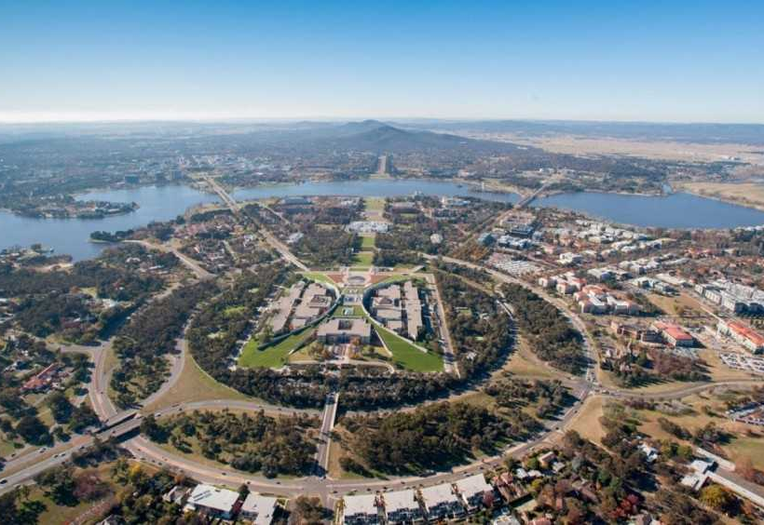
Canberra
The capital of Australia is CAMBERRA

Slide 7
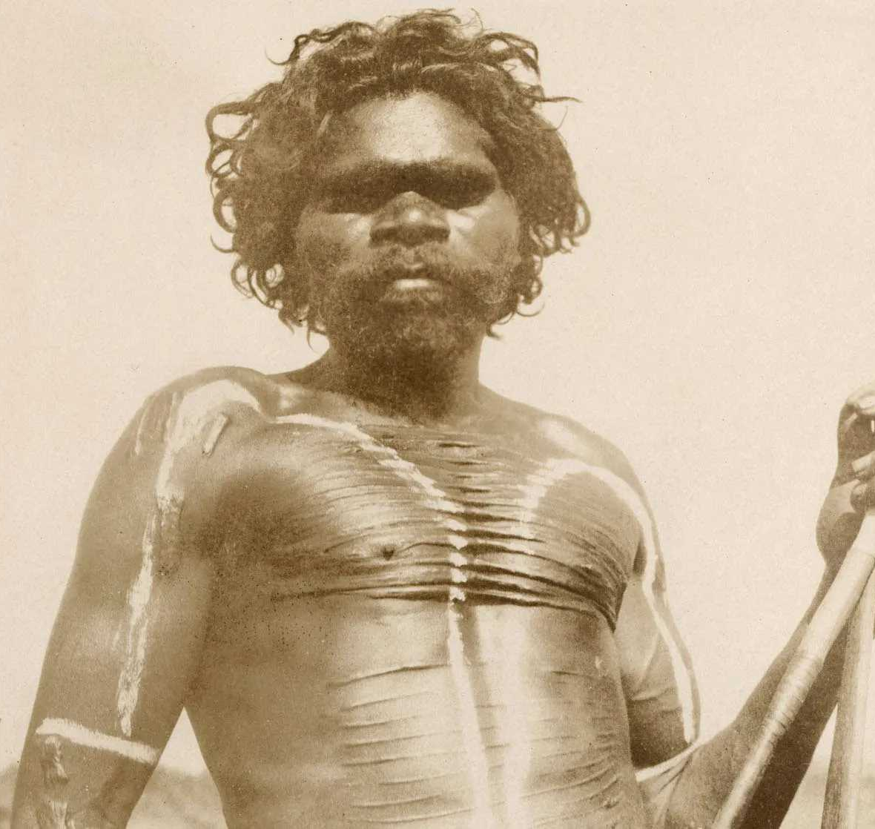
HISTORY
discovered in the 17th Century
In 1606
the Aboriginal and Torres Strait Islander Peoples
Indigenous Australians have lived on the continent for over 65,000 years

Slide 8
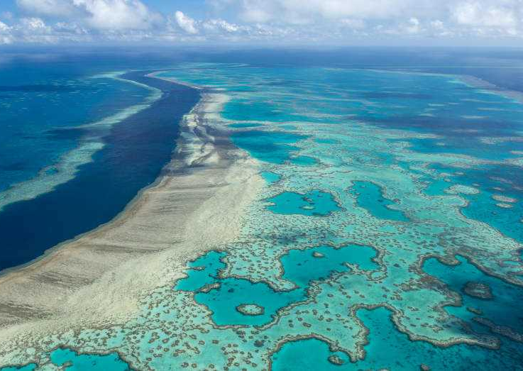
The Great Barrier Reef
the biggest coral reef system in the world
3,000 reefs, 900 islands
over 350 species of corals
over 1,500 species of fish

Slide 9
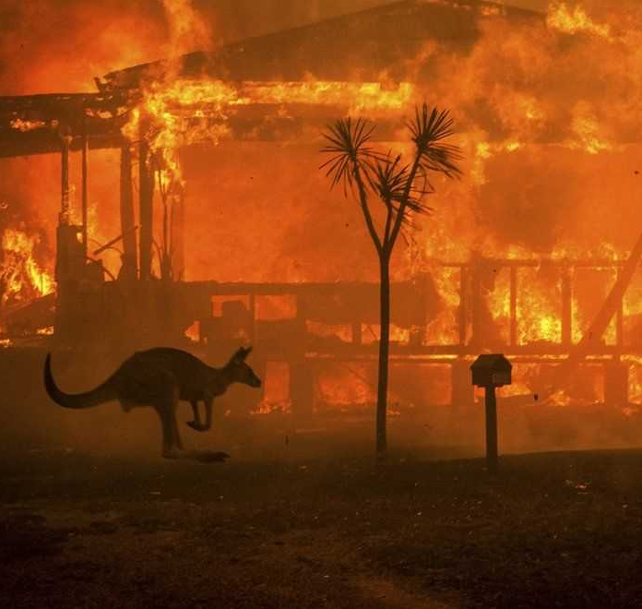
Bushfires in Australia

Slide 10
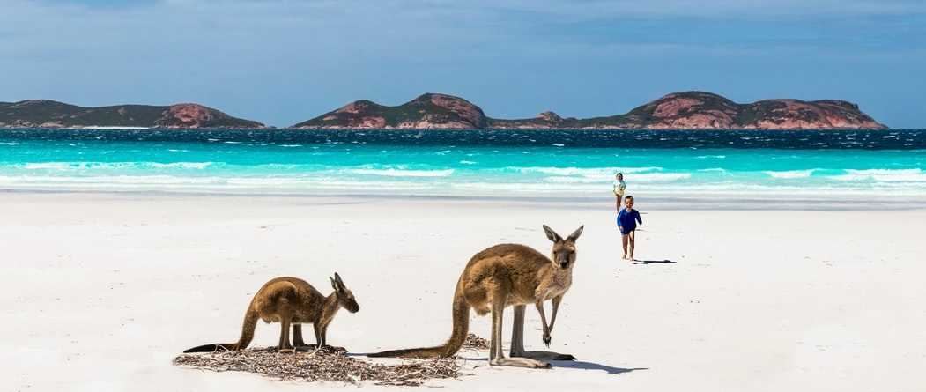
Top 5 coolest places in Australia

Slide 11
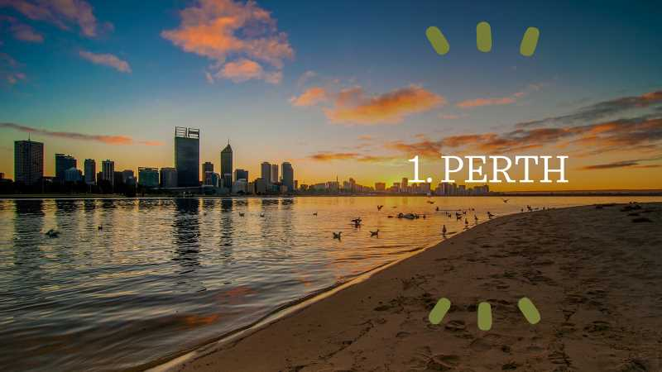

Slide 12
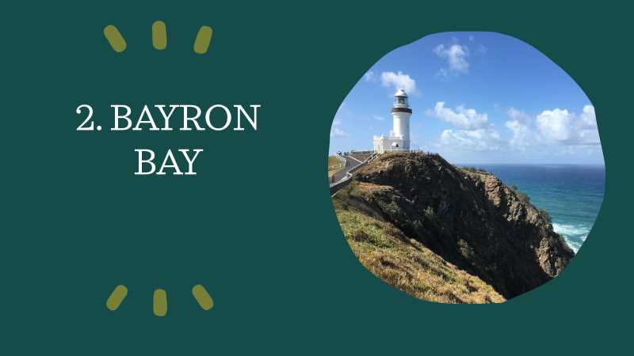

Slide 13
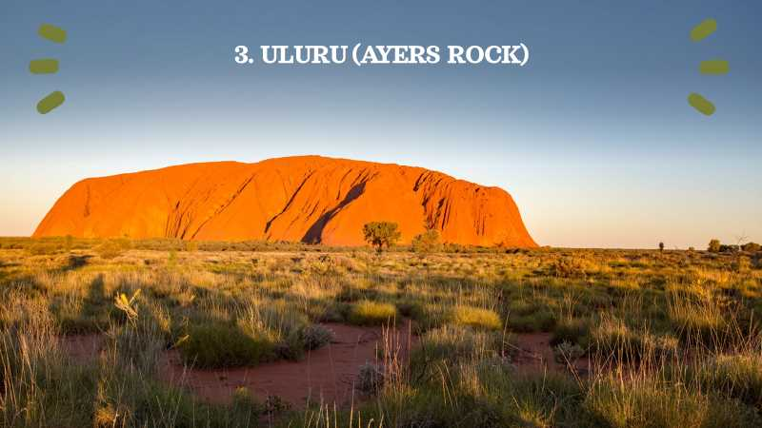

Slide 14
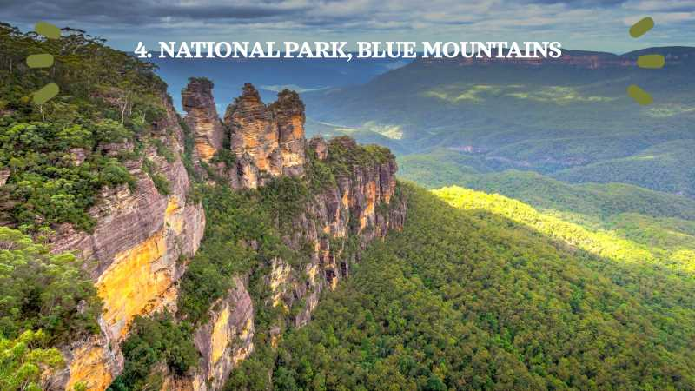

Slide 15
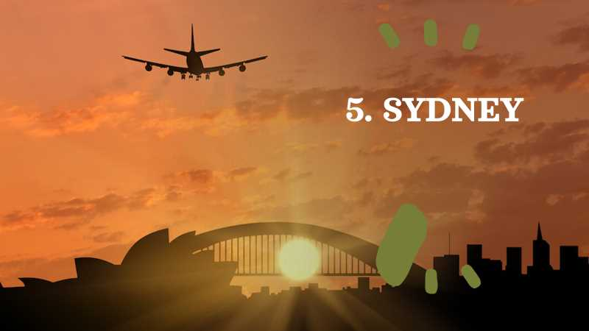

Slide 16
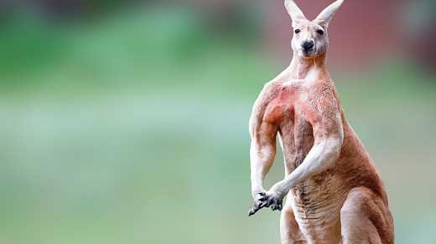
The animals of Australia

Slide 17
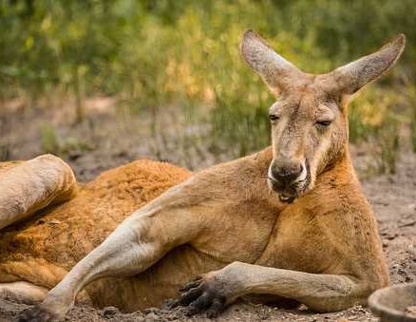
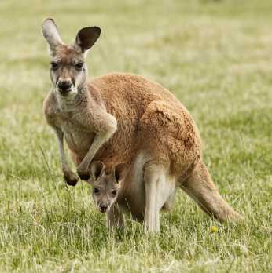
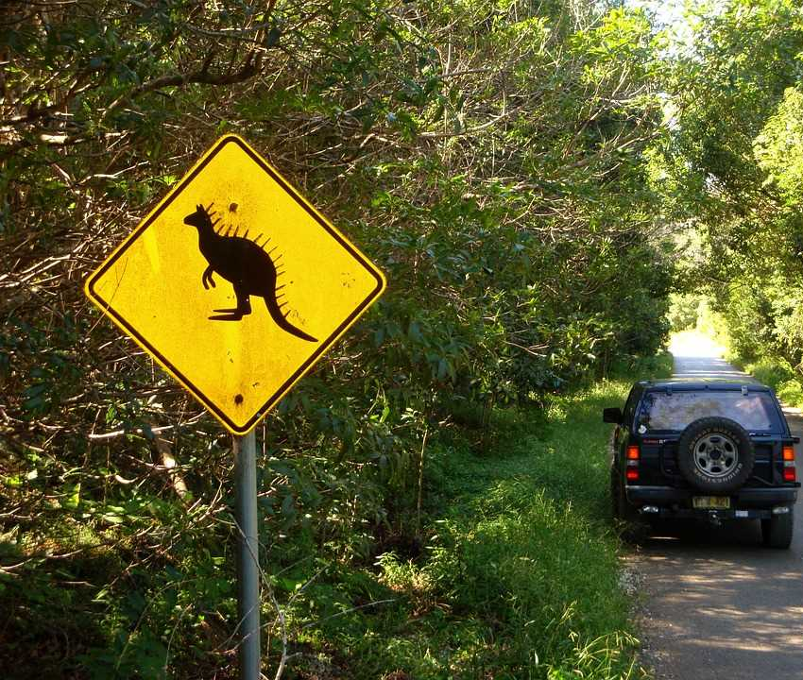
Kangaroo
Symbol
Weight
Reproduction
What do they eat?

Slide 18
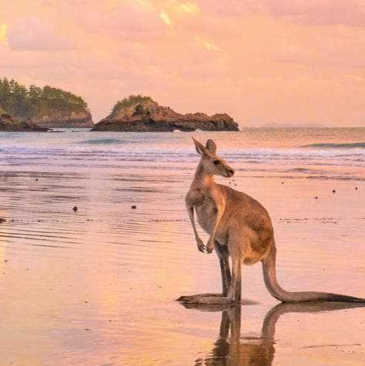
Fun facts about kangaroos
Kangaroo pup
Movement
Species
How much can they hop?
Pregnancie
Tail
Only exist in australia

Slide 19
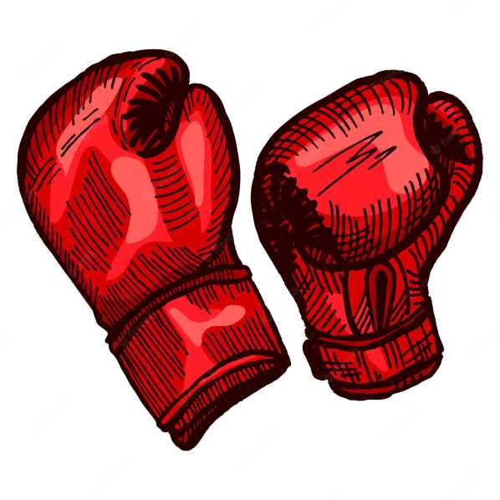
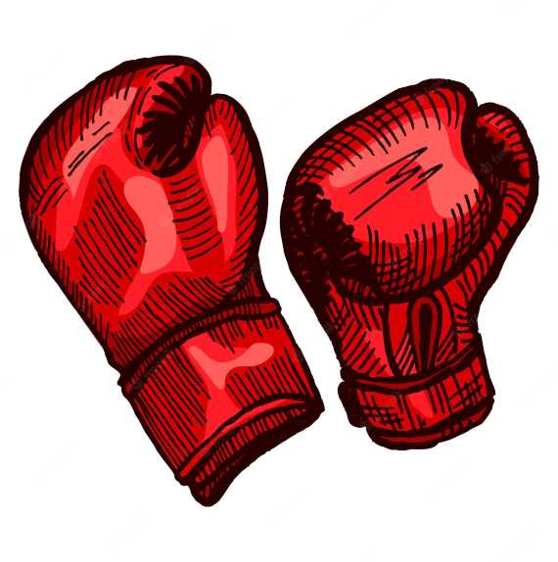
Boxing fight

Slide 20
Other interesting animals

Slide 21
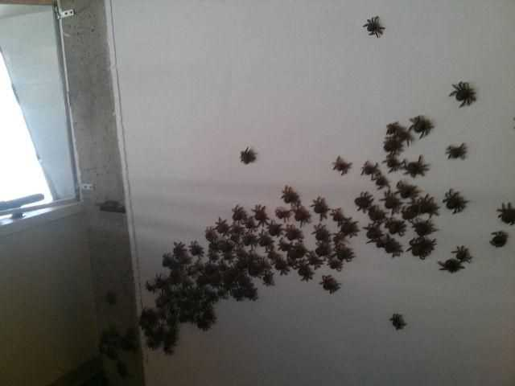
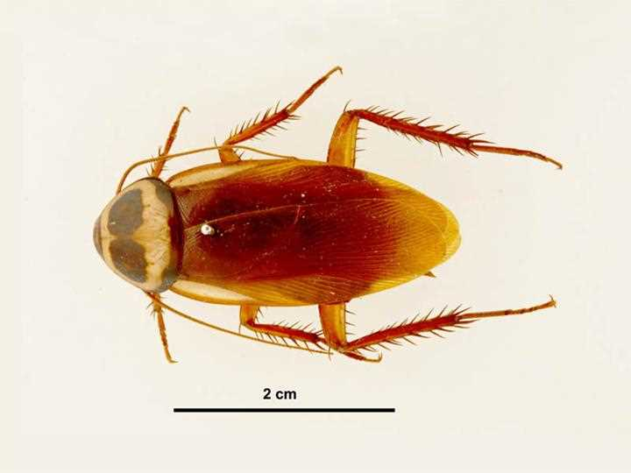
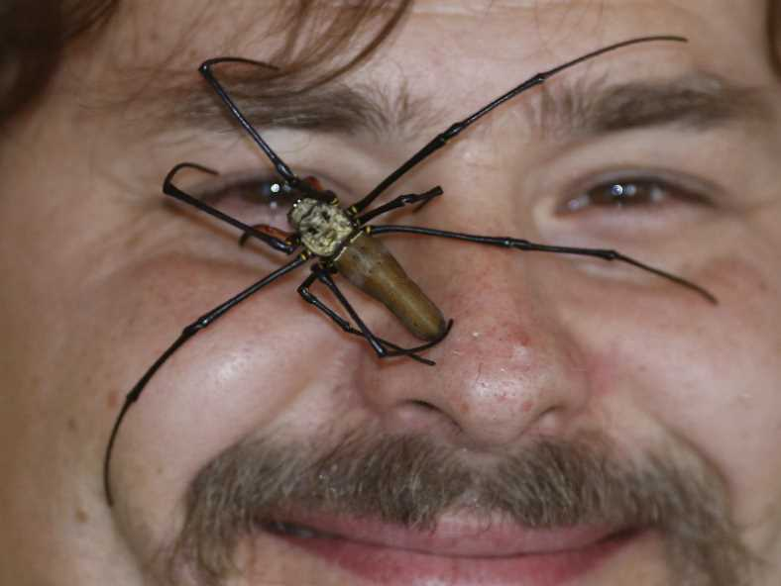
Scary animals

Slide 22
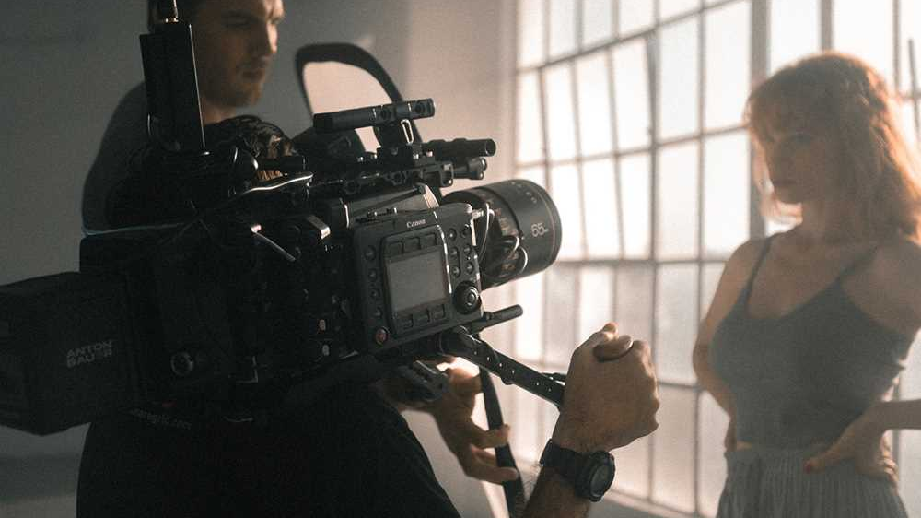
Famous people

Slide 23
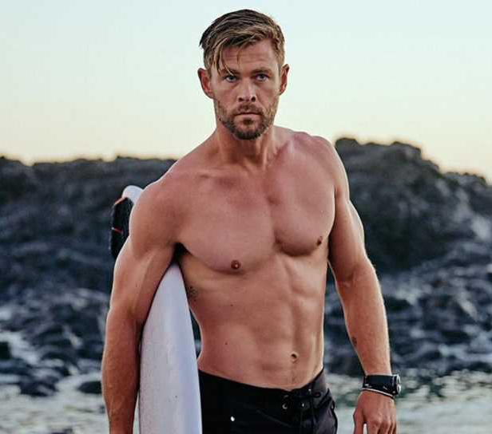
Chris Hemsworth
39 years, born in Melbourne
Movies: Thor, Avengers, Extraction, Snow White and the Huntsman, Men in black...

Slide 24
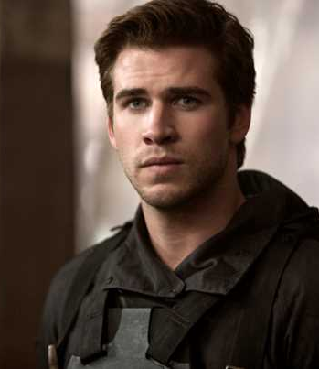
Liam Hemsworth
32 years, Melbourne
Miley Cyrus
Movies: Hunger Games (Gale), Empire State, THE WITCHER?

Slide 25
Australian Grand Prix
an annual motor racing event
held at the Albert Park Circuit in Melbourne
TV show on Netflix
Attendance: almost half a milion

Slide 26
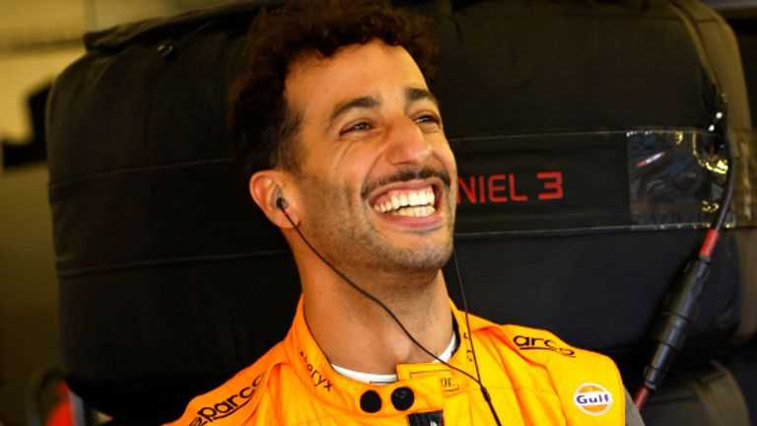
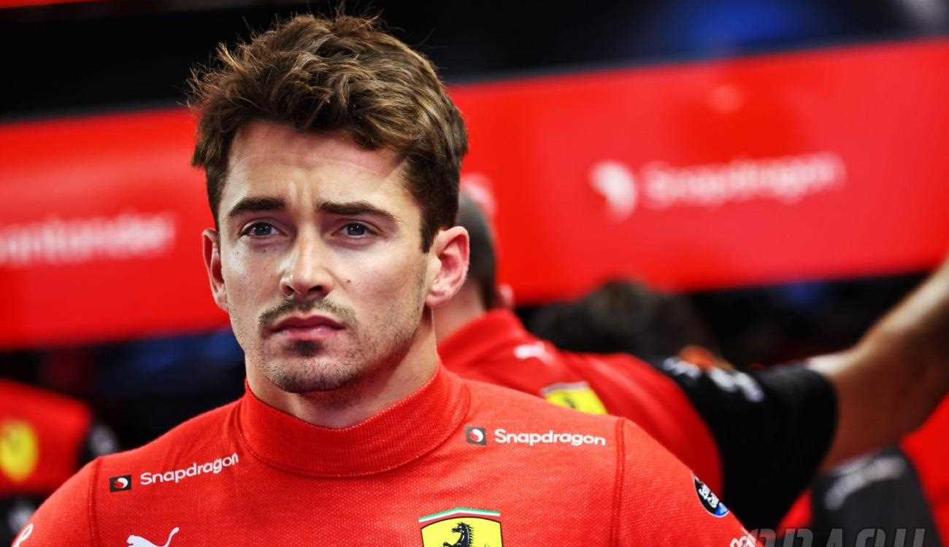
2022 winner: Charles Leclerc (Ferrari)
Australian F1 driver: Daniel Ricciardo (Red Bull)

Slide 27
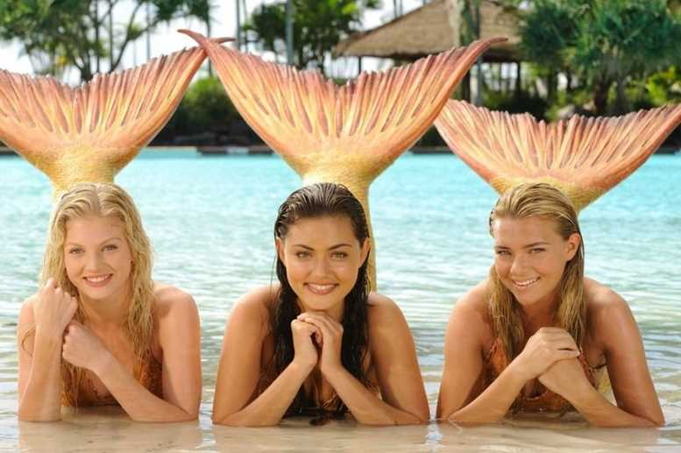
H2o just add water
three girls who are mermaids
Cleo, Emma (Bella later) and Rikki
The story takes place around the Gold Coast

Slide 28
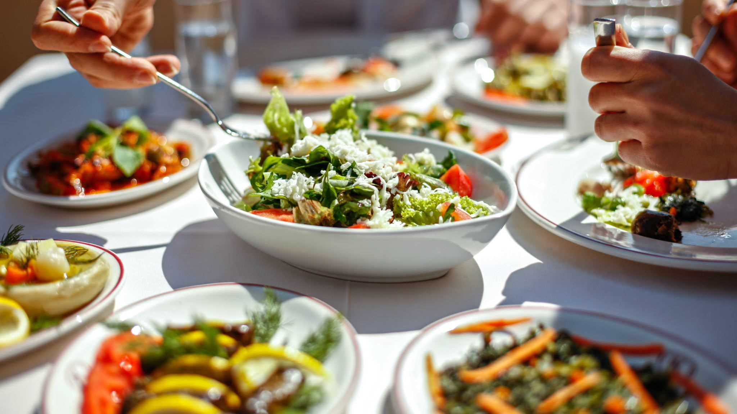
Food

Slide 29
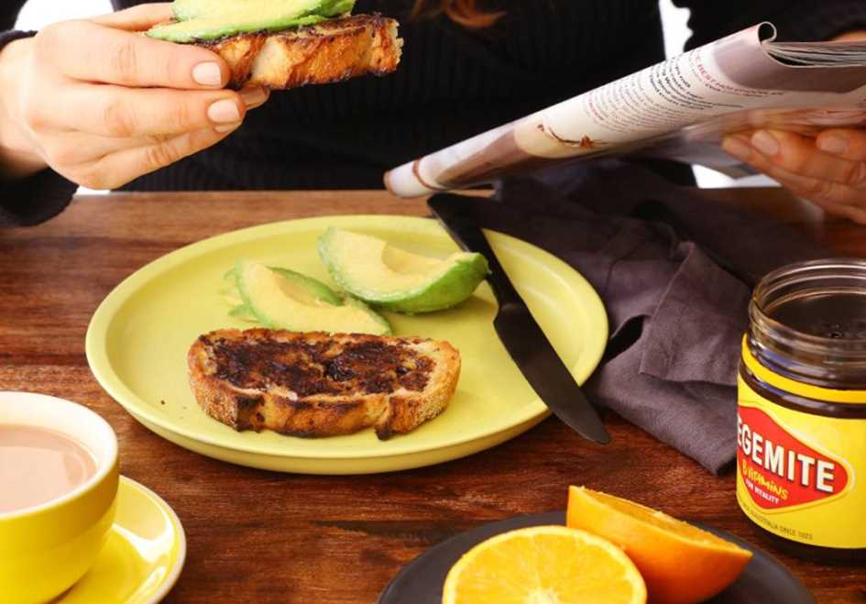
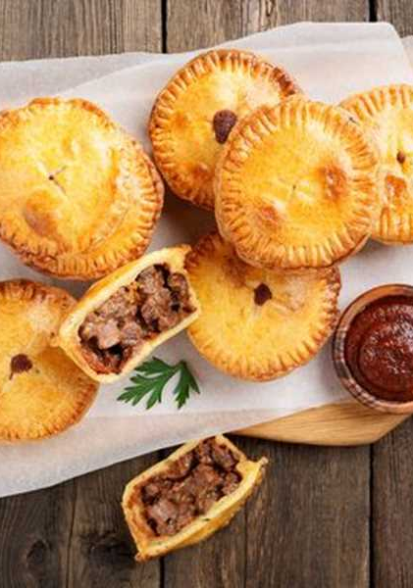
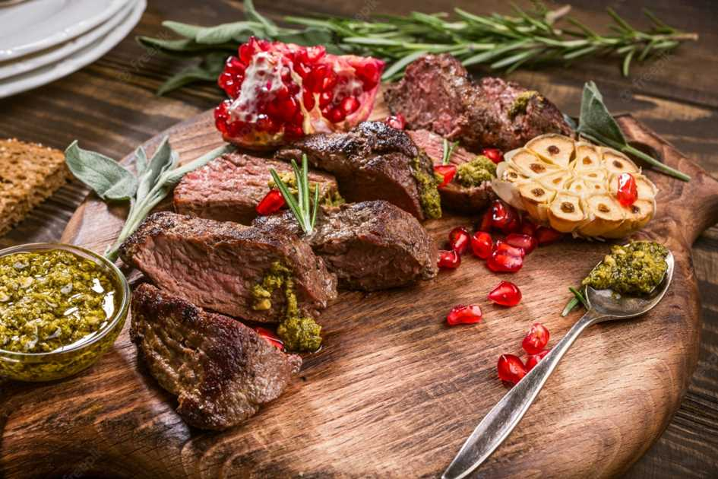
Typical Australian Food
Pie - salty pie, contains many types of minced meat or stomachs, liver or kidneys
Vegemite – dark brown spread, made of yeast
Kangaroo meat – many ways to prepare, tastes like game meat but its more juicy

Slide 30
Thank you for your attention

