Slide 1






HOW TO WRITE AN ESSAY
Balarinová Eliška

Slide 2

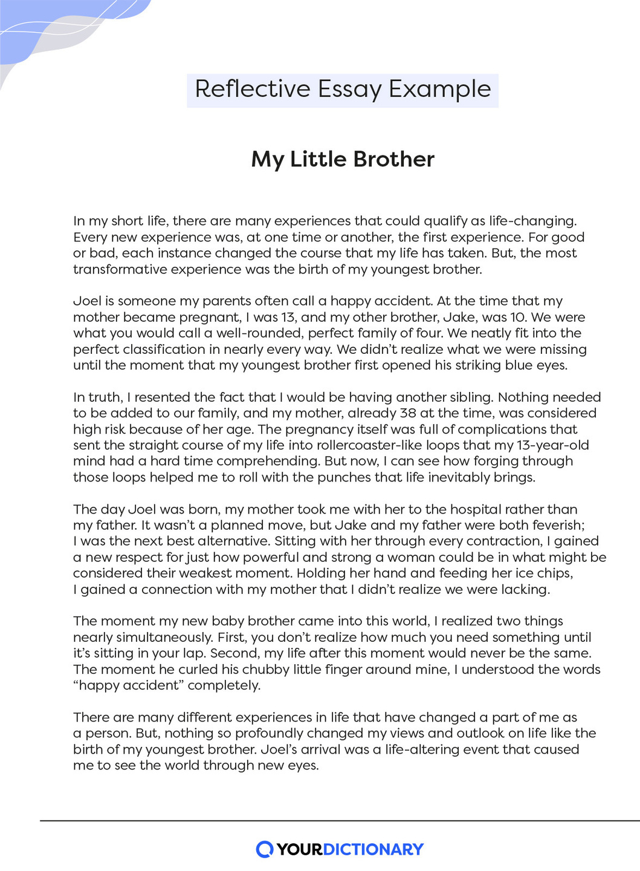



WHAT IS ESSAY?
An essay is a piece of writing that is written to convince someone of something or to simply inform about particular topic .
An essay must include important
components !

Slide 3



PARTS OF AN ESSAY
2.BODY/MIDDLE SECTION
1.INTRODUCTION
3.A CONCLUSION
-Summarizing the content
-Introducing
the topic
-Provides evidences
-Explaining your thesis

Slide 4
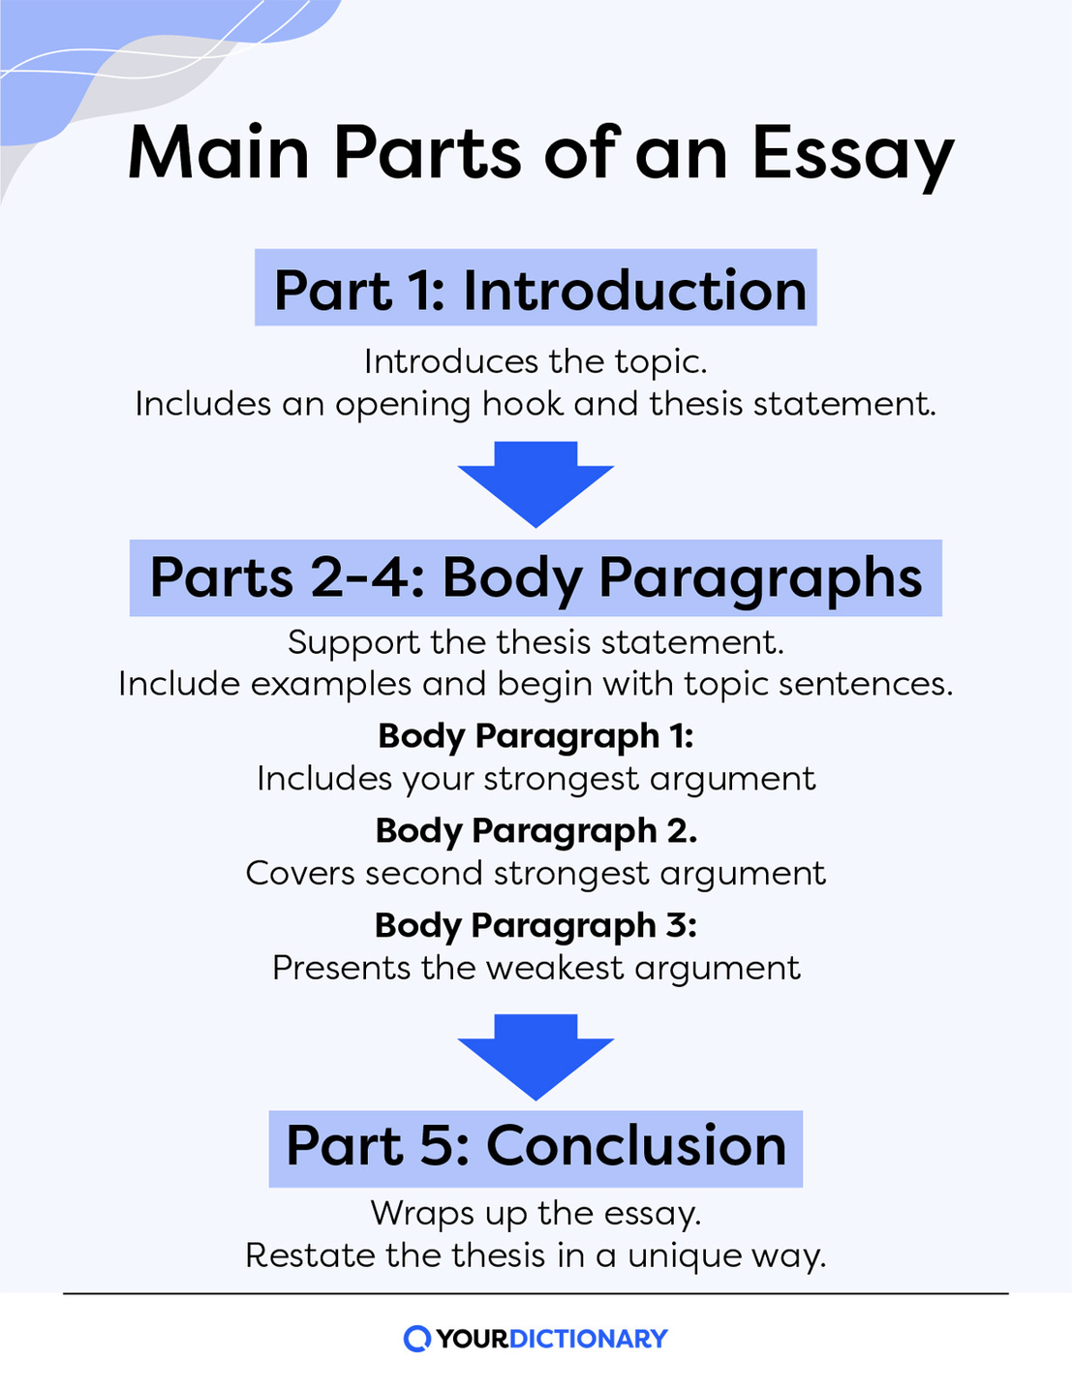
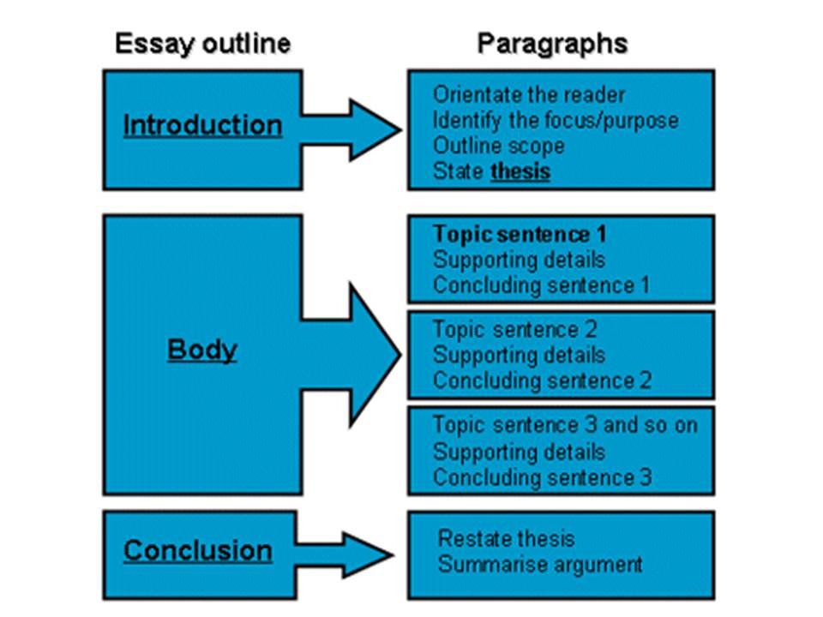

Slide 5






TYPES OF ESSAYS
ARGUMENTATIVE- Evidence and facts
COMPARATIVE- Comparing
EXSPOSITORY-Factual informations
NARRATIVE-Telling a story

Slide 6
BE CAREFUL !
What could go wrong ?->>

Slide 7
5 basic types of mistakes
Content mistakes
Structural mistakes
Vocabulary mistakes
Stylistic mistakes
Grammar mistakes

Slide 8






Content mistakes
Boring introduction
Using irrelevant facts
Weak arguments

Slide 9




Stylistic Mistakes
  Repeating words
  Too long/short sentences
  Overly informal/formal words and phrases

Slide 10





Structural mistakes
Sentence errors
Text structure error
Fragments
Run-on sentence
Introduction
Whoever goesto the meeting...
There was complete silence around me I still couldn't fall asleep
2 main paragraphs
Whoever goes to the meeting
There was complete silence around me but I still couldn't fall asleep
Conclusion

Slide 11




Grammar mistakes
  Noun form mistakes
  Pronouns
  Verb form mistakes

Slide 12
Vocabulary mistakes
  Misuse of hononyms- hear x here
hole x whole
its x it's
  Wrong word form- Disable people x disabled people
  Confused words- loose-lose
affect-effect
quite-quit-quiet

Slide 13


THE END

