Slide 1
Declaration of Independence
Veronika Stodolová

Slide 2
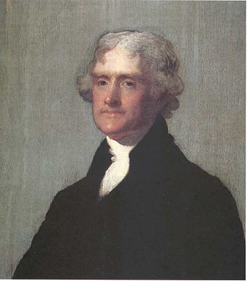
Thomas Jefferson
The main author of Declaration of Indpendence, he explained why 13 colonies were forming a new country
He was the third president of the USA (1801 -1809)
Notes:
First president – george washington, second John Adams

Slide 3
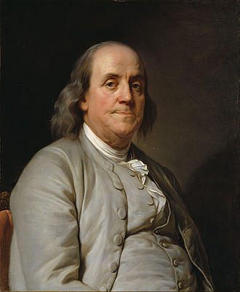
Benjamin Franklin (1706 – 1790)
One of the Founding Fathers of the United States (group of american revolutionary leaders who united the 13 colonies)
He never became president
Title „The First American“ for his campaigning for colonial unity as an spokesman in London for several colonies
He helped Thomas Jefferson with writing the Declaration of Independence (edited the document and made some changes)
Notes:
Jefferson, Franklin and John Adams
Franklin also inventor (something with elektricity - storms)
„join or die“
Worked as ambassador in France or Sweden

Slide 4
First Continental Congress (September 1774)
The first national goverment of the United States until being replaced by the US Congress
Leaders from every colony (except Georgia)
Met in Carpenter‘s Hall in Philadelphia
Decided to express the concerns of the colonists to George III. -> it didn‘t help at all (Britain sent more soldiers to colonies)

Slide 5
Second Continental Congress
Group of representatives from each colonies in America (about 60)
Met at Independence Hall in Philadelphia
The Resolution of Independence was aproved on July 2nd 1776

Slide 6
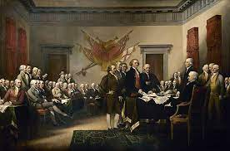
Declaration of Independence
Was finalised and signed on July 4th 1776 in Philadephia (in Independence Hall) – signed by 56 people (not all at once)
it explained why the 13 colonies were forming a new state

Slide 7
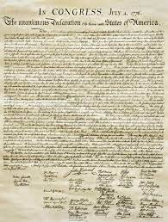
„We hold these truths to be self-evident, that all men are created equal, that they are endowed by their creator with certain unalienable rights, that among these are life, liberty and the pursuits of happiness.“
The Declaration of Independence is kept in The National Archives Museum – people can come and read it on a display (in Washington D.C.)

