Slide 1
Statue of
Liberty
Jakub Kantor
SI1
jakub.kantor04@gmail.com

Slide 2
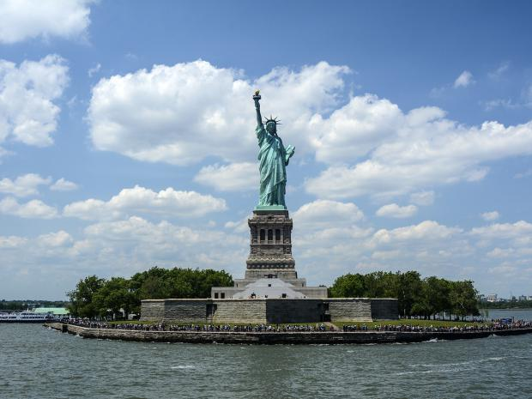
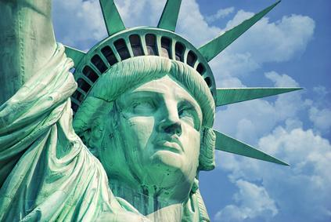
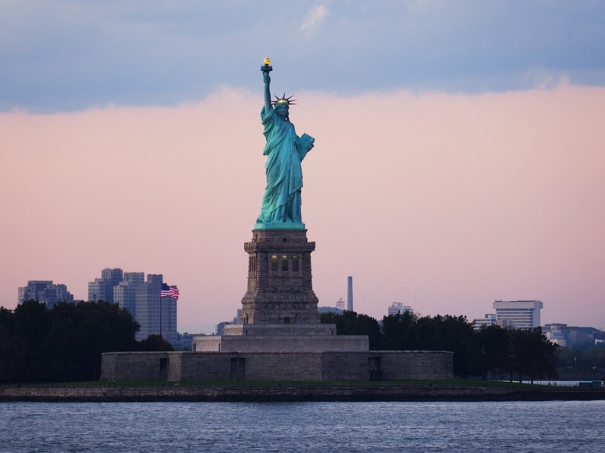
Statue of Liberty, full name Liberty Enlightening the World is a statue standing on the Island of Liberty near New York, USA.
New York
Statue of Liberty

Slide 3
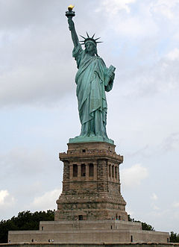
Description
The statue is 46 meters high, together with a 47-meter-high pedestal, the top of the torch is 93 meters above the ground.
The statue weighs 205 tons
In his left hand he holds a statue of the plaque representing the Declaration of Independence, with the inscription JULY IV MDCCLXXVI (July 4, 1776, Declaration of Independence Day)
Statue of Liberty was built in France in 1886.

Slide 4
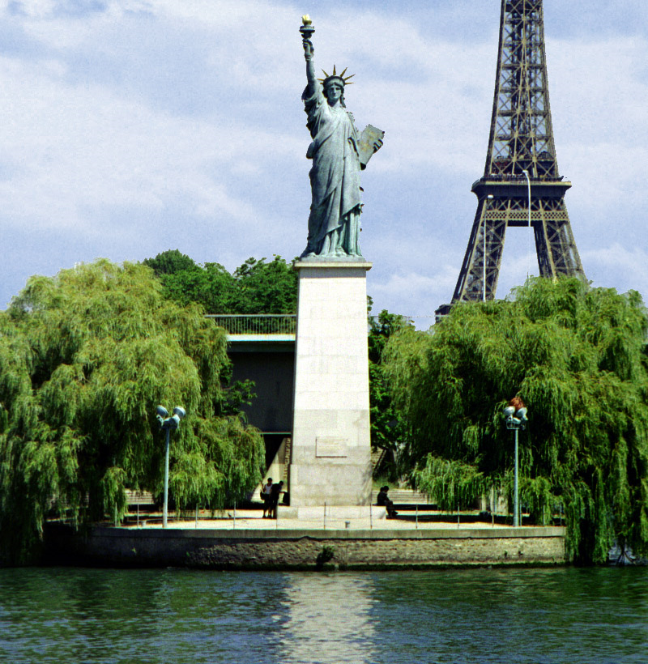
History
The Statue of Liberty commemorates the friendship and assistance France has provided to the American settlers in their struggle for independence from the United Kingdom, begun in 1776. Only France has sent troops to America.
The French also wanted to express their sympathy with the Statue of Liberty for the new Republic emerging beyond the Atlantic Ocean.
Paris Statue Of Liberty

Slide 5
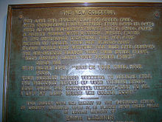
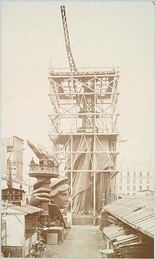
Attractions
The supporting structure of the Statue of Liberty was designed and constructed by the famous French builder, including the Parisian Eiffel Tower, Gustave Eiffel
Inside the pedestal, there is an engraved message of the statue itself, as a tribute to the journalist Emma Lazarus, who, thanks to this text, helped to fill the collection to build the pedestal of the statue:
Give me your poor, tired,
their huddled masses longing to breathe freely,
the pitiful abundance of your crowded shores.
Send them here, thunderous and homeless,
for them I will lift the torch at the golden doo
Emma Lazarus (part)
Dej mi své ubohé, unavené, své schoulené masy toužící volně dýchat, ten žalostný nadbytek tvých přeplněných břehů. Pošli je sem, zmítané bouří a bez domova, pro ně já pozvedám pochodeň u zlatých dveří!
Emma Lazarus (úryvek, český překlad)

Slide 6
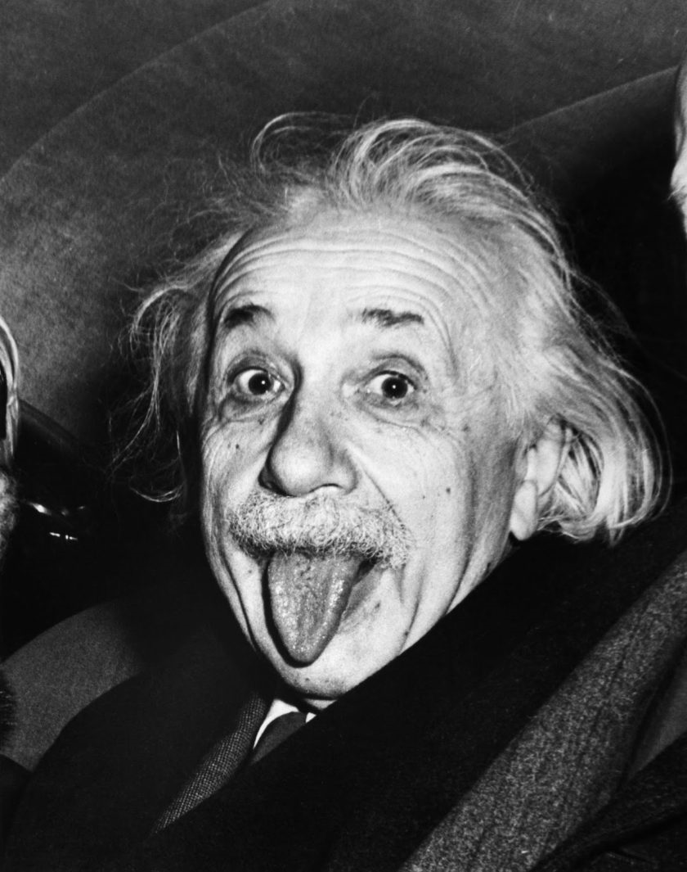
Questions
1.How much does the Statue of Liberty weigh?
2.Where the Statue of Liberty was built?
3.In what year was the Statue of Liberty built?
Correct answers:
205 tons
France
1886

