Slide 1
Education system in the UK
Anna Roušarová

Slide 2
AGE |  | YEARS
21 | graduation | 18
20 | University | 17
19 |  | 16
18 |  | 15
17 | SIXTH FORM “A levels“ exam | 14
16 |  | 13
16 | GCSE | 12
15 | Secondary school Optional subjects | 11
14 |  | 10
13 |  | 9
12 |  | 8
11 |  | 7
10 | Primary school (Infant and Junior) | 6
9 |  | 5
8 |  | 4
7 |  | 3
6 |  | 2
5 |  | 1
4 | Nursery school
3
The school is compulsory from the age od 5 to 16
State school or independent school=public school
The school year is divided into 3 terms
Some of the children goes to nursery school

Slide 3
Primary and secondary school
Primary school is for children from age 5 to 11
Interesting fact – Teachers in primary schools are mainly woman
Secondary school is fro young people between the age 11 and 16
2 types: Comprehesive and grammar school
At the age of 16 you have to take GCSE

Slide 4
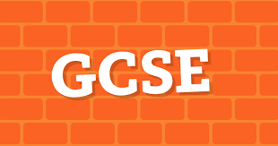
Further education
Qualification
A-Levels, GNVQ's, BTEC‘s
UK students planning to go to college or university must complete further education

Slide 5
Higher education
Degree Level | Average Completion Time (full-time) | Common Prerequisite
Associate degree | 2 years | High school diploma or equivalent
Bachelor's degree | 4 years | High school diploma or equivalent
Master's degree | 1-2 years | Bachelor's degree
Doctoral degree | 2+ years | Master's degree (sometimes bachelor's degree is acceptable)
3 to 4 years
Optional

