Slide 1
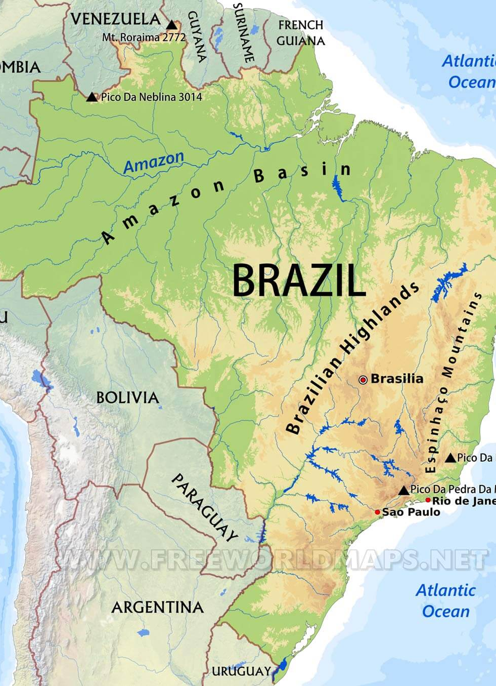
Brazil
Suchánková A.

Slide 2
Basic information
The largest country in both South America and North America
Total area: 8,515,767 km²
Population: 210,147,125
Population density: 25/km²
Capital: Brasília
Largest city: São Paulo
Official language: Portuguese

Slide 3
São Paulo

Slide 4
Economy
Developing mixed economy, 12th largest in the world by GDP
Major economical inequalities: Brazil’s six richest men have the same wealth as poorest 50 percent of the population- around 100 million people
Agriculture is dominant, largest producer of sugarcane, soy, coffee, oranges, açaí and Brazil nut
Cattle-raising (beef)
Extraction of iron ore (the second world exporter), copper, gold, bauxite, diamonds
Export of steel, automobiles, electronics, and consumer goods

Slide 5
Interesting facts
Brazil is one of the world’s most biodiverse countries, with a total of four million plant and animal species, according to estimates. It has more species of monkey than any other nation.
Brazil was the last country in the Americas to abolish slavery, in 1888.
The largest amount of money stolen from a bank by robbers occurred in Fortaleza, Brazil, according to the Guinness Book of World Records. A gang of up to 10 people dug 80 metres long tunnel to seize five containers of currency estimated at nearly $70 million. (1miliarda 556tisíc milionů Kč)

Slide 6
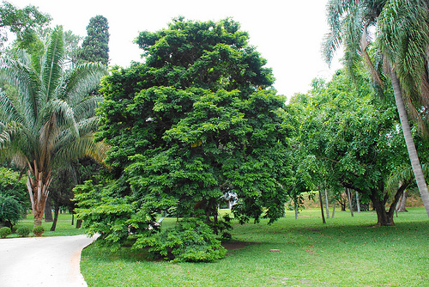
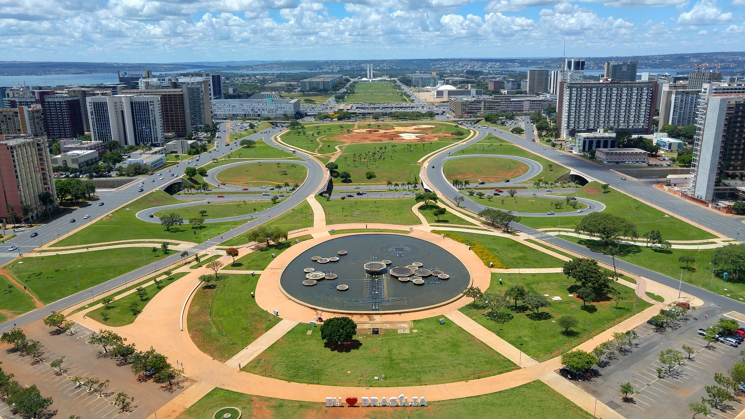
Interesting facts
Brazil is the only country in South America that speaks Portuguese.
The name Brazil comes from a tree named brazilwood.
Brasilia, the country’s capital, took just 41 months to build, from 1956 to 1960 (Rio had been the capital for the previous 197 years).

Slide 7
Sources
https://en.wikipedia.org/wiki/Bras%C3%ADlia
ttps://www.sciencekids.co.nz/sciencefacts/countries/brazil.html
https://www.britannica.com/place/Brazil/The-economy
https://cafodeastanglia.wordpress.com/2014/09/30/brazil-rich-or-poor/

