Slide 1
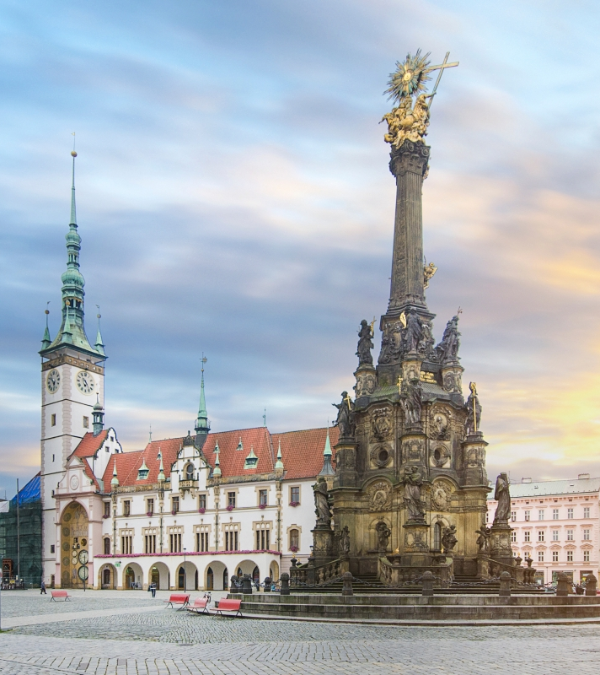
Olomouc region
Kateřina Koudelková, 4.C

Slide 2
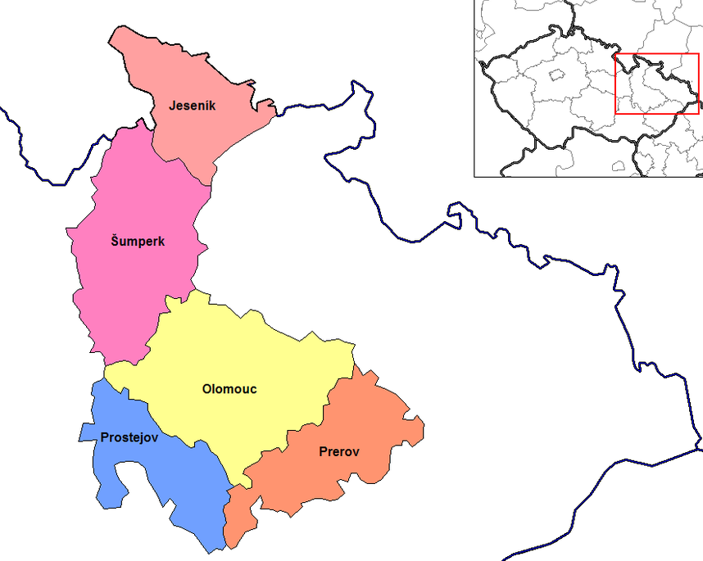
Basic information
Located in the north-western and central part of its historical region Moravia
Named after its capital Olomouc
Divided into 5 districts

Slide 3
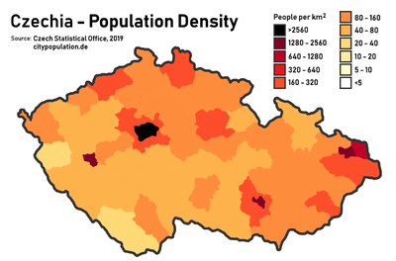
Population
January 2019: 632,492 inhabitants
The capital, Olomouc: 100 000 inhabitants
The whole region: 120.1 inhabitants per km2
In the long term: the population is aging
The average age of population in 2019: 42.8 - the 4th highest among regions in the Czech Republic

Slide 4
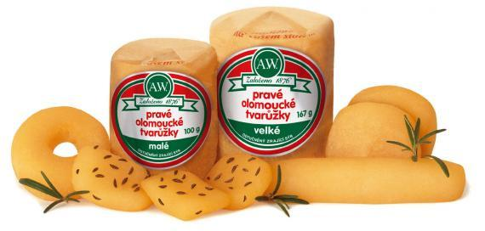
Economy
Focuses on traditional agriculture, food industry, textile and clothing industry, manufacture of machinery, optics and optical equipment
Olomouc - Olma (dairy products)
Přerov - brewery Zubr a Regent
Loštice – “Olomoucké tvarůžky“

Slide 5
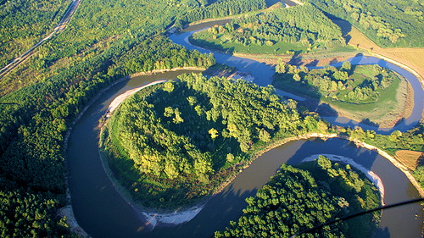
Geography
Total area: 5,267 km² ⁻ 6.7% of the entire area of the Czech Republic
The northern part of the region is of mountainous nature – Jeseníky mountain, Praděd (1,492 m)
The southern part of the region consists of the Hanakian lowland
The Morava river flows through the region

Slide 6
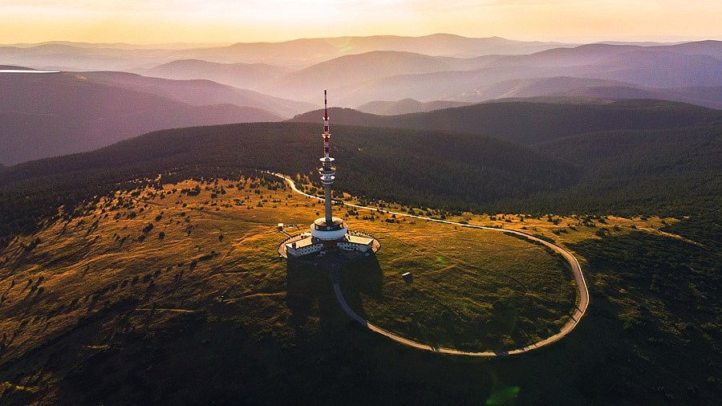
Praděd

Slide 7
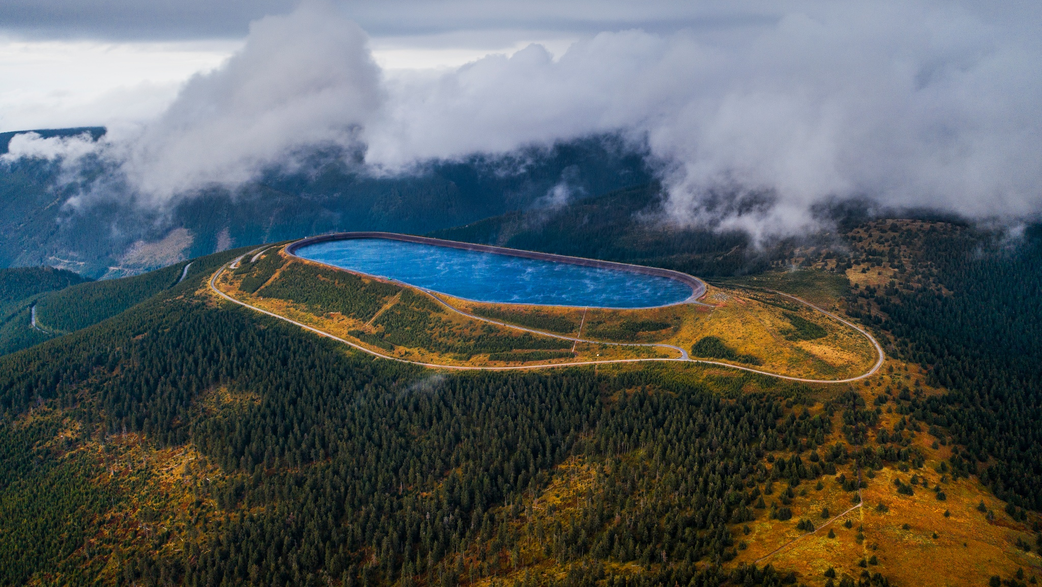
Pumped hydroelectric power station Dlouhé stráně

Slide 8
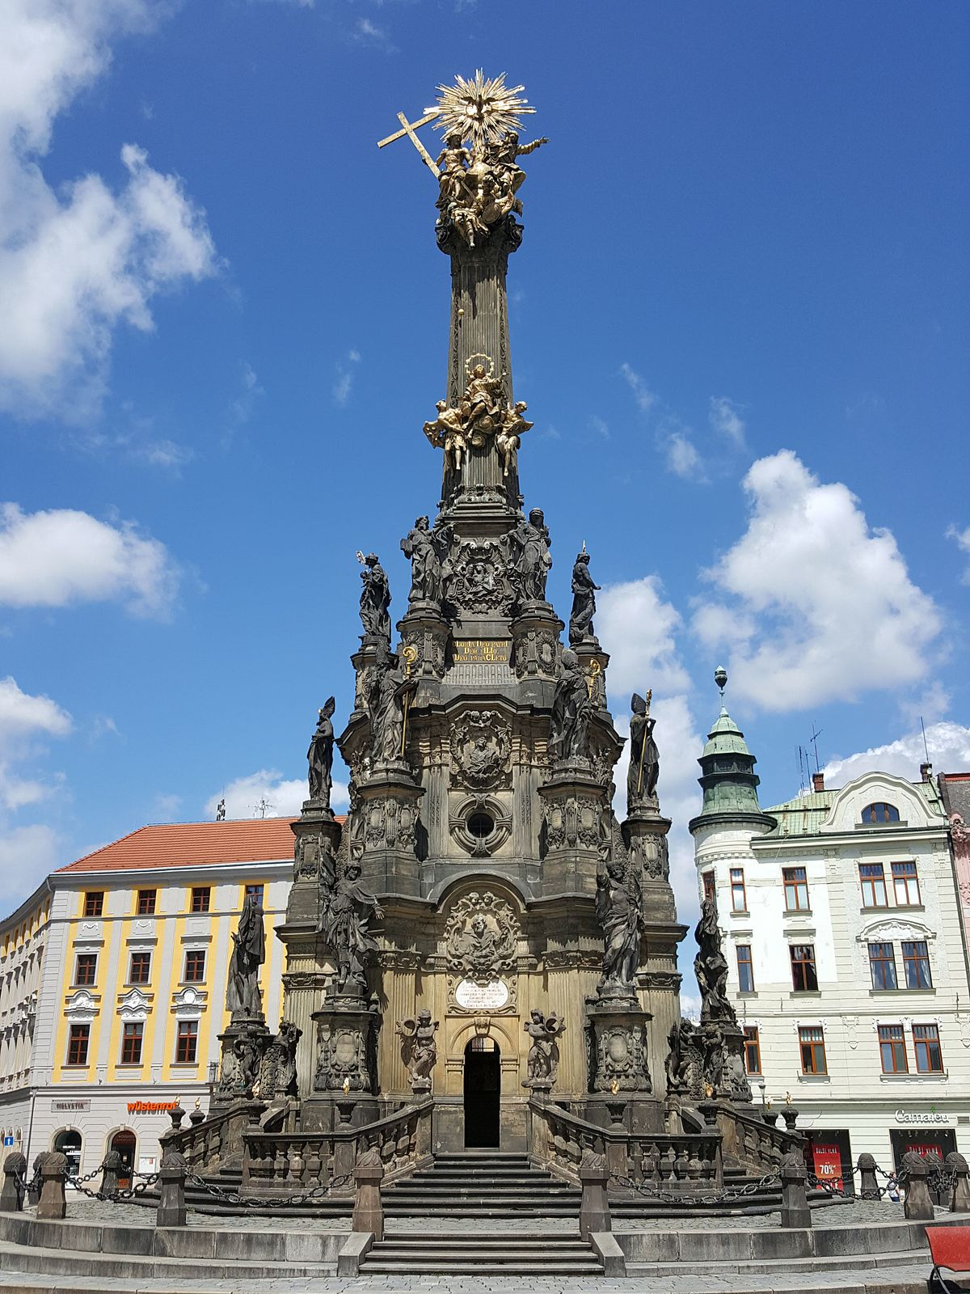
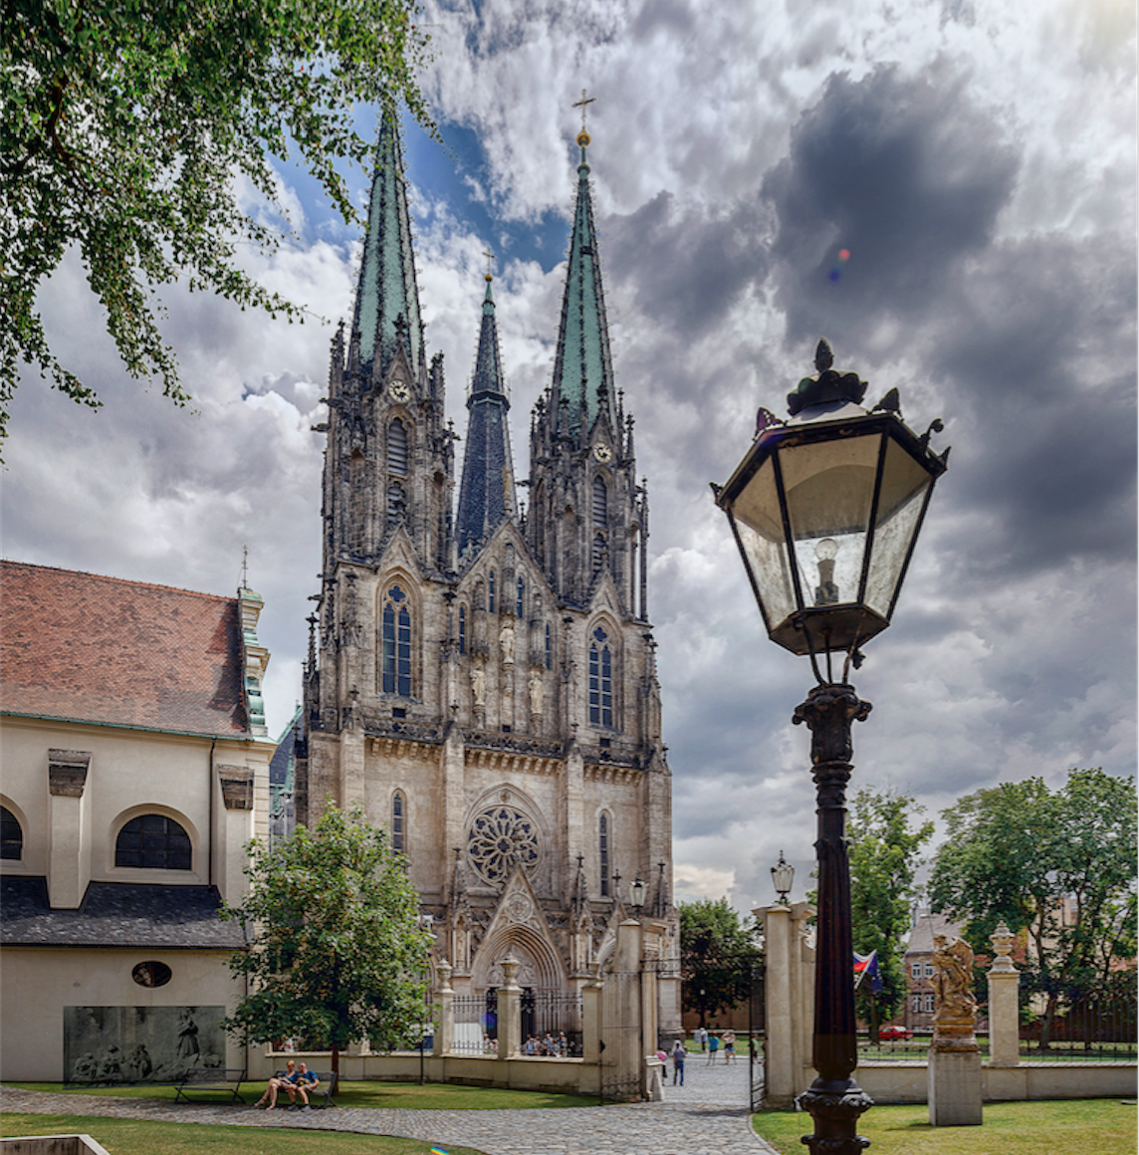
Olomouc
Saint Wenceslav cathedral
Holy trinity Column

Slide 9
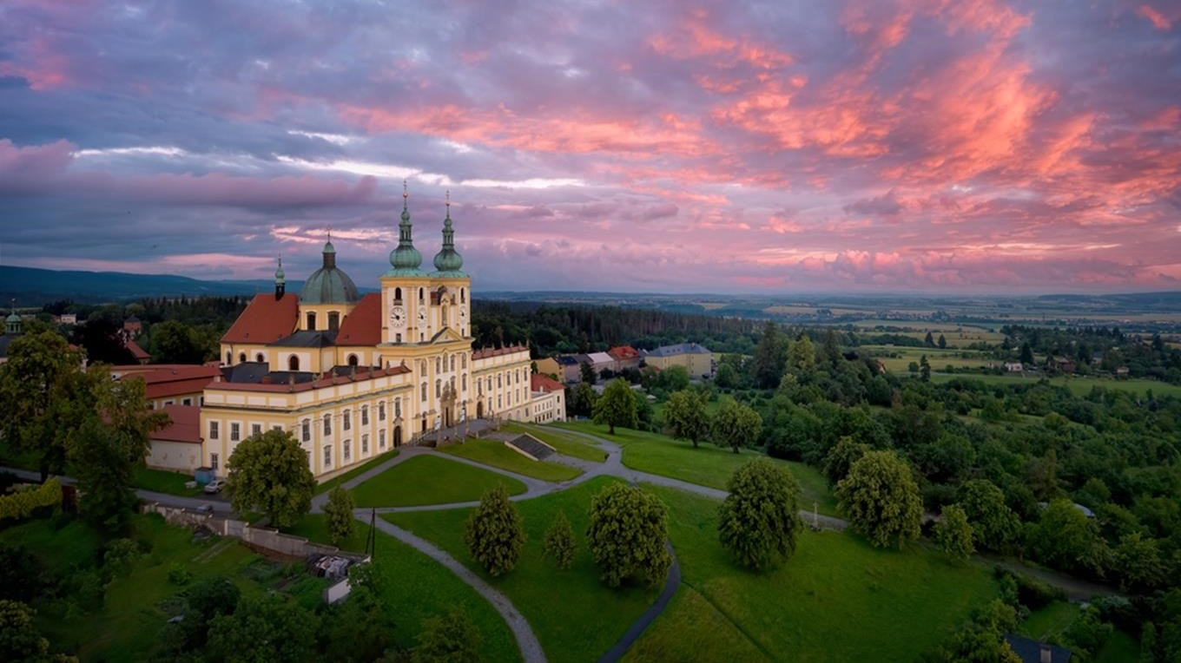
Holy Hill

Slide 10
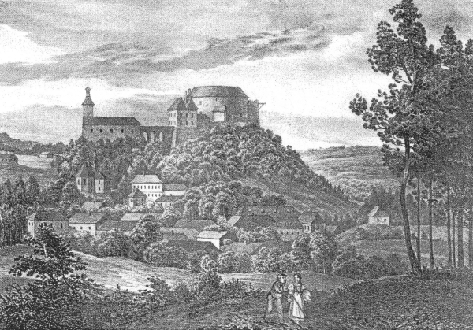
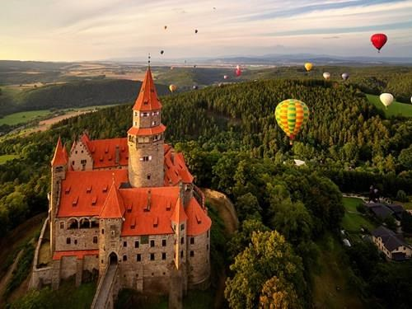
Bouzov Castle

Slide 11
Sources
https://en.wikipedia.org/wiki/Olomouc_Region
https://www.kr-olomoucky.cz/zakladni-informace-cl-143
https://www.idnes.cz/olomouc

