Slide 1
British Literature

Slide 2
Distribution
Literature from United Kingdom of Great Britain and Northern Ireland
Can be divided into 3 periods corresponding to the development of English language
1) Anglo – Saxon literature = Old English literature
2) Middle – English literature
3) Modern English literature

Slide 3
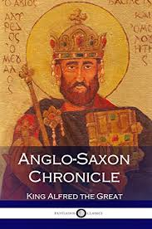
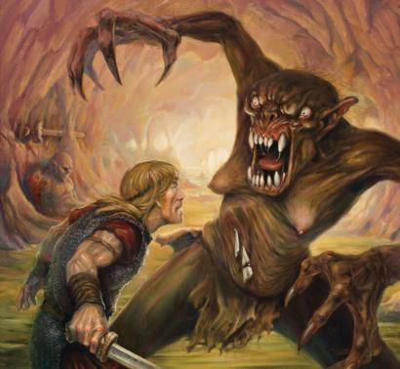
Old english literature
8th century - Beowulf ( germanic legend)
It is heroic poetry about the strong and courageous hero from north named Beowulf.
9th century – Anglo-Saxon Chronicle
This Chronicle was inspired by King Alfred.

Slide 4
Middle english literature
From the 11th centurty to the 15th century
Corresponds to the Medieval period
Divided into 4 general periods:
1) The Early Period
The Thirteenth Century
The Fourteenth Century
The Fifteenth Century

Slide 5
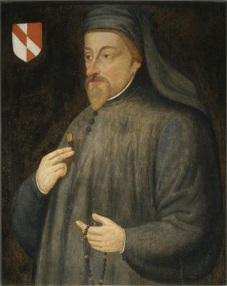
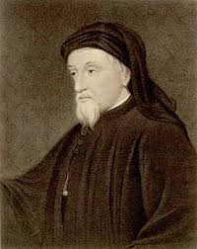
Geoffrey Chaucer
Writer and poet
Was born 1343 in London and died 1400 London
Burried in Westminster Abbey
His work: Canterbury tales (collection of 26 tales)
Picture of society in the 14th century

Slide 6
William Shakespeare
Born in 1564 and died 1616
He was a poet, playwriter, actor and writer
He is regarded as the greatest writer in English language and world´s greatest dramatist.
He wrote 39 dramas, 154 sonnets
He died on the same day as he was born
He wrote in time of “Golden Age of literature“
Queen Elisabeth and James I. Gave theatre moral support

Slide 7
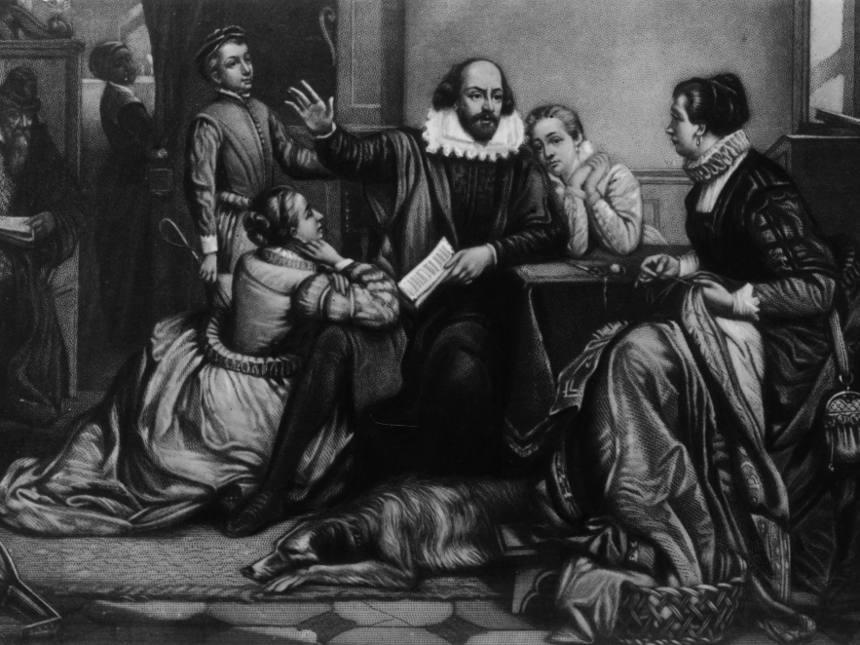
William Shakespeare
He married at age of 18. His wife Anne was 8 years older than him.
They had 3 children: Susanna and twins Hamnet and Judith
In last yeras of his life, he wrote mainly tragicomedies.

Slide 8
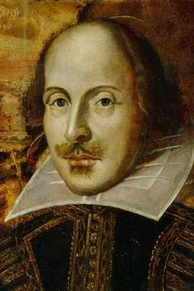
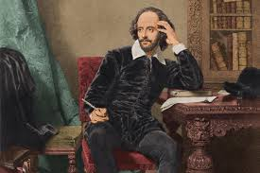
William Shakespeare
He wrote comedies: A Midsummer-Night´s Dream
Tragedies: Romeo and Juliet, Macbeth, Hamlet
History plays: Julius Caesar, Antonius and Cleopatra

Slide 9
Modern english literature
From the 16th century up tody
Literary trends of modernism emerged after the end of the First World War. They includes:
Surrealism
Cubism
Futurism
Sympolism
Dadaism
And more

Slide 10
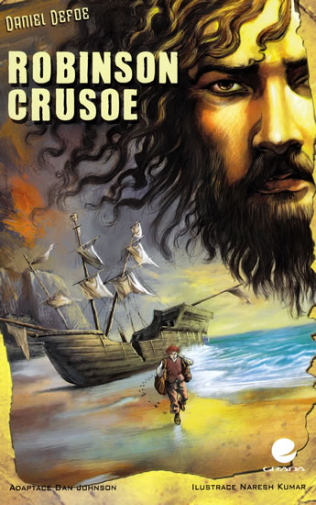
18th century
This time was development of society and economy, journalism, novels and drama
Daniel Defoe – Robinson Crusoe
He heard this story in the pup and when he was 60 he wrote it
Jonathan Swift – Guliver´s Travels
Satirical book, he criticized politics in England, armies and corruption

Slide 11
19th century
Romantism
Can be divided into two parts:
1) Lake poets – lyrical ballads (William Wordsworth and Samuel Taylor Coleridge)
2) Percy Bysshe Shelley (Prometheus unbound), John Keats, George Gordon Byron (Manfred)

Slide 12
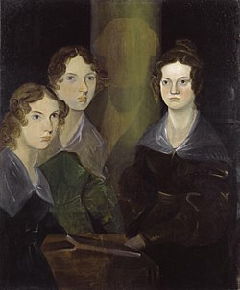
Brontë sisters
They writting began, when they started to invent the stories in the evenigs.
Charlotte Brontë – Jane Eyre
Emily Brontë – Wuthering Heights
Novel about passion and hate

Slide 13
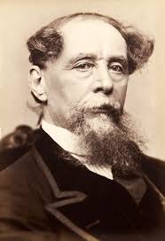
Charles Dickens
Born in 1812 – died in 1870
He often used his own experience from his childhood
He describes truly the life of poor people in England in 19th century
He usually combines comic and serious situation
His work: Christmas Carol, Oliver Twist, David Copperfield (autobiography)

Slide 14
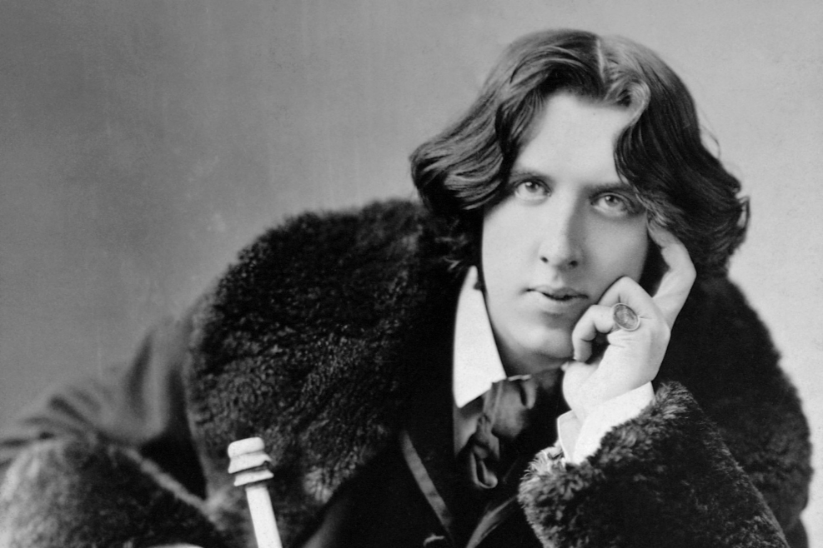
Oscar Wilde
Born in 1854 – died in 1900
He represents English decadence and symbolism
He wrote drama and comedies
His work: The picture of Dorian Gray

Slide 15
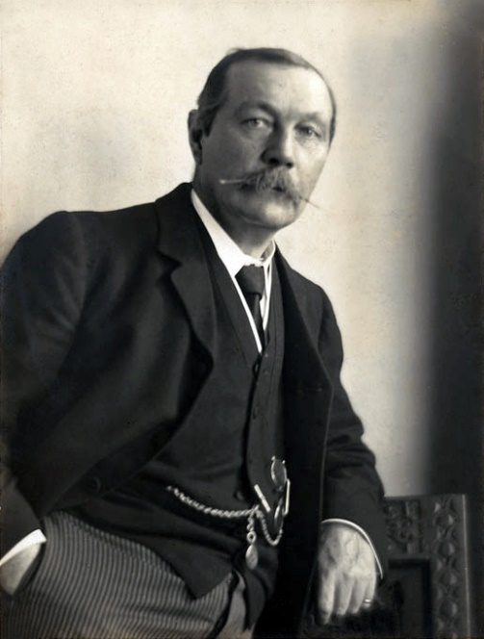
Sir arhur conan Doyle
Born in 1859 – Died in 1930
He was a doctor
He is a creator of Sherlock Holmes
His work: The Hound of Baskervilles

Slide 16
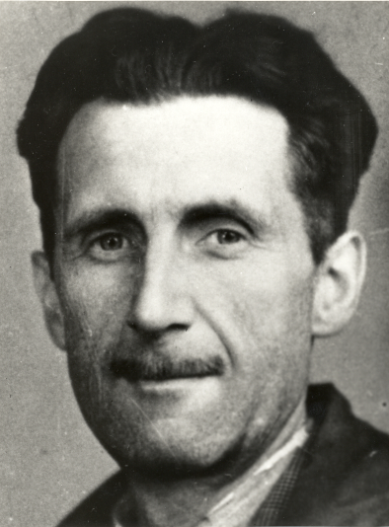
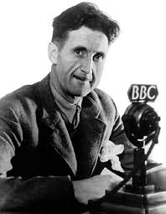
George orwell
Born in 1903 – Died in 1950
His real name is Eric Blair
He had a lot of jobs
His work: Animal Farm
It is about animals who occupied the farm.

Slide 17
Joanne Rowling
pen name: J. K. Rowling
*31 July 1965 (age 54)
British author, film producer, television producer, screenwriter, and philanthropist
best known for writing the Harry Potter fantasy series
Rowling has lived a "rags to riches" life (from poorness to riches)

Slide 18
Harry Potter
best-selling book series in history
published: 26 June 1997 – 21 July 2007
have been translated into eighty languages
the books are the basis of a popular film series, over which Rowling had overall approval on the scripts

