Slide 1
FRANCE

Slide 2
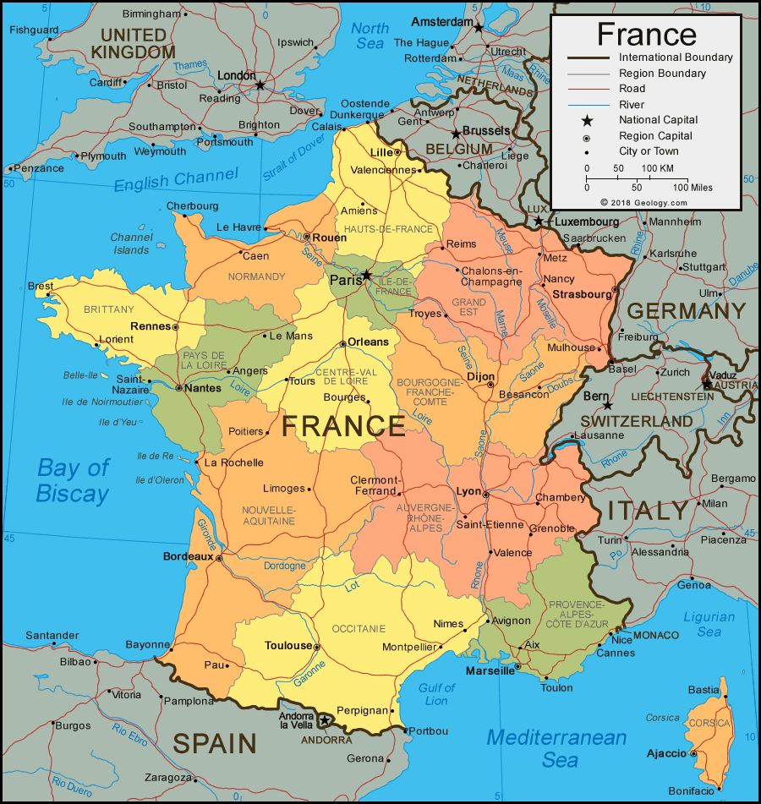
GEOGRAPHY
country whose territory consists of metropolitan France in Western Europe and several overseas regions and territories
It is bordered by Belgium, Luxembourg and Germany to the northeast, Switzerland and Italy to the east, and Andorra and Spain to the south

Slide 3
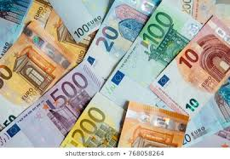
BASIC INFORMATIONS
capital city: Paris
population: 67,076,000
area: 640,679 km²
currency: Euro
language: French
religion: Roman Catholic, Protestants

Slide 4
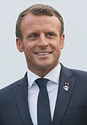
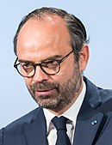
POLITICS
president: Emanuel Macron
prime minister: Édouard Philippe
The French Republic is a unitary semi-presidential representative democratic republic with strong democratic traditions

Slide 5
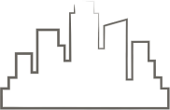
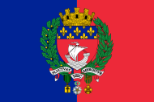
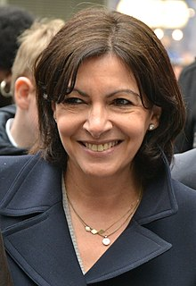
PARIS
the capital city of France
most populous city of France (2,148,271)
since the 17th century, Paris has been one of Europe's major centres of finance, diplomacy, commerce, fashion, science and arts
mayor of Paris: Anne Hidalgo

Slide 6
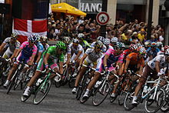
SPORT
most popular sport clubs are the association football (Paris Saint-Germain F.C. )
the rugby union clubs Stade Français
Racing 92, the last of which is based just outside the city proper
Tennis is another popular sport in Paris and throughout France (the French Open)
most famous bicycle racing in the world (Tour de France, always finishes in Paris.)

Slide 7
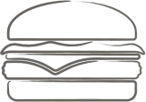
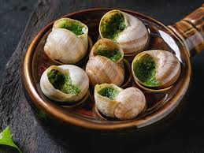
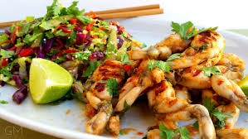
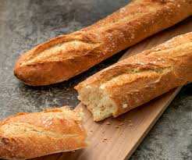
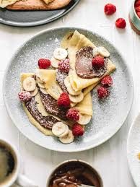
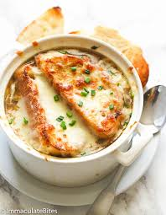
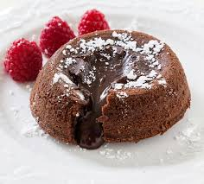
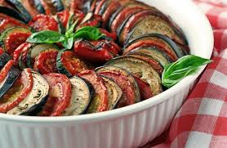
FOOD
Onion soup
French bred
Chocolate soufflé
Ratatouille
Frog legs

Slide 8
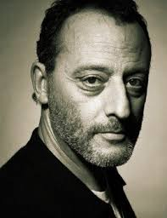
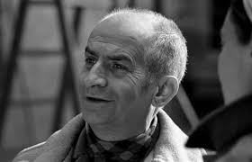
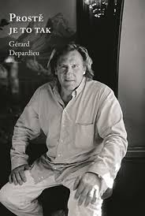
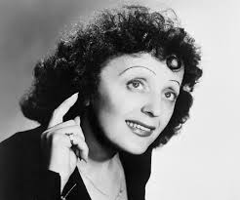
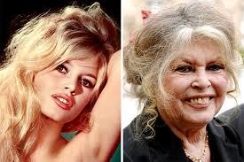
FAMOUS FRENCH PEOPLE
Gérard Depardieu
Jean Reno
Louis de Founés
Brigitte Bardot
Édith Piaf

Slide 9
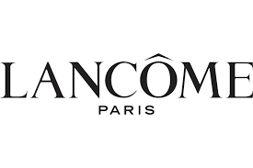
FAMOUS FRENCH BRANDS
Louis Vuitton
Hermés
Lancome
Cartier
Chanel

Slide 10
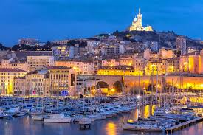
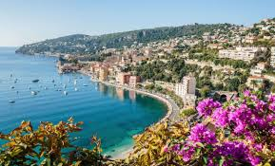
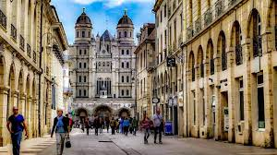
PLACES TO VISIT
Paris
Nice
Marseille
Dijon

Slide 11
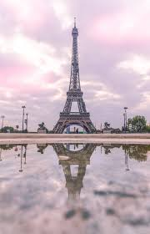
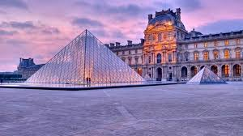
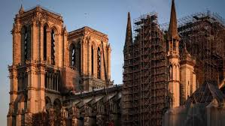
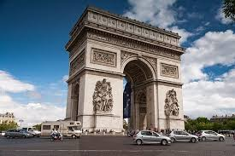

Slide 12
https://www.youtube.com/watch?v=-kF_HR6rCEQ

