Slide 1
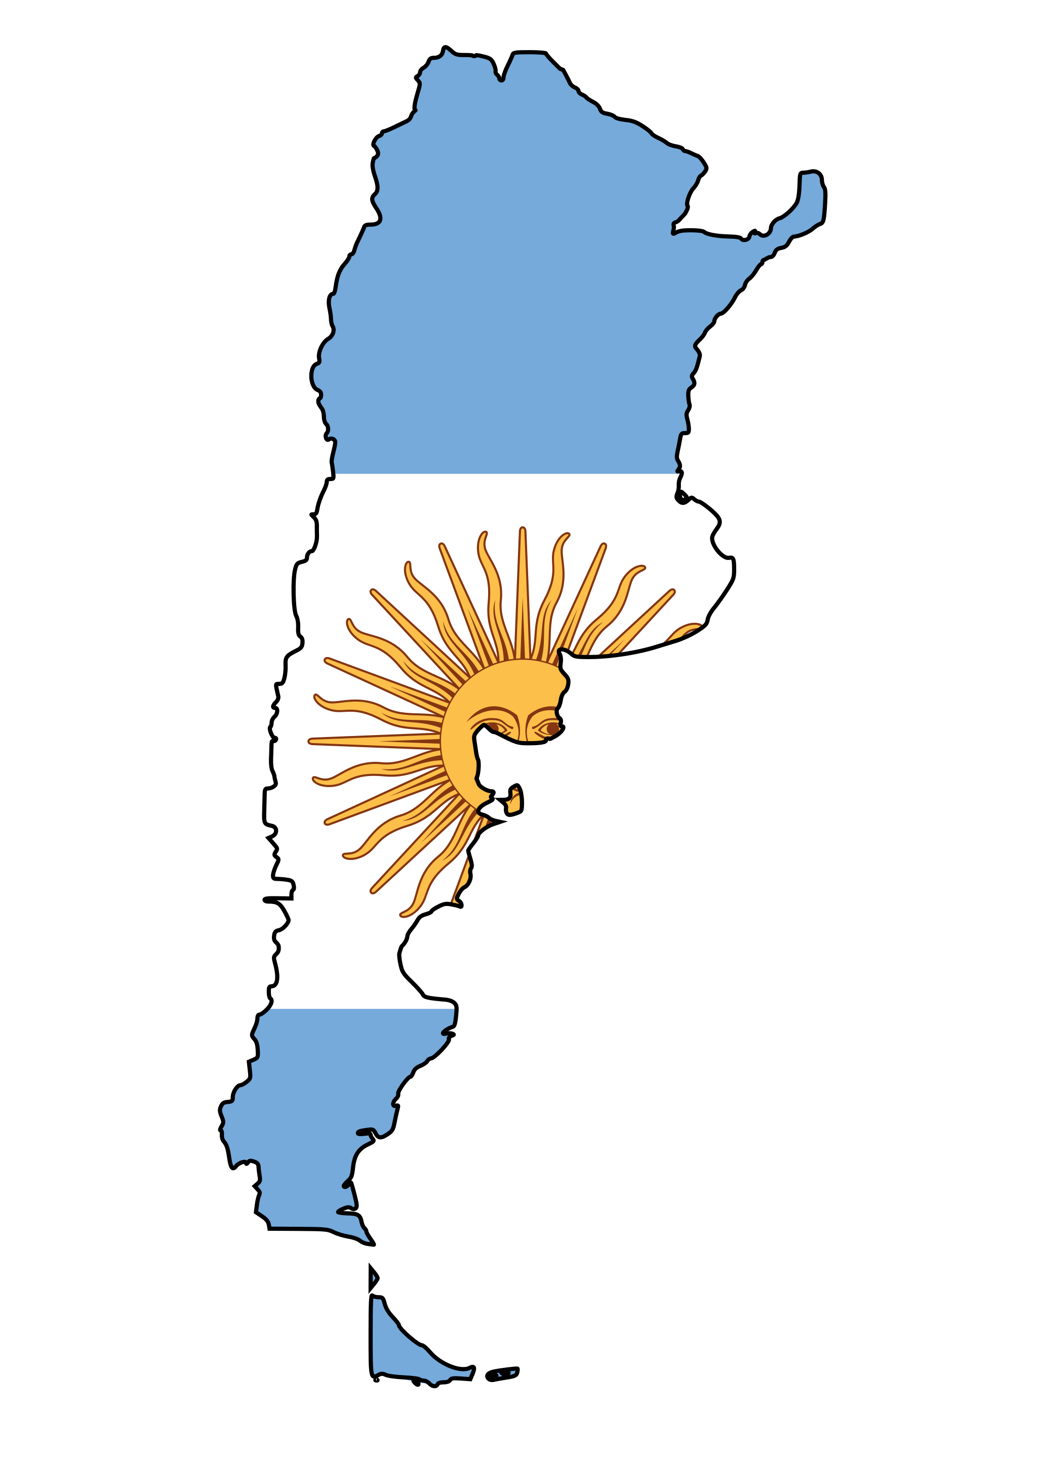
Argentina

Slide 2
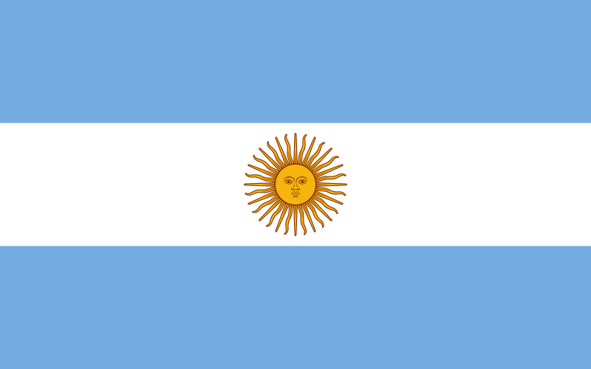
Meaning of Flag

Slide 3
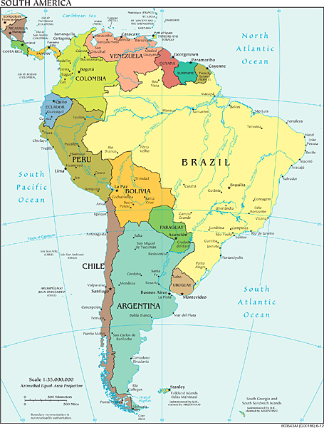
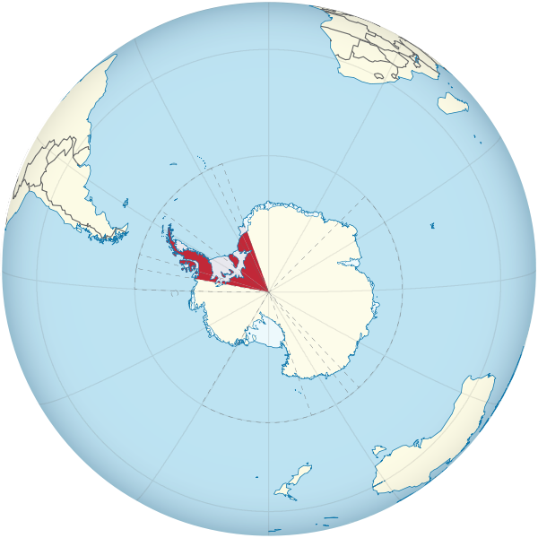
Political Geography
Argentina is located in south corner of
South America
It´s bordered by Chile, Bolivia, Paraguay,
Brazil and Uruguay
The 8th largest country in the world and
the 2nd largest in Latin America
It has territorial claims in Antarctica
Its area is 2,780,400 km²

Slide 4
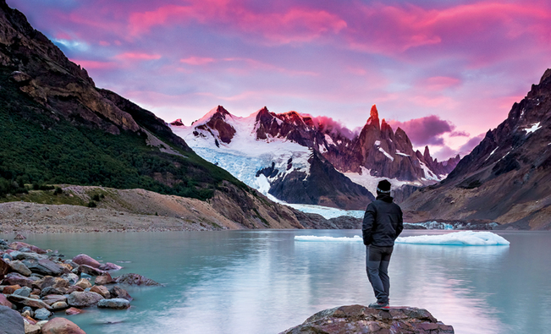
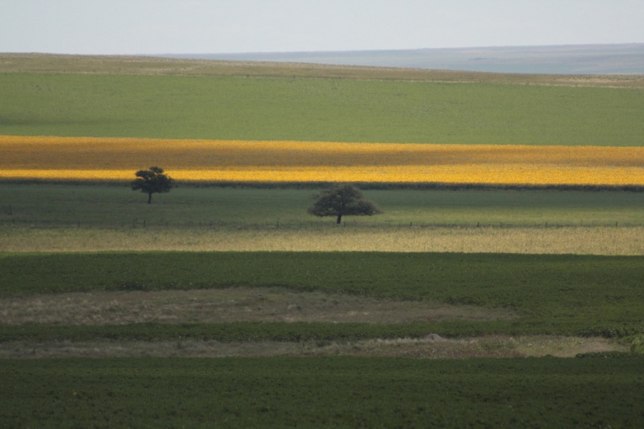
Physical Geography
Its west part is formed by Andes, where is also located Argentine highest mountain – Aconcagua (6,959 m)
On the north are huge plains with fertile soil, which are called "Pampas" and the area is used for cattle farming and for vineyards
On the south is area called "Patagonia" and it´s very inhospitable cold region of Argentina with deserts and steppes
Fertile - úrodný
Vineyards – vinice
Inhospitable - nehostinný

Slide 5
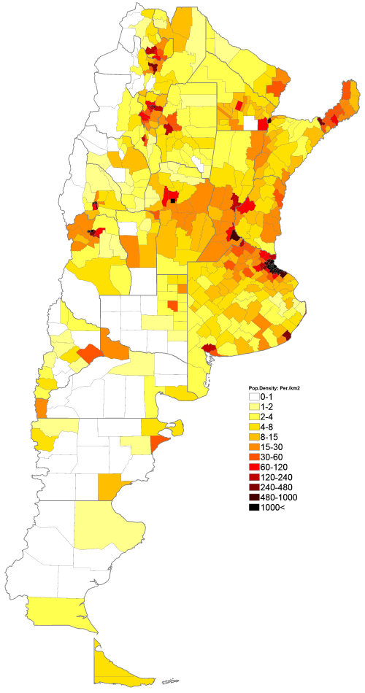
Demographics
Argentina has 43 500 000 inhabitants
It´s mostly immigrant country, Argentinians come from European countries (Italy, France, Germany, Spain)
Half of them were Italians, 15% were French, 8% were German, 2% are native Americans and there is also population of Arabs and Asians
Population density is very low (14.4/km²)
The official language is Spanish but it has a lot of
dialects

Slide 6
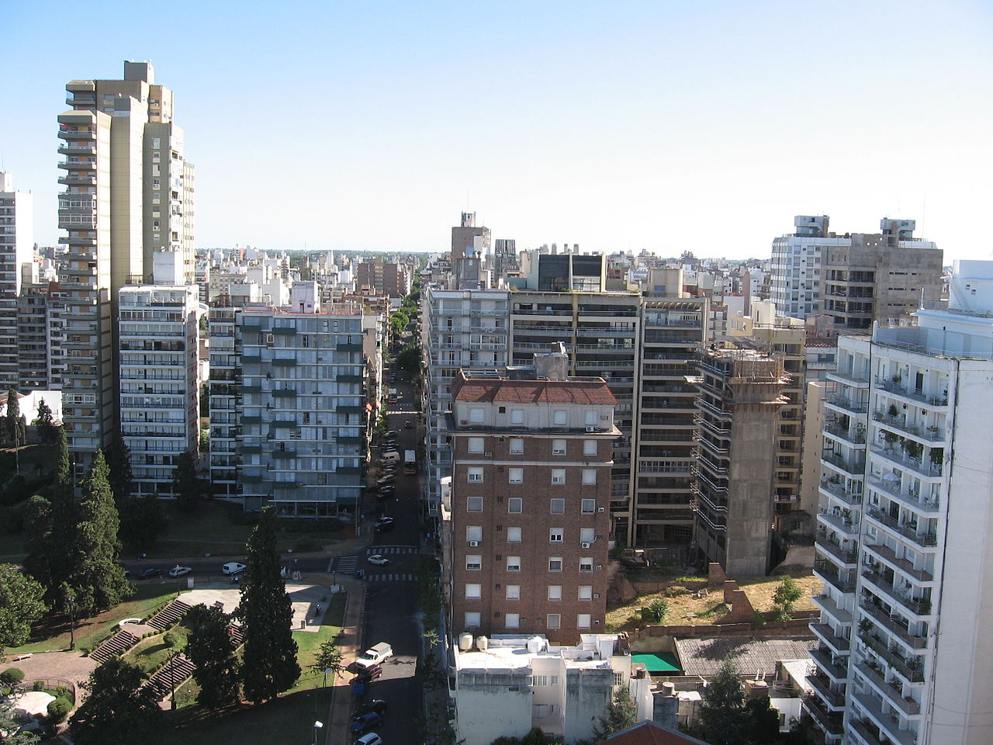
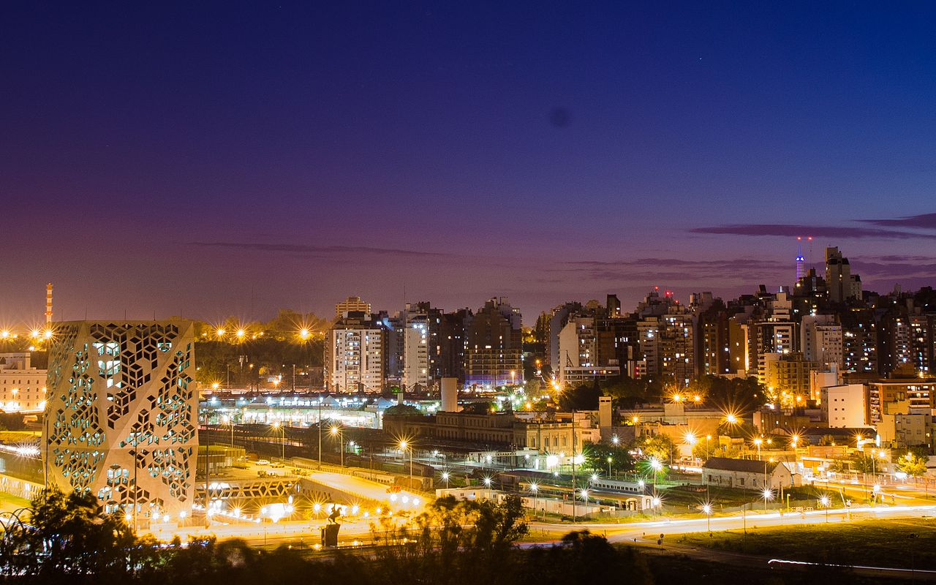
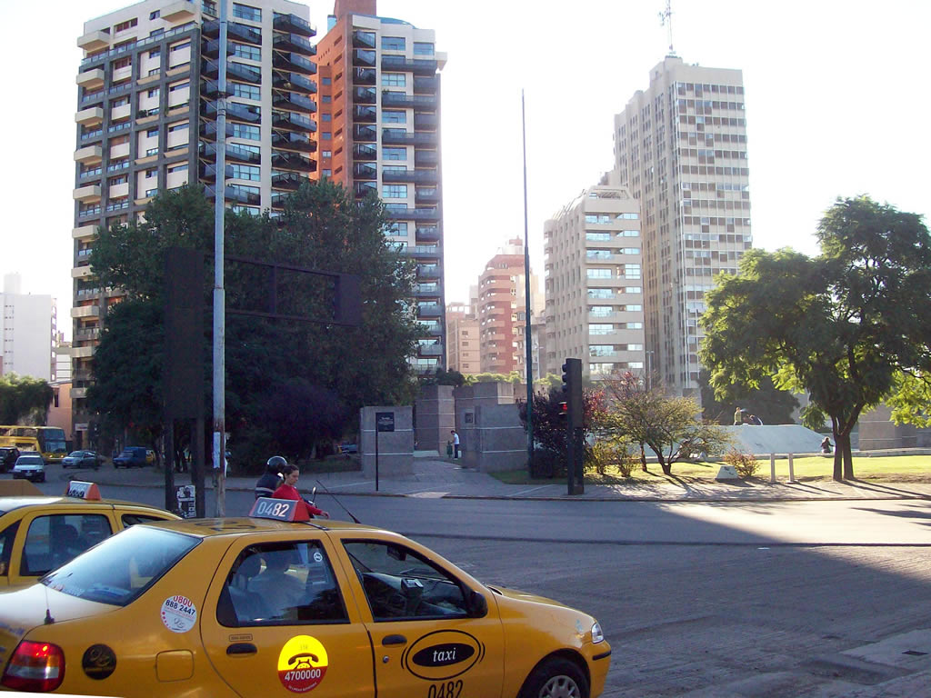
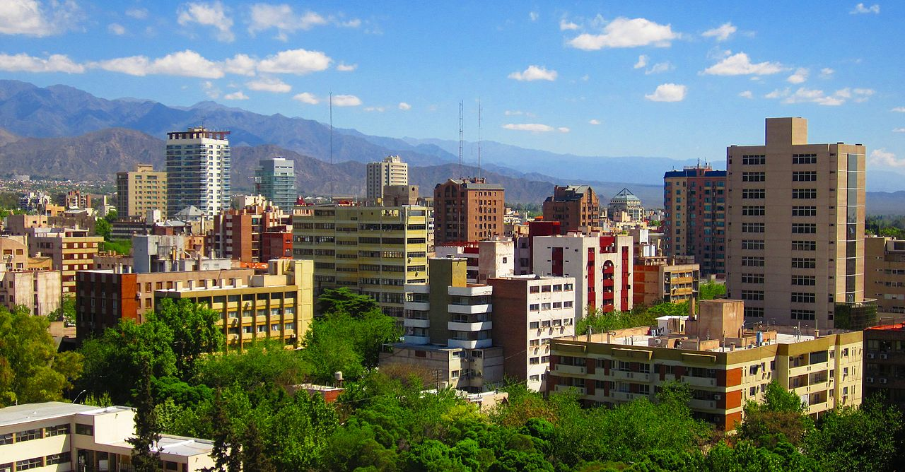
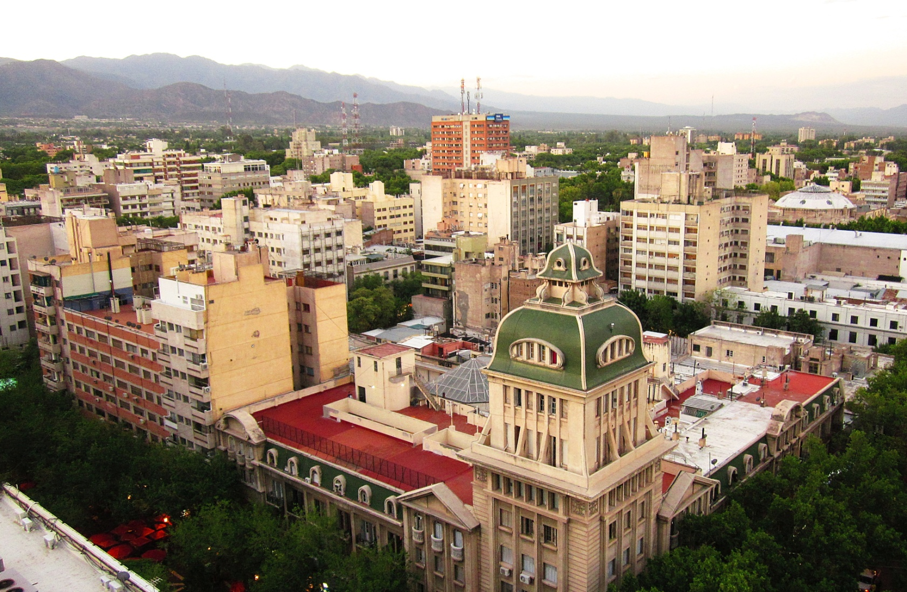
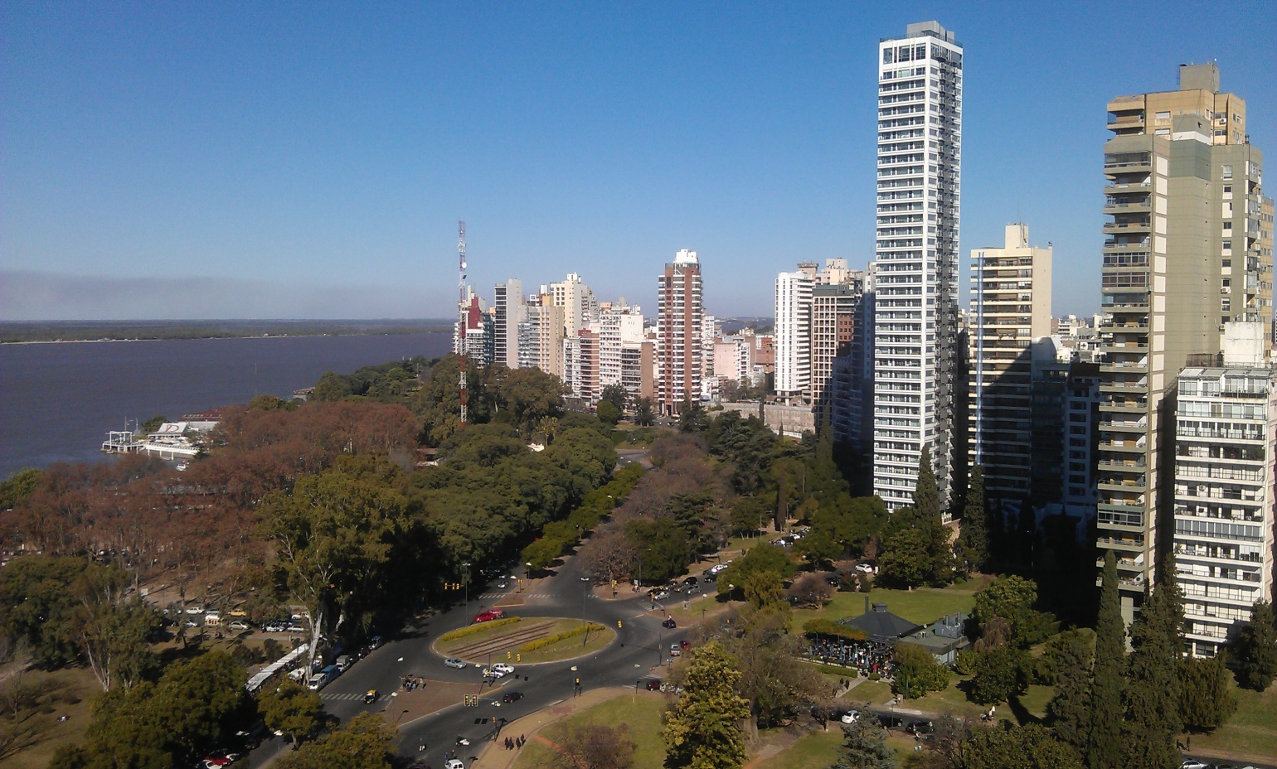
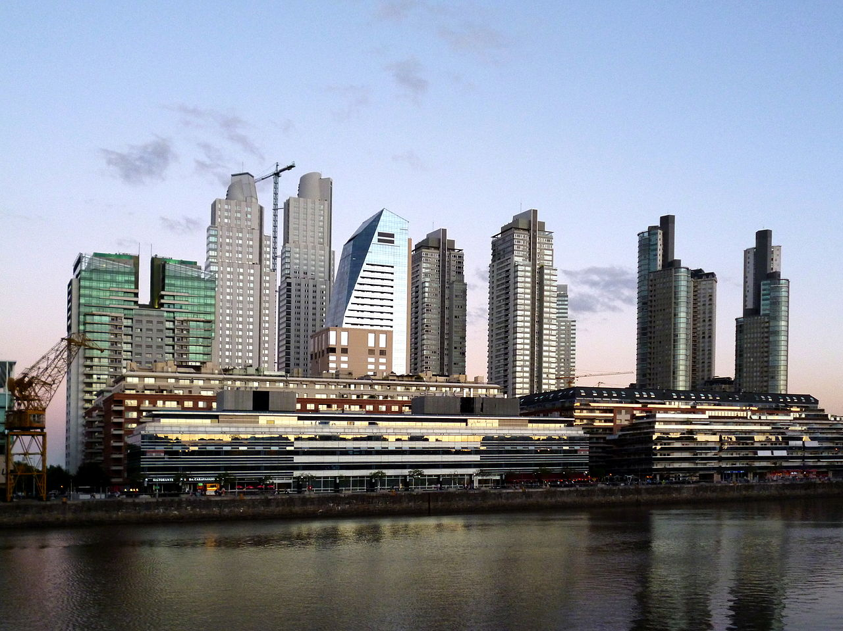
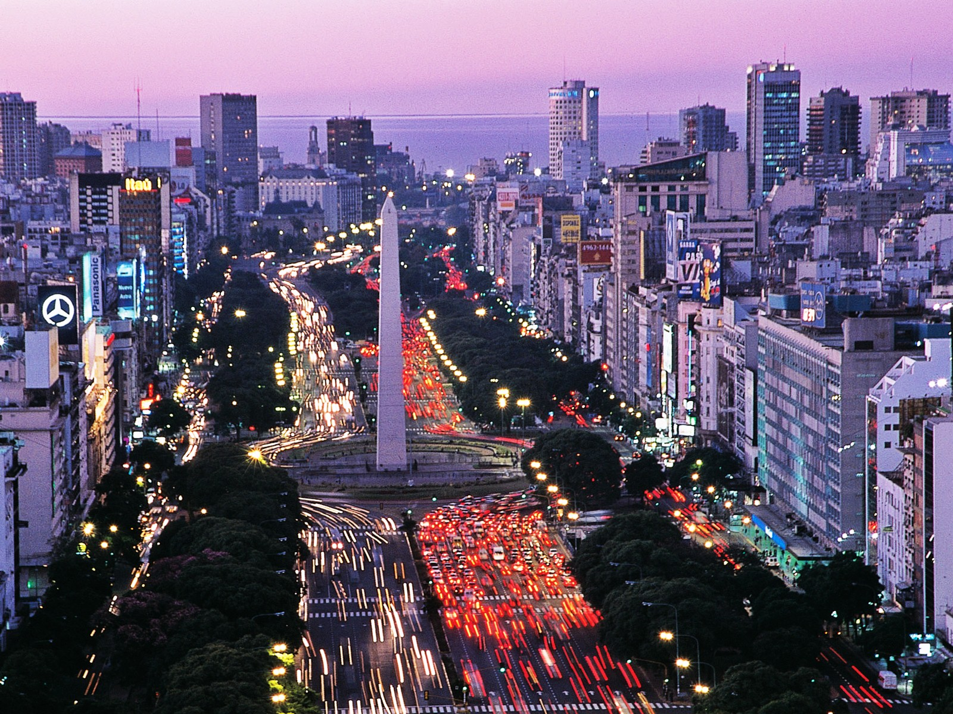
Cities
The capital city is Buenos Aires (2,890,151 inhabitants)
Other large cities are: - Córdoba (1,372,000 inhabitants)
- Rosario (1,242,000 inhabitants)
- Mendoza (885,434 inhabitants)

