Slide 1
The House of Tudor
Krebsová Andrea

Slide 2
Who were they?
English Royal house
Welsh origin
1485-1603 - ruled the Kingdom of England, ancestral Wales, Lordship of Ireland
Successors of the House of Plantagenets
Succeeded by the House of Stuart
The 1st king – Henry VII (Jindřich VII.)
The last monarch – Elizabeth I (Alžběta I.)

Slide 3
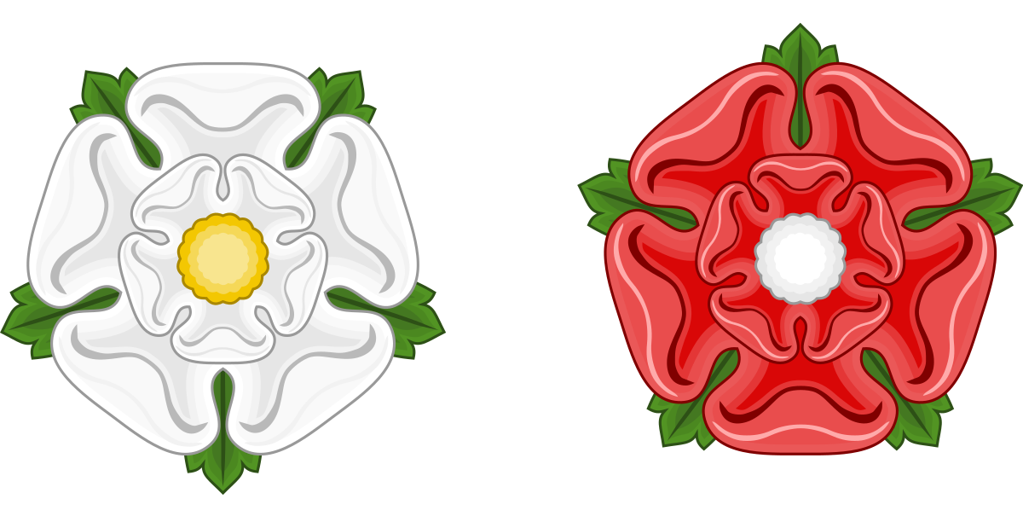
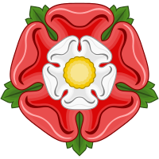
Tudor Rose
The War of Roses – Lancasters x Yorks – Henry VI (Lancaster) won against Richard III (York)
Lancaster (red)
York (White)
Houses unified – marriage of Henry VII with Elizabeth of York

Slide 4
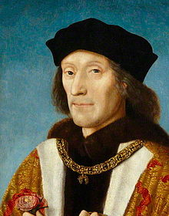
Henry VII (Jindřich VII.)
The first ruler
Married to Elizabeth of York – 4 children, 2 survived
Married his son Arthur to Catherine of Aragon (Kateřina Aragonská), Henry VIII married her after his death
Peace with France in 1492
England poor = concerned about the funds in the royal treasury = strict monetary strategy
Strenghtened the judicial system

Slide 5
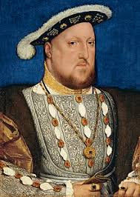
Henry VIII (Jindřich VIII)
Married to Catherine of Aragon
Young – gentle in debate, generous
Old – cruel, volatile and obese
Desperate for a son – executing of wives
6 wives, 2 executed

Slide 6
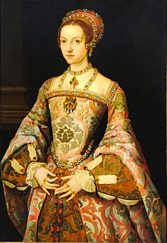
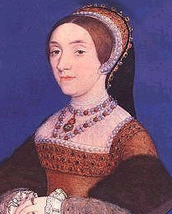
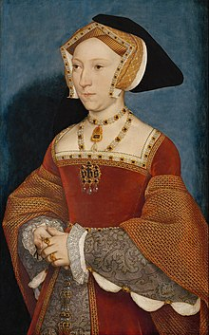
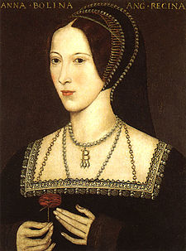
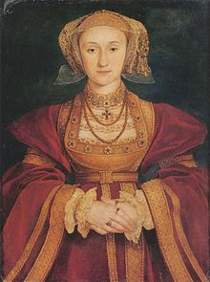
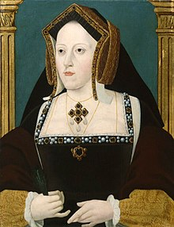
The wives of Henry VIII
Catherine of Aragon
Anne Boleyn
Jane Seymour
Anne of Cleves
Catherine Howard
Catherine Parr

Slide 7
Catherine of Aragon – Daughter Mary I., annulment of the marriage
Anne Boleyn – Daughter Elizabeth I., claimed of having a lot of lovers – beheaded
Jane Seymour – Son Edward VI
Anne of Cleves (Anna Klevská) – Alliance with Protestant German states
Catherine Howard – Persuaded H. to restore Catholic religion, Henry was boring to her = cheating on him = beheaded
Catherine Parr – the last wife of Henry

Slide 8
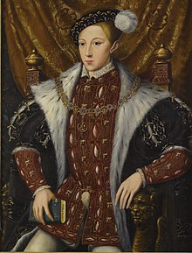
Edward VI (Eduard VI.)
Economical problems
Military attacks from the Scotts
Church of England = protestand organisation

Slide 9
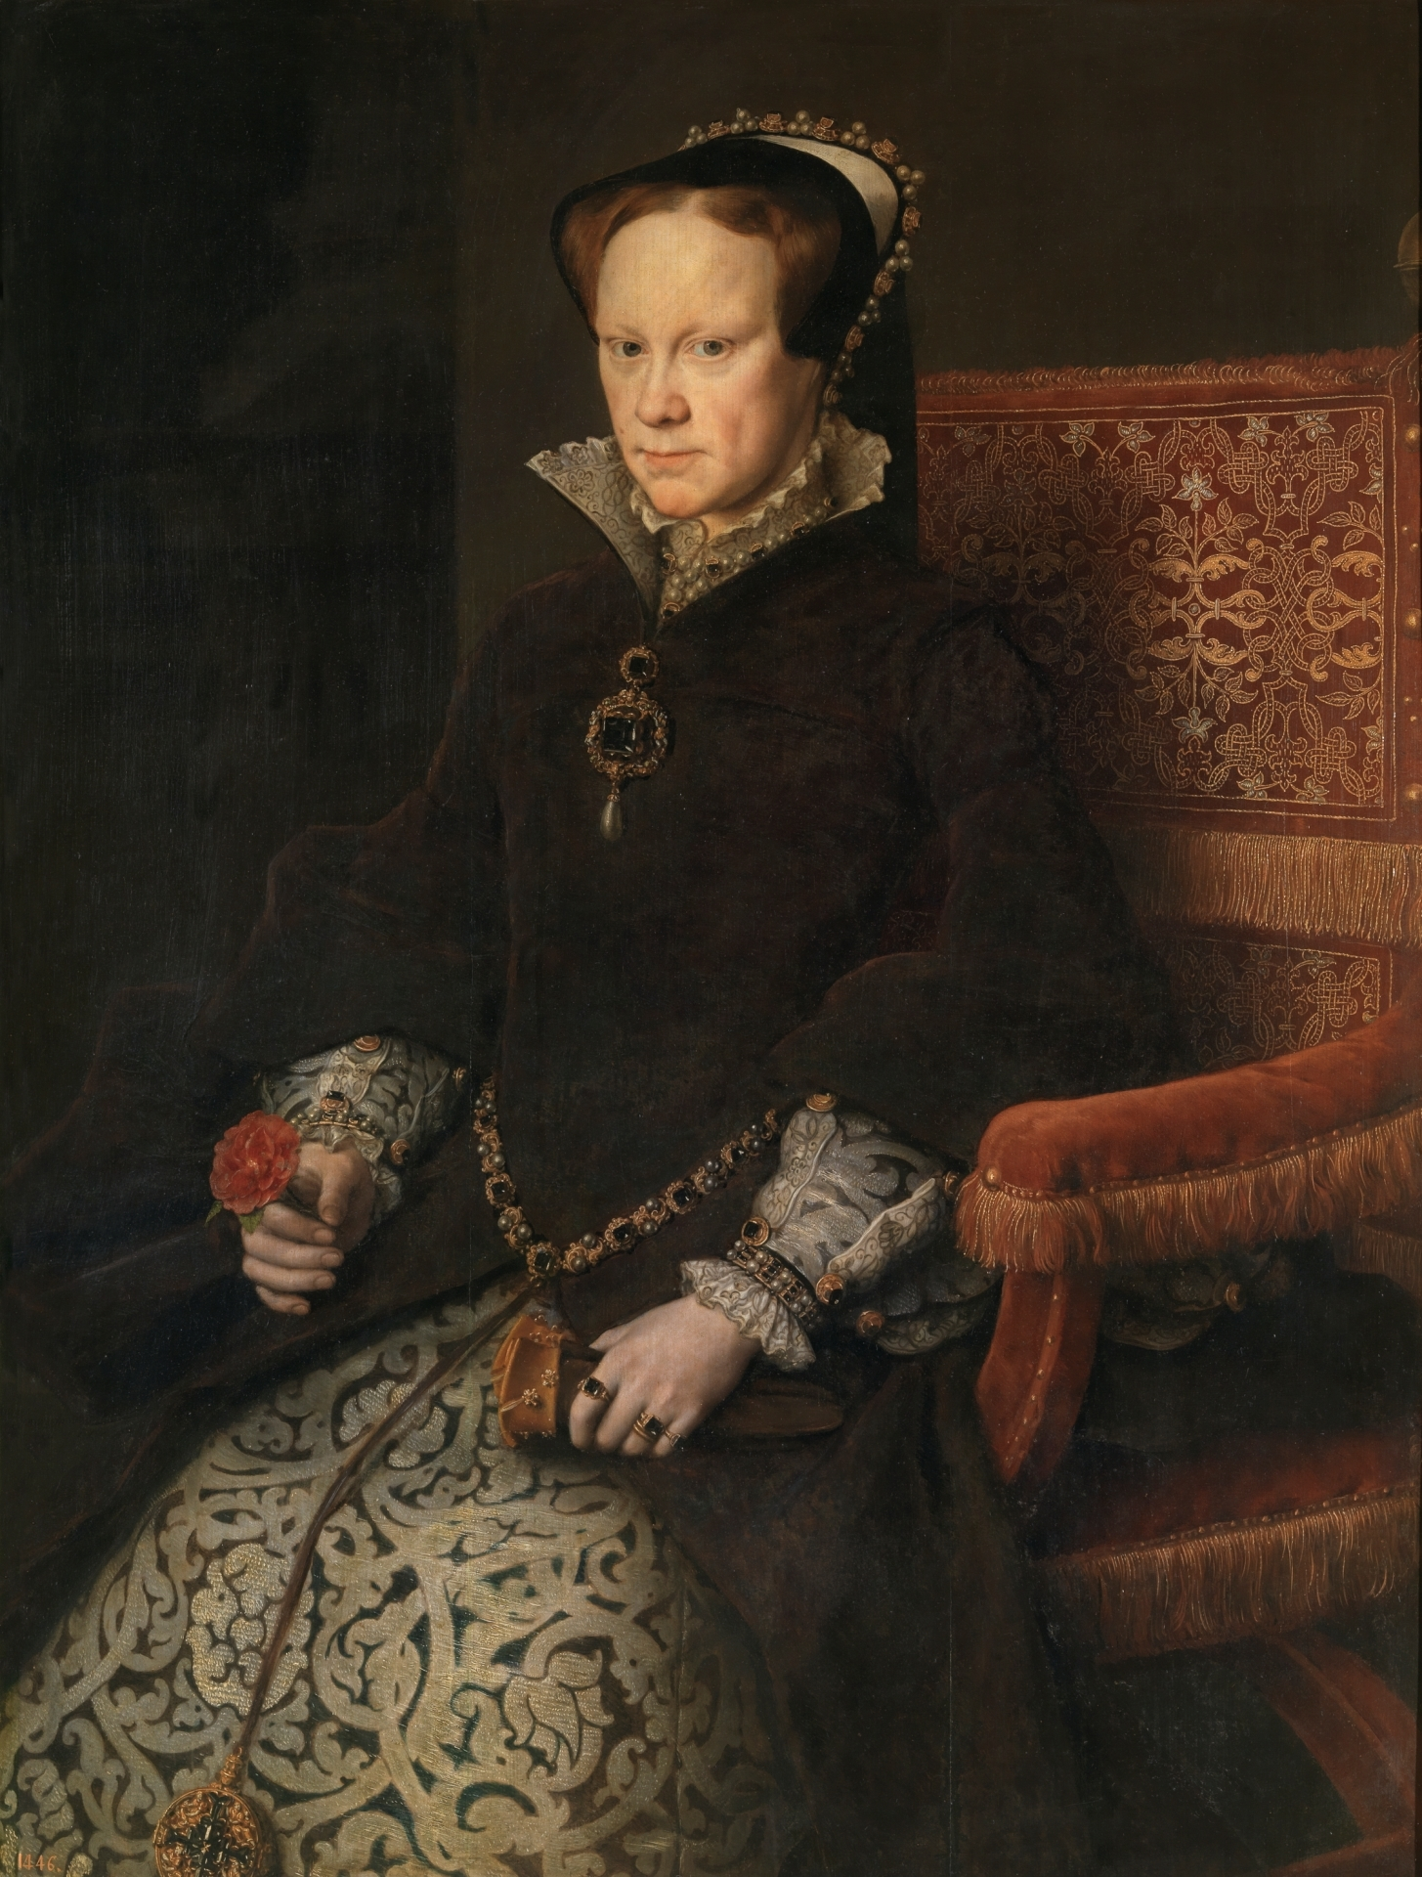
Mary I (Marie I.)
Wanted to marry Spanish prince Philip
Thomas Wyat – leader of the Protestants that wanted to replace her with Elizabeth I. (imprisoned for 2 months in Tower)
She could not get pregnant – worried about the dynasty – became bitter, cruel
Restoring Catholic faith – 200-300 Protestants burnt at the stake = Bloody Mary

Slide 10
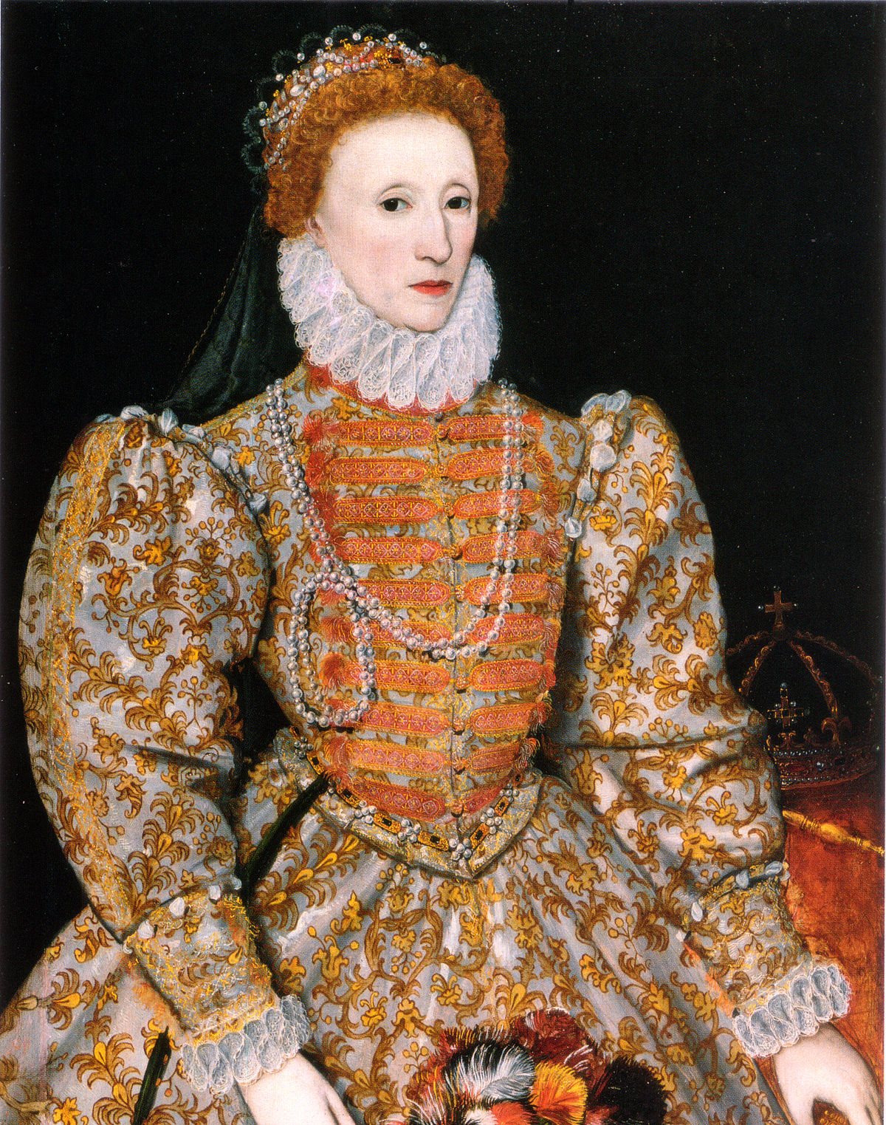
Elizabeth I (Alžběta I.)
Supporting Protestants – imprisoned
Never been married – without children (Virgin Queen)
Colony of Virginia (east coast of USA)
Secretly supported pirates (sir Francis Drake)
Refused Philip as her husband – able to fight against the Spanish herself

Slide 11
Inspired: The Tudors - TV Show

Slide 12
Sources:
https://cs.wikipedia.org/wiki/Marie_I._Tudorovna
https://cs.wikipedia.org/wiki/Al%C5%BEb%C4%9Bta_I.
https://cs.wikipedia.org/wiki/Tudorovci
https://en.wikipedia.org/wiki/House_of_Tudor

