Slide 1
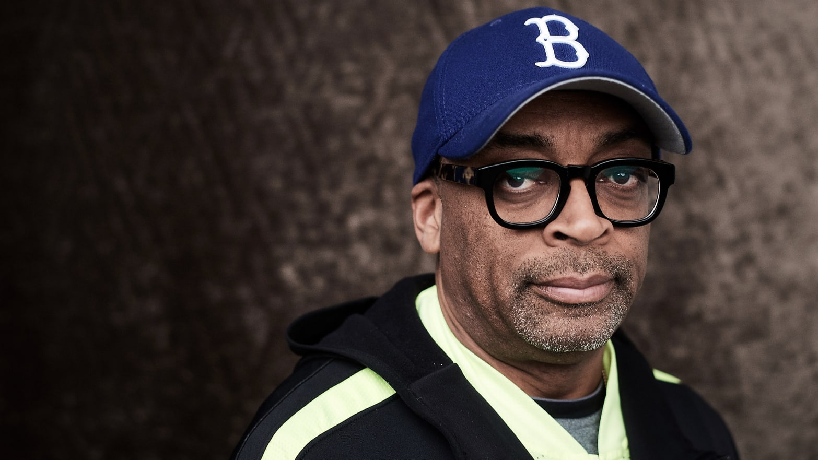
Spike Lee (* March 20, 1957)

Slide 2
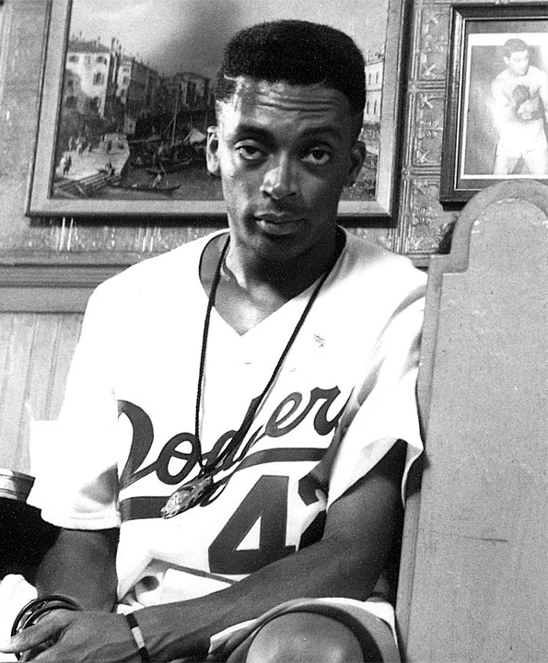
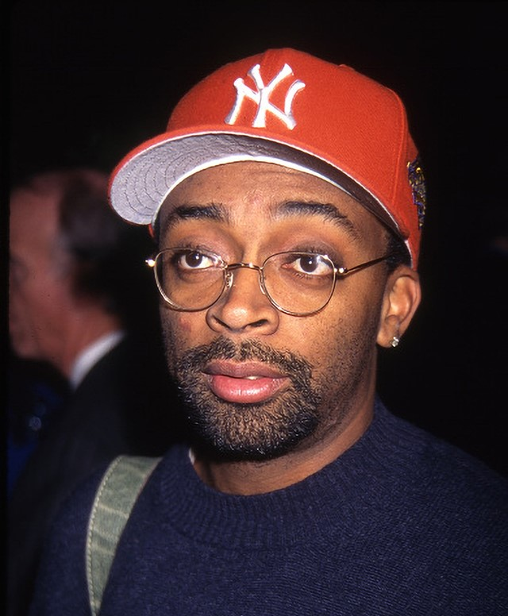
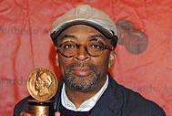
Who is Spike lee?
His real name is Shelton Jackson Lee (the nickname "Spike" was given to him by his mother)
He is a film director, actor, screenwriter and producer.
He was born in Atlanta, Georgia, but during his childhood the family moved to Brooklyn, New York, which is often shown in his works.
During his studies at the University he made his first film - LAST HUSTLE IN NEW YORK.
After graduating, he continued at New York University of Art (Film), which he graduated in 1982.

Slide 3
His most important films
He made his directorial debut with She's Gotta Have It (1986).
He has written and directed such films as: -The Right Thing (1989),
-Malcolm X (1992),
-He Got Game (1998),
-The Original Kings of Comedy (2000),
-Inside Man (2006),
-BlacKkKlansman (2018).
Lee also took starring roles in his films.
He is also a quality documentary filmmaker. The Oscar nomination was awarded to his 4 Little Girls.

Slide 4
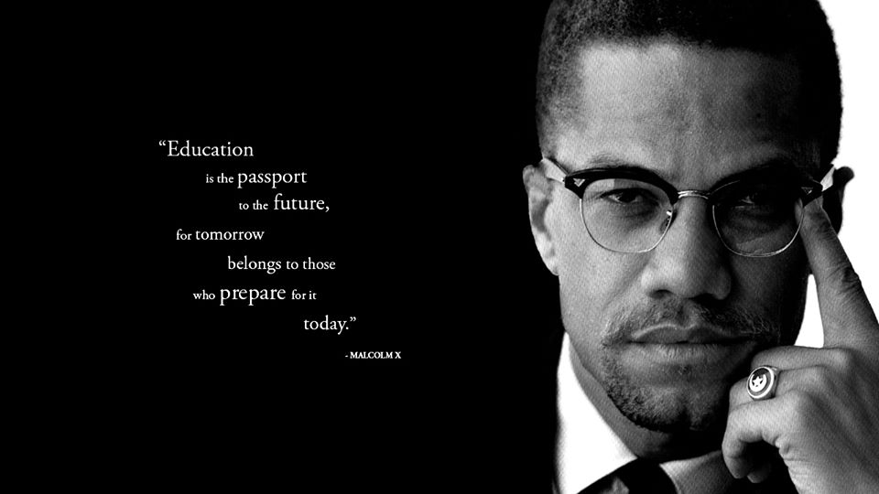
Biographical drama - Malcolm X
It is about the life story of Malcolm X, a black leader and spokesman for the Nation of Islam, who publicly expressed the dissatisfaction of African Americans with their character in society in the 1960s that US blacks are not Americans
Lee took the lead role of Denzel Washington, who was nominated for an Oscar for his role
movie trailer: https://www.youtube.com/watch?v=sx4sEvhYeVE

Slide 5
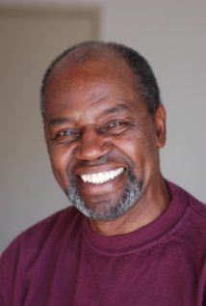
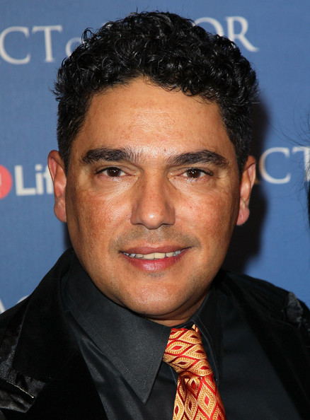
Main Characters
Denzel Washington
Albert Hall
Nicholas Turttulo
Angela Bassett

Slide 6
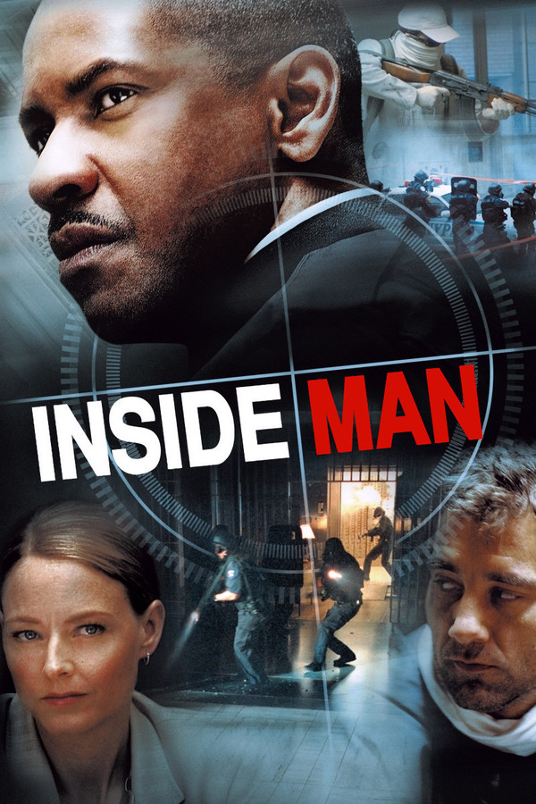
Thriller - Inside man
This movie is one of my favorites.
New York detective Keith Miller is a typical harsh cop whose career advancement is hampered by allegations of illegal conduct. There's a new case with an ambush bank and dozens of hostages. Miller must stand up to the terrible criminal he has met in his career. When the bargaining between the police and the cold-blooded killer gets sharp, an influential lawyer appears. Again, the situation is a little more complicated. Detective Miller is increasingly realizing that it is not possible to pinpoint the sides of good and evil. At first glance, perfect crime can actually be even more perfect.
The film's main characters are: Denzel Washington, Clive Owen, Jodie Foster, Christopher Plummer, Willem Dafoe
It's a thriller with an intelligent screenplay, likable characters and an unexpected end, and that's why I was intrigued by this film.
Spike Lee doesn't needs no action to evoke the atmosphere, all he needs is the detached view and cleverness of his heroes.
movie trailer: https://www.youtube.com/watch?v=44v8NhVEL5A

Slide 7
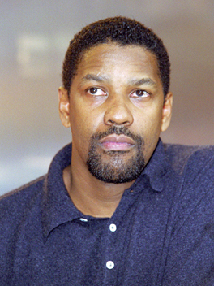
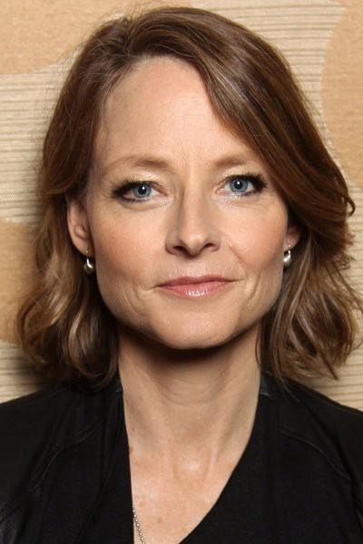
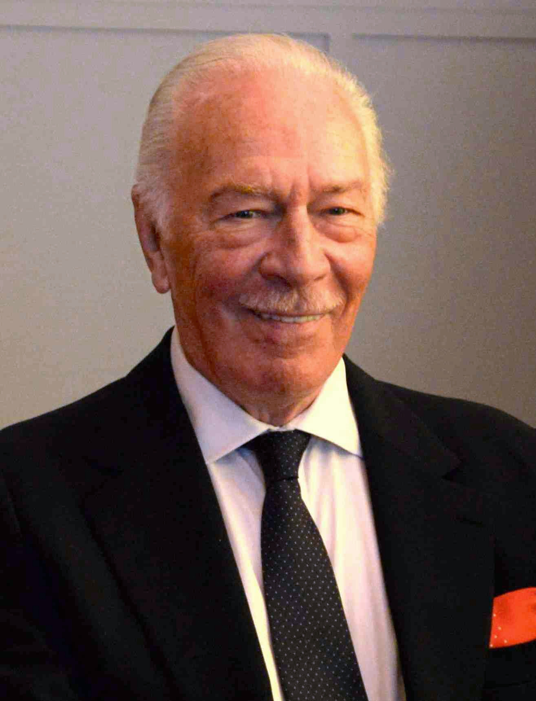
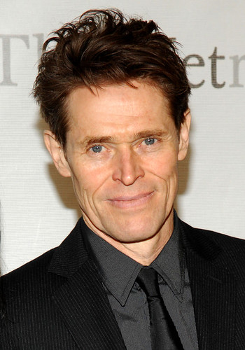
Main characters
Denzel Washington
Clive Owen
Jodie Foster
Christopher Plummer
Willem Dafoe

Slide 8
Thank you for your attention

