Slide 1
Diary of a Wimpy kid
By: Martin Boubín 4.AO

Slide 2
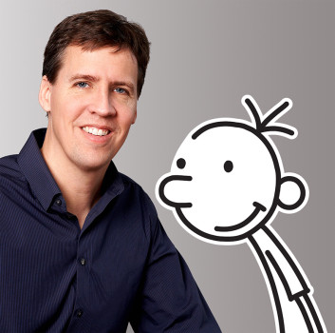
Jeff Kinney
Full name is Jeffrey Patrick Kinney
Born in February 19, 1971
He is an American author and cartoonist for the children‘s book series Diary of a Wimpy Kid.
Jeff with his book hero named “Greg“.
Can you guess who is who?

Slide 3
How it all started
It all started in college in the early 90‘s where he created a comic strip named „Igdoof“ which ran in the newspaper and was very popular.
Then he brought up the idea of a middle-school boy named „Greg Heffley“ who writes and draws about his personal life.
He worked on his book for almost eight years before showing it to a publisher in NY.

Slide 4
How it all started pt. 2
In February 2006, he signed a multi-book deal with publisher Harry N. Abrams, Inc. To turn the Diary of a Wimpy Kid into a print series.
The book became an instant worldwide hit.
To today, there have been eighteen Wimpy Kid Books released, including 2 Do-It-Yourself Books and 2 Movies based on the book.

Slide 5
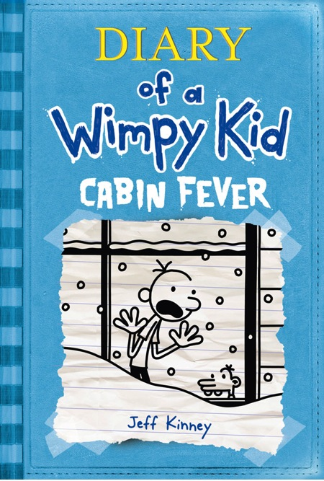
Some of the books
The red one is the first one and it‘s also a special one and as you can see, the whole presentation is based on the colours from the cover.

Slide 6
Main Characters
Greg Heffley (12) –main character, middle-school boy who writes and draws the stories about his life
Rodrick Heffley (19) – „singer“ and Greg‘s older brother (he really loves doing something bad to him)
Manny Heffley (3) – Greg‘s and Rodrick‘s brother, youngest member of the family, he can do whatever he wants to, because he is so small and obviously young
Susan Heffley (40) – their mother
Frank Heffley (40) – their father
Rowley Jefferson (12) – Greg‘s best friend and schoolmate
There is much more characters, but they are waiting for you in the books to be discovered….

Slide 7
Content of the book
The book doesn‘t have one story line.
It containts a lot of stories, but the main plot is, that Greg wants to be popular at his school, so he is trying a lot of ways to become him, but unfortunately his best friend Rowley became popular, even if he doesn‘t want to.
In this first book we get to know all the main characters, his school, schoolmates, friends and his whole family.

Slide 8
Content of the book
In these stories, we can clearly see that Greg has to deal with his younger and older brother.
Then he is forced by his mom to perform in the schoolplay based on The Wizard Of Oz, where he got the role of the tree.
Another story is, where Greg decides to play a game with Rowley, where Rowley must ride a bike while Greg tries to knock him off with a football. Unfortunetelly the ball gets under the front wheel, which causes Rowley to fall off and break his arm.
Also, there is a funny story from Halloween, when they got chased by older boys with pick-up truck, because they splashed them with water.
This and a lot of other really funny stories you can find in this book!

Slide 9
My opinion
My opinion is, that i would highly recommend you this book, even if it seems that it‘s for the kids, the humor is extraordinary, so age doesn‘t matter!
This is the best book you can read, when you are on the college, have a younger or older brother and know the struggle with it or if you are just bored.
I personally own 10 books, so i know what I‘am talking about.
It will really help you to go to other thoughts. Try it!

Slide 10
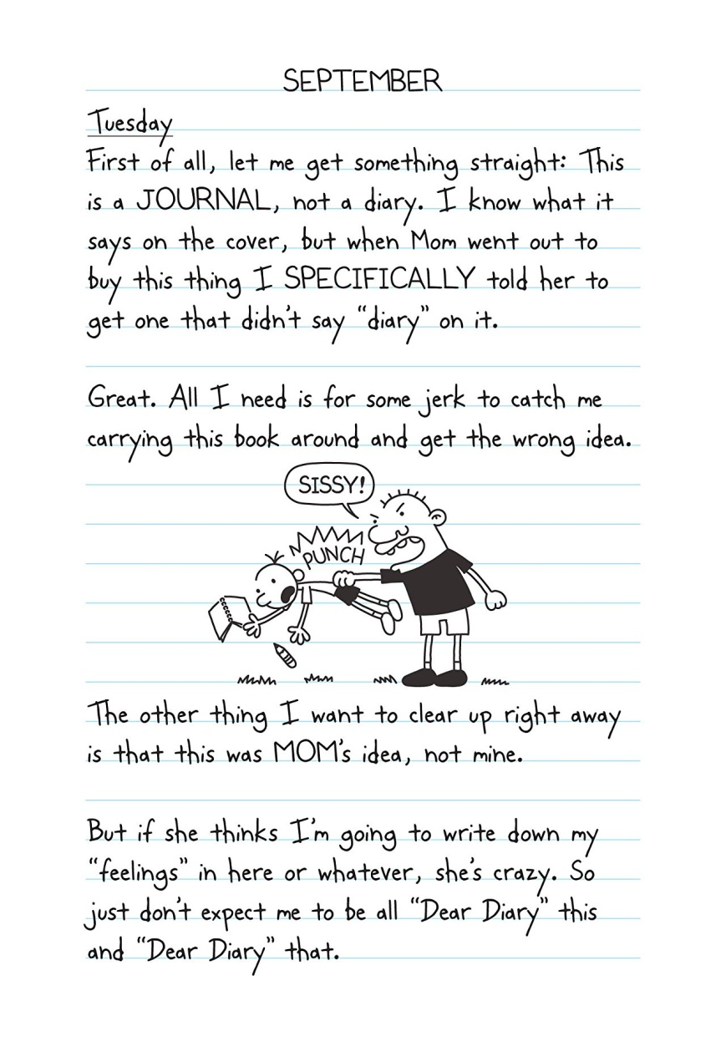
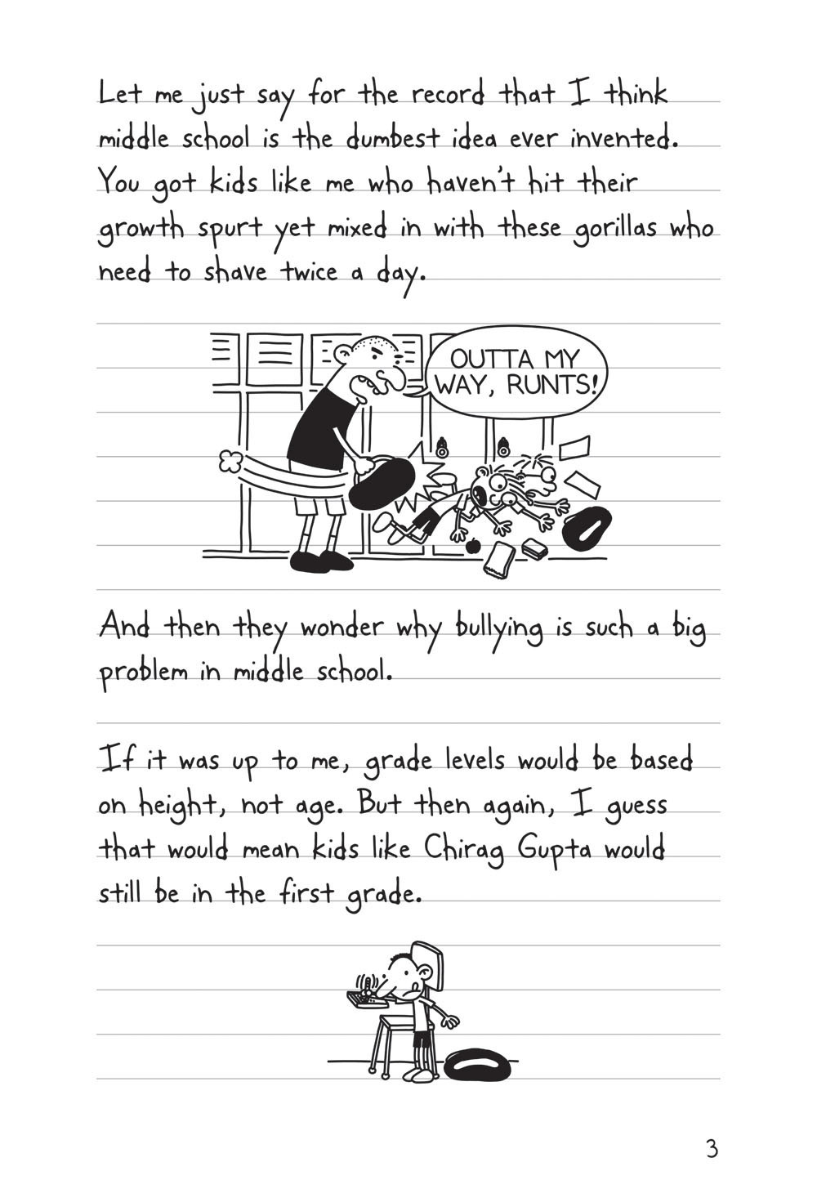
Preview

Slide 11
New Words
Reevaluate – Přehodnotit
Veto (vetoed) – Zakázat
Clerk – Úředník
Racket – Rámus (v knize myšleno jako podvod)
Sermon - Kázání

Slide 12
Resources
https://en.wikipedia.org/wiki/Jeff_Kinney
https://en.wikipedia.org/wiki/Diary_of_a_Wimpy_Kid
The book

Slide 13
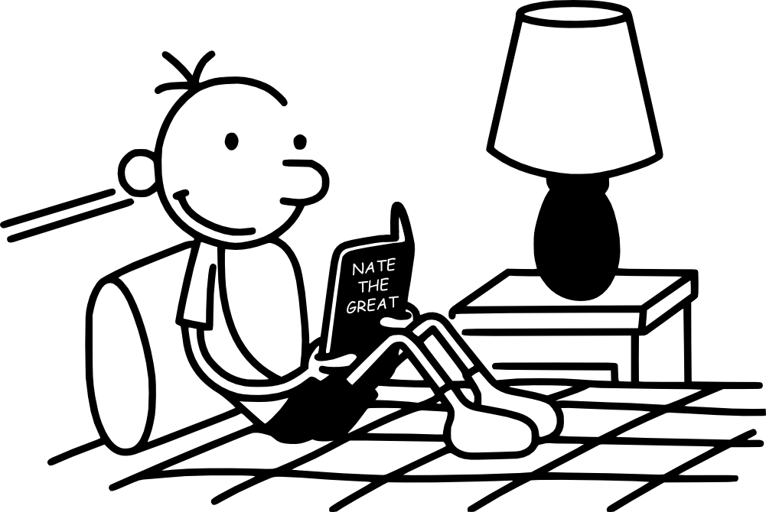
THE END

