Slide 1
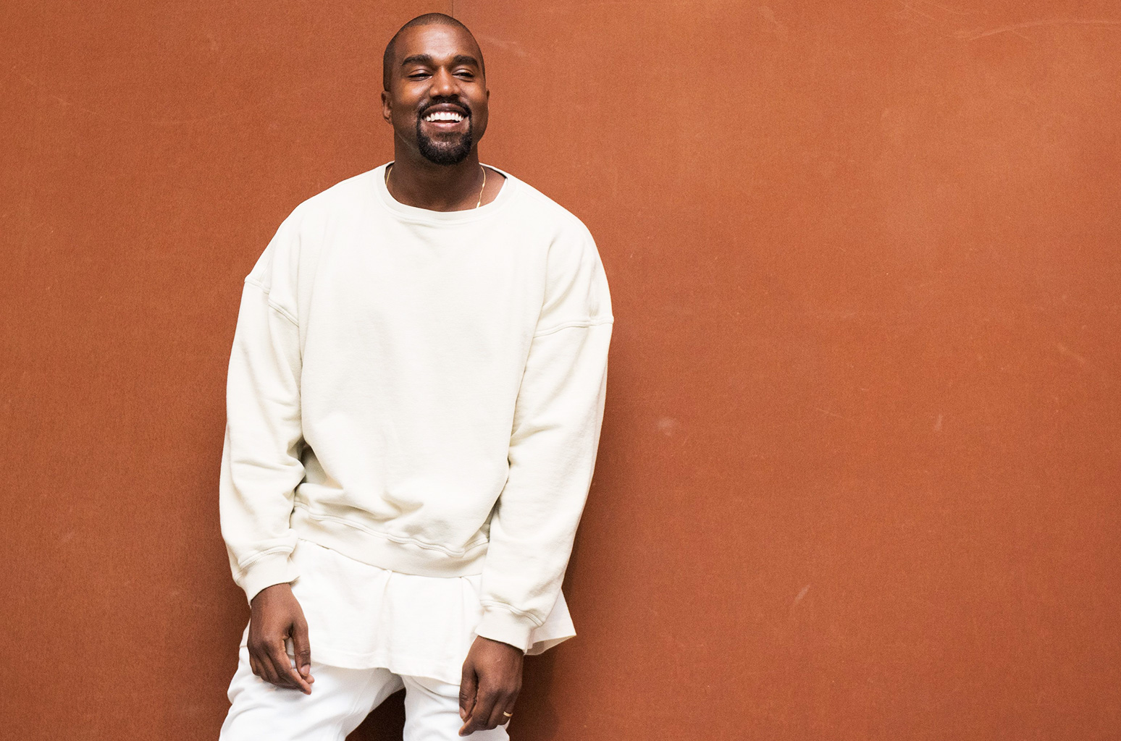
Kanye West
By: Martin Boubín

Slide 2
The Beginning
Born In 8, 1977 in Atlanta
Parents divorced when he was 3 years old
He moved to Chicago with his mother (teacher)

Slide 3
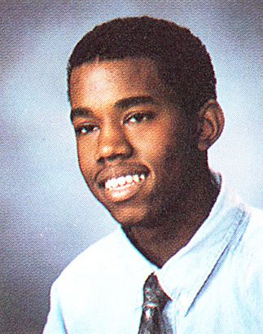
The College Dropout
Had good grades in high school
College at American Academy of Art in Chicago
Enrolled at Chicago State University bud dropped out for music

Slide 4
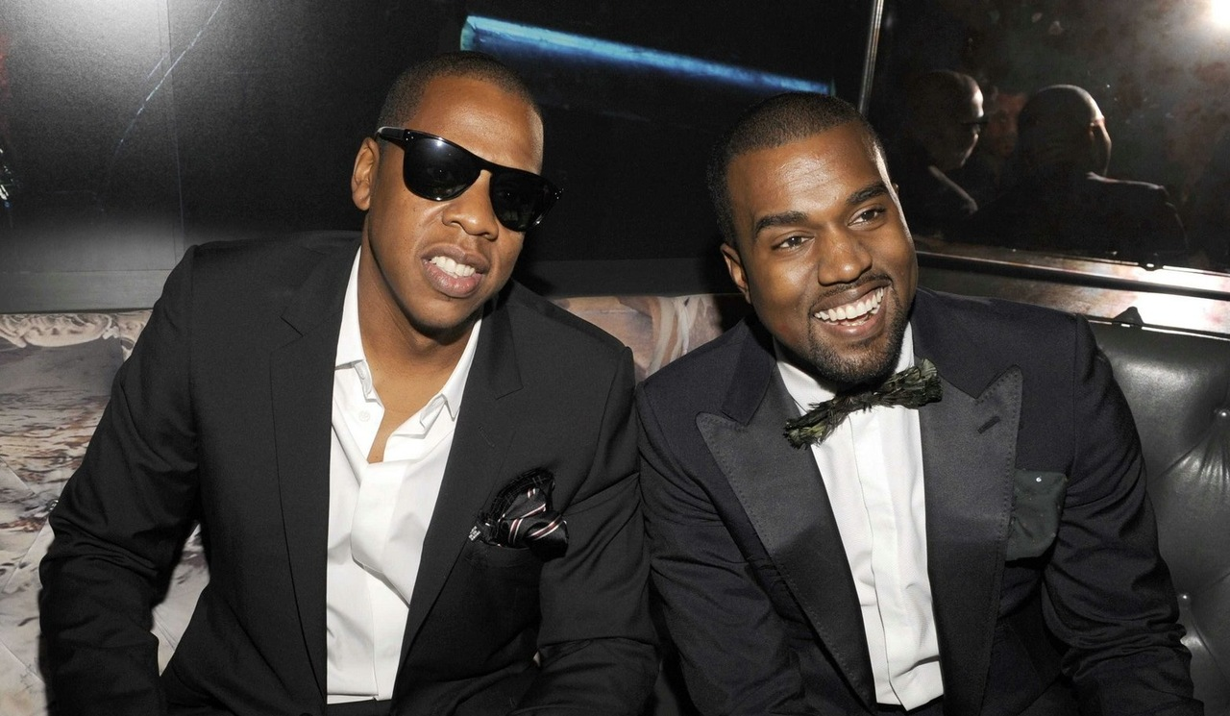
Music
Began producing and making beats for best local artist
Roc-A-Fella Records (debut album released 2004)
Jay Z

Slide 5
Top Albums

Slide 6
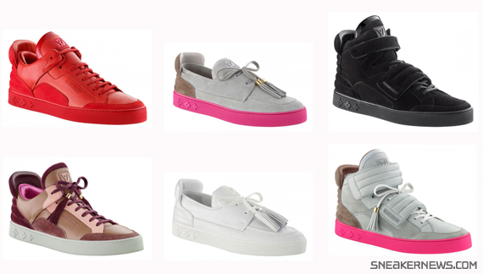
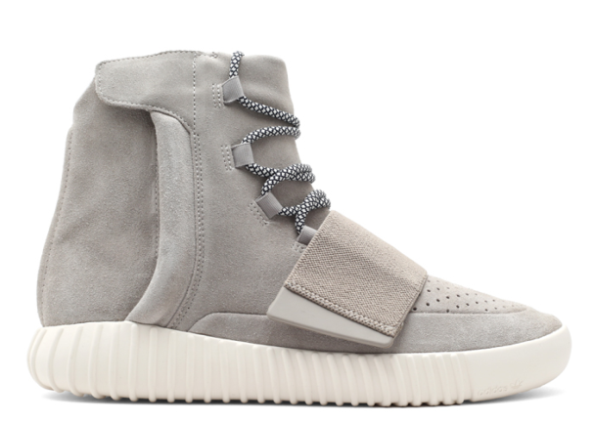
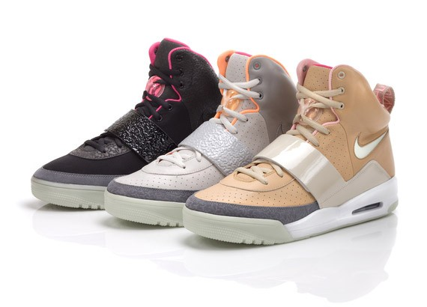
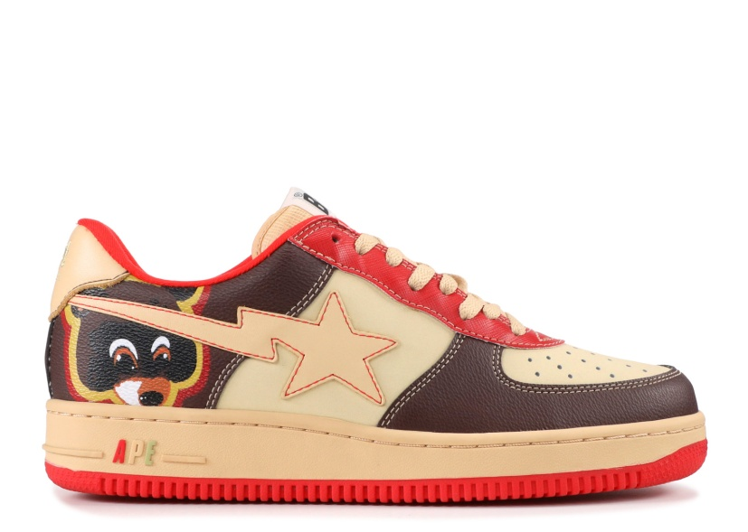
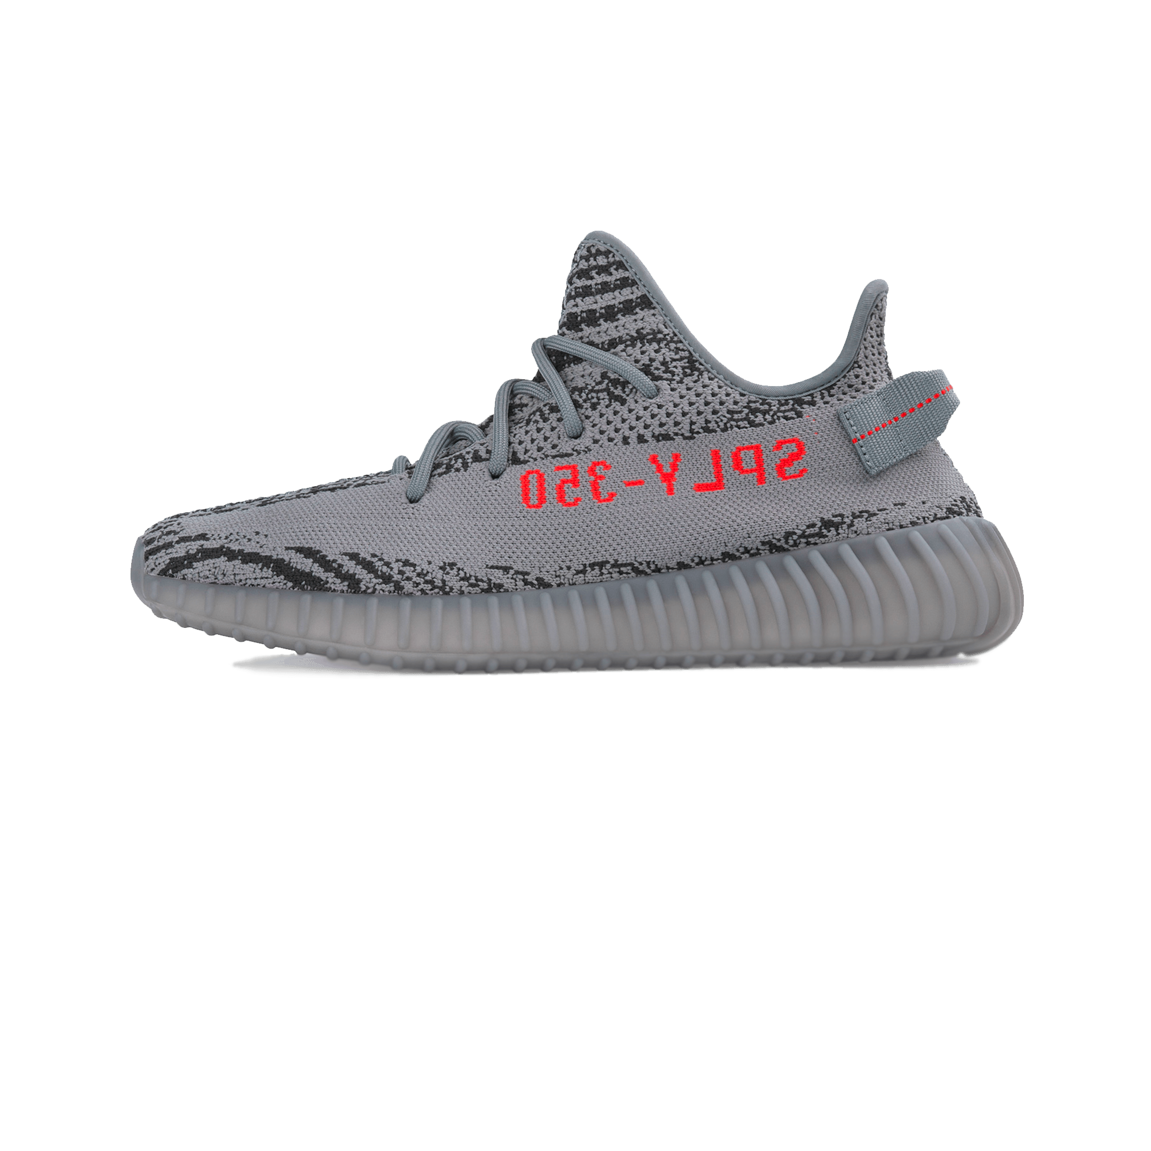
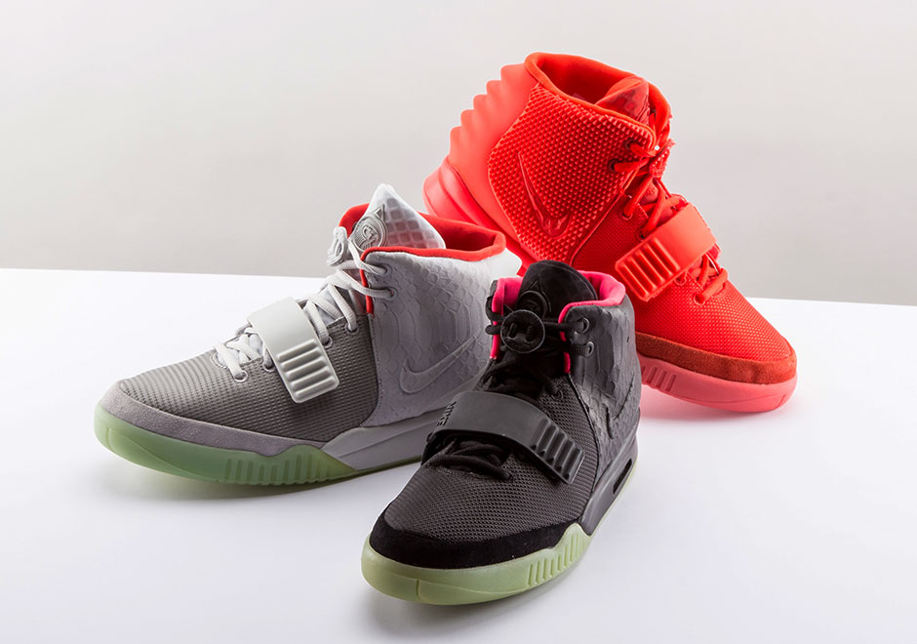
Fashion
Louis Vuitton (2009)
Bape (2007)
Nike (2009)
Adidas (2015)

Slide 7
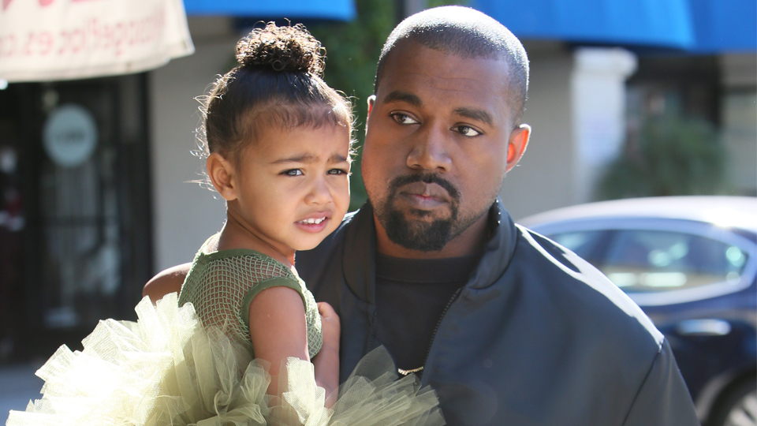
Family
Married with Kim Kardashian West
3 daughters
North West (5 years old)
Saint West (2 years old)
Chicago West (2 months old)

Slide 8
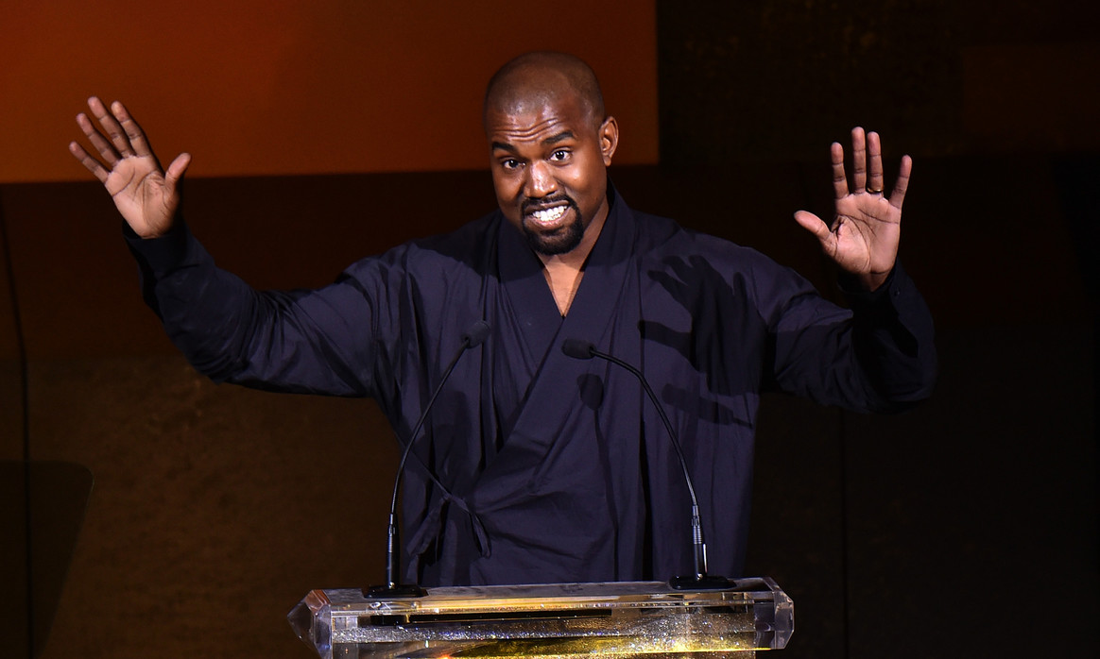
THAT‘S ALL
Thanks for your attention

