Slide 1
Honolulu
Vytvořila: Andrea polnická

Slide 2
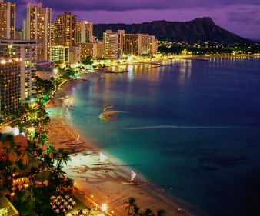
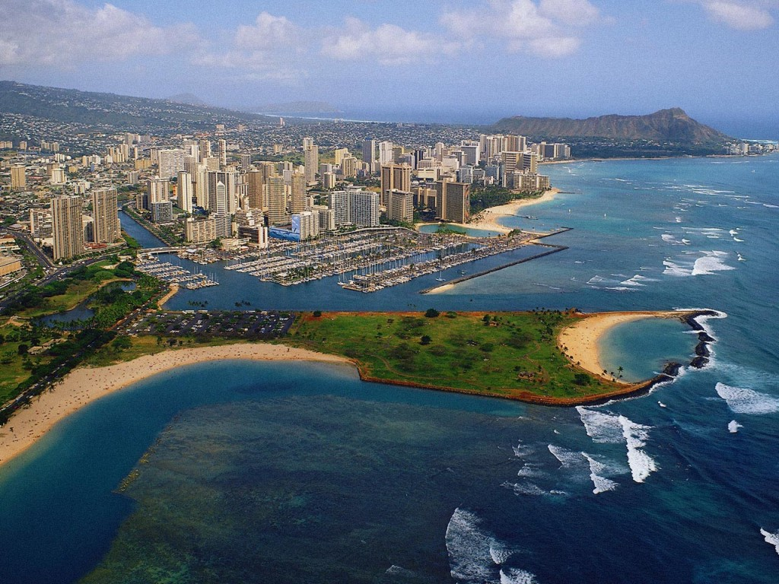
Basics information
capital and largest city of the U.S. state of Hawaii
Population: 377 050 people
Area: 1,540 sq km
Government: Mayor and nine-member city council
Flag: Honolulu does not fly a city flag
Nickname: The Gathering Place
Island Flower: Ilima

Slide 3
Geography
According to the Unitit States Census Bureau
Southern shore of Oahu
one of eight major islands in the state of Hawaii
in the northern Pacific Ocean
most remote major city in the world

Slide 4
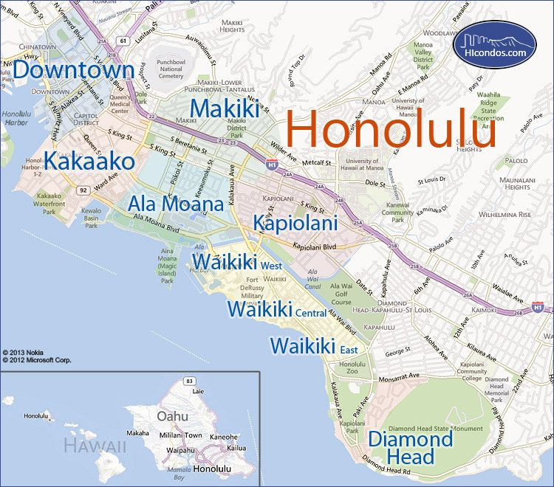

Slide 5
climate
warm and sunny throughout the year
Summer highs range from 29.4–30.6°C
n the winter, daytime highs range from 21.1–23.3°C

Slide 6
Ethnic Composition
24% Caucasian
21% Japanese
17% mixed ancestry, other than part-Hawaiian
16% part-Hawaiian
7% Filipino
6% Chinese
1% pure Hawaiian

Slide 7
History
Founded in 1850, Kamehameha III proclaimed Honolulu the capital city of the independent Kingdom of Hawaii. Under US control, the county of Oahu was established on July 1, 1905. Two years later, it was renamed the city and county of Honolulu.
On August 21, 1959, Hawaii became the fiftieth state of the United States

Slide 8
Sports
no professional sports teams in Hawaii
women's and men's NCAA volleyball
NCAA football Hawaii Bowl
surfing and body board
three large road races

Slide 9
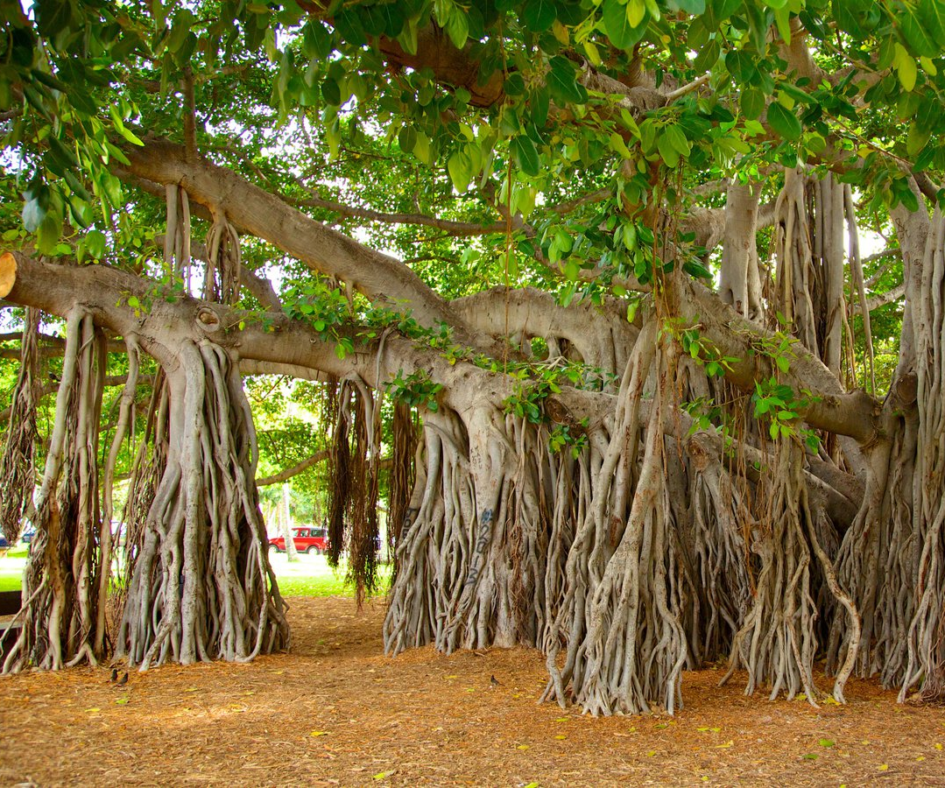
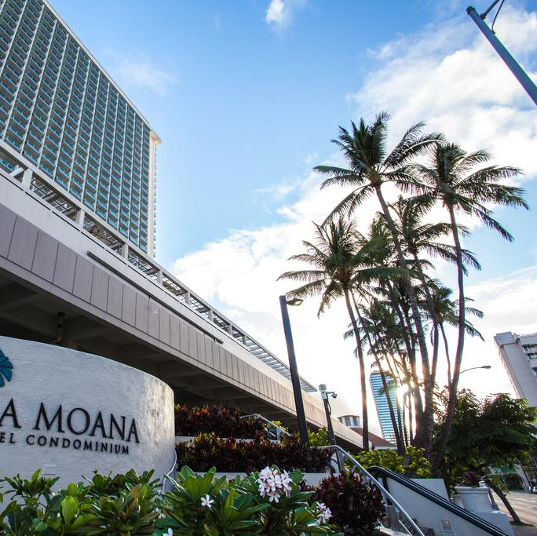
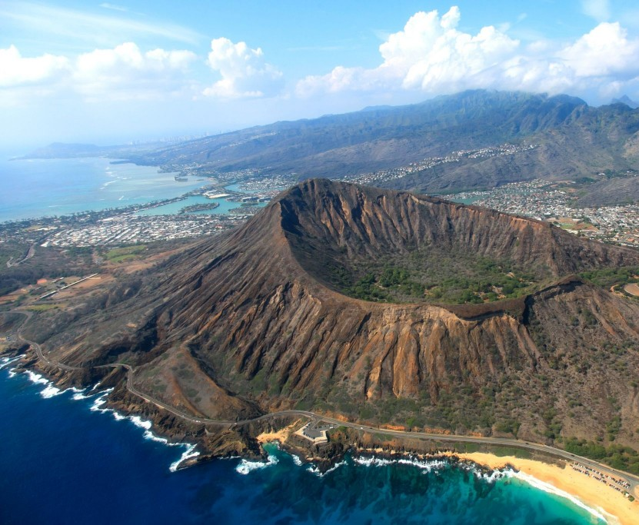
Parks and Recreation
Oahu has more than 60 beach parks
Ala Moana
Kapiolani Park - home to the city's zoo
Diamond Head

Slide 10
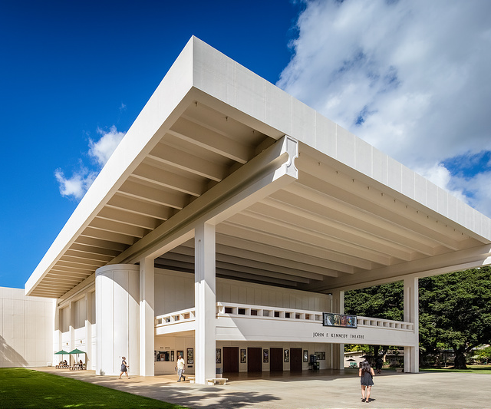
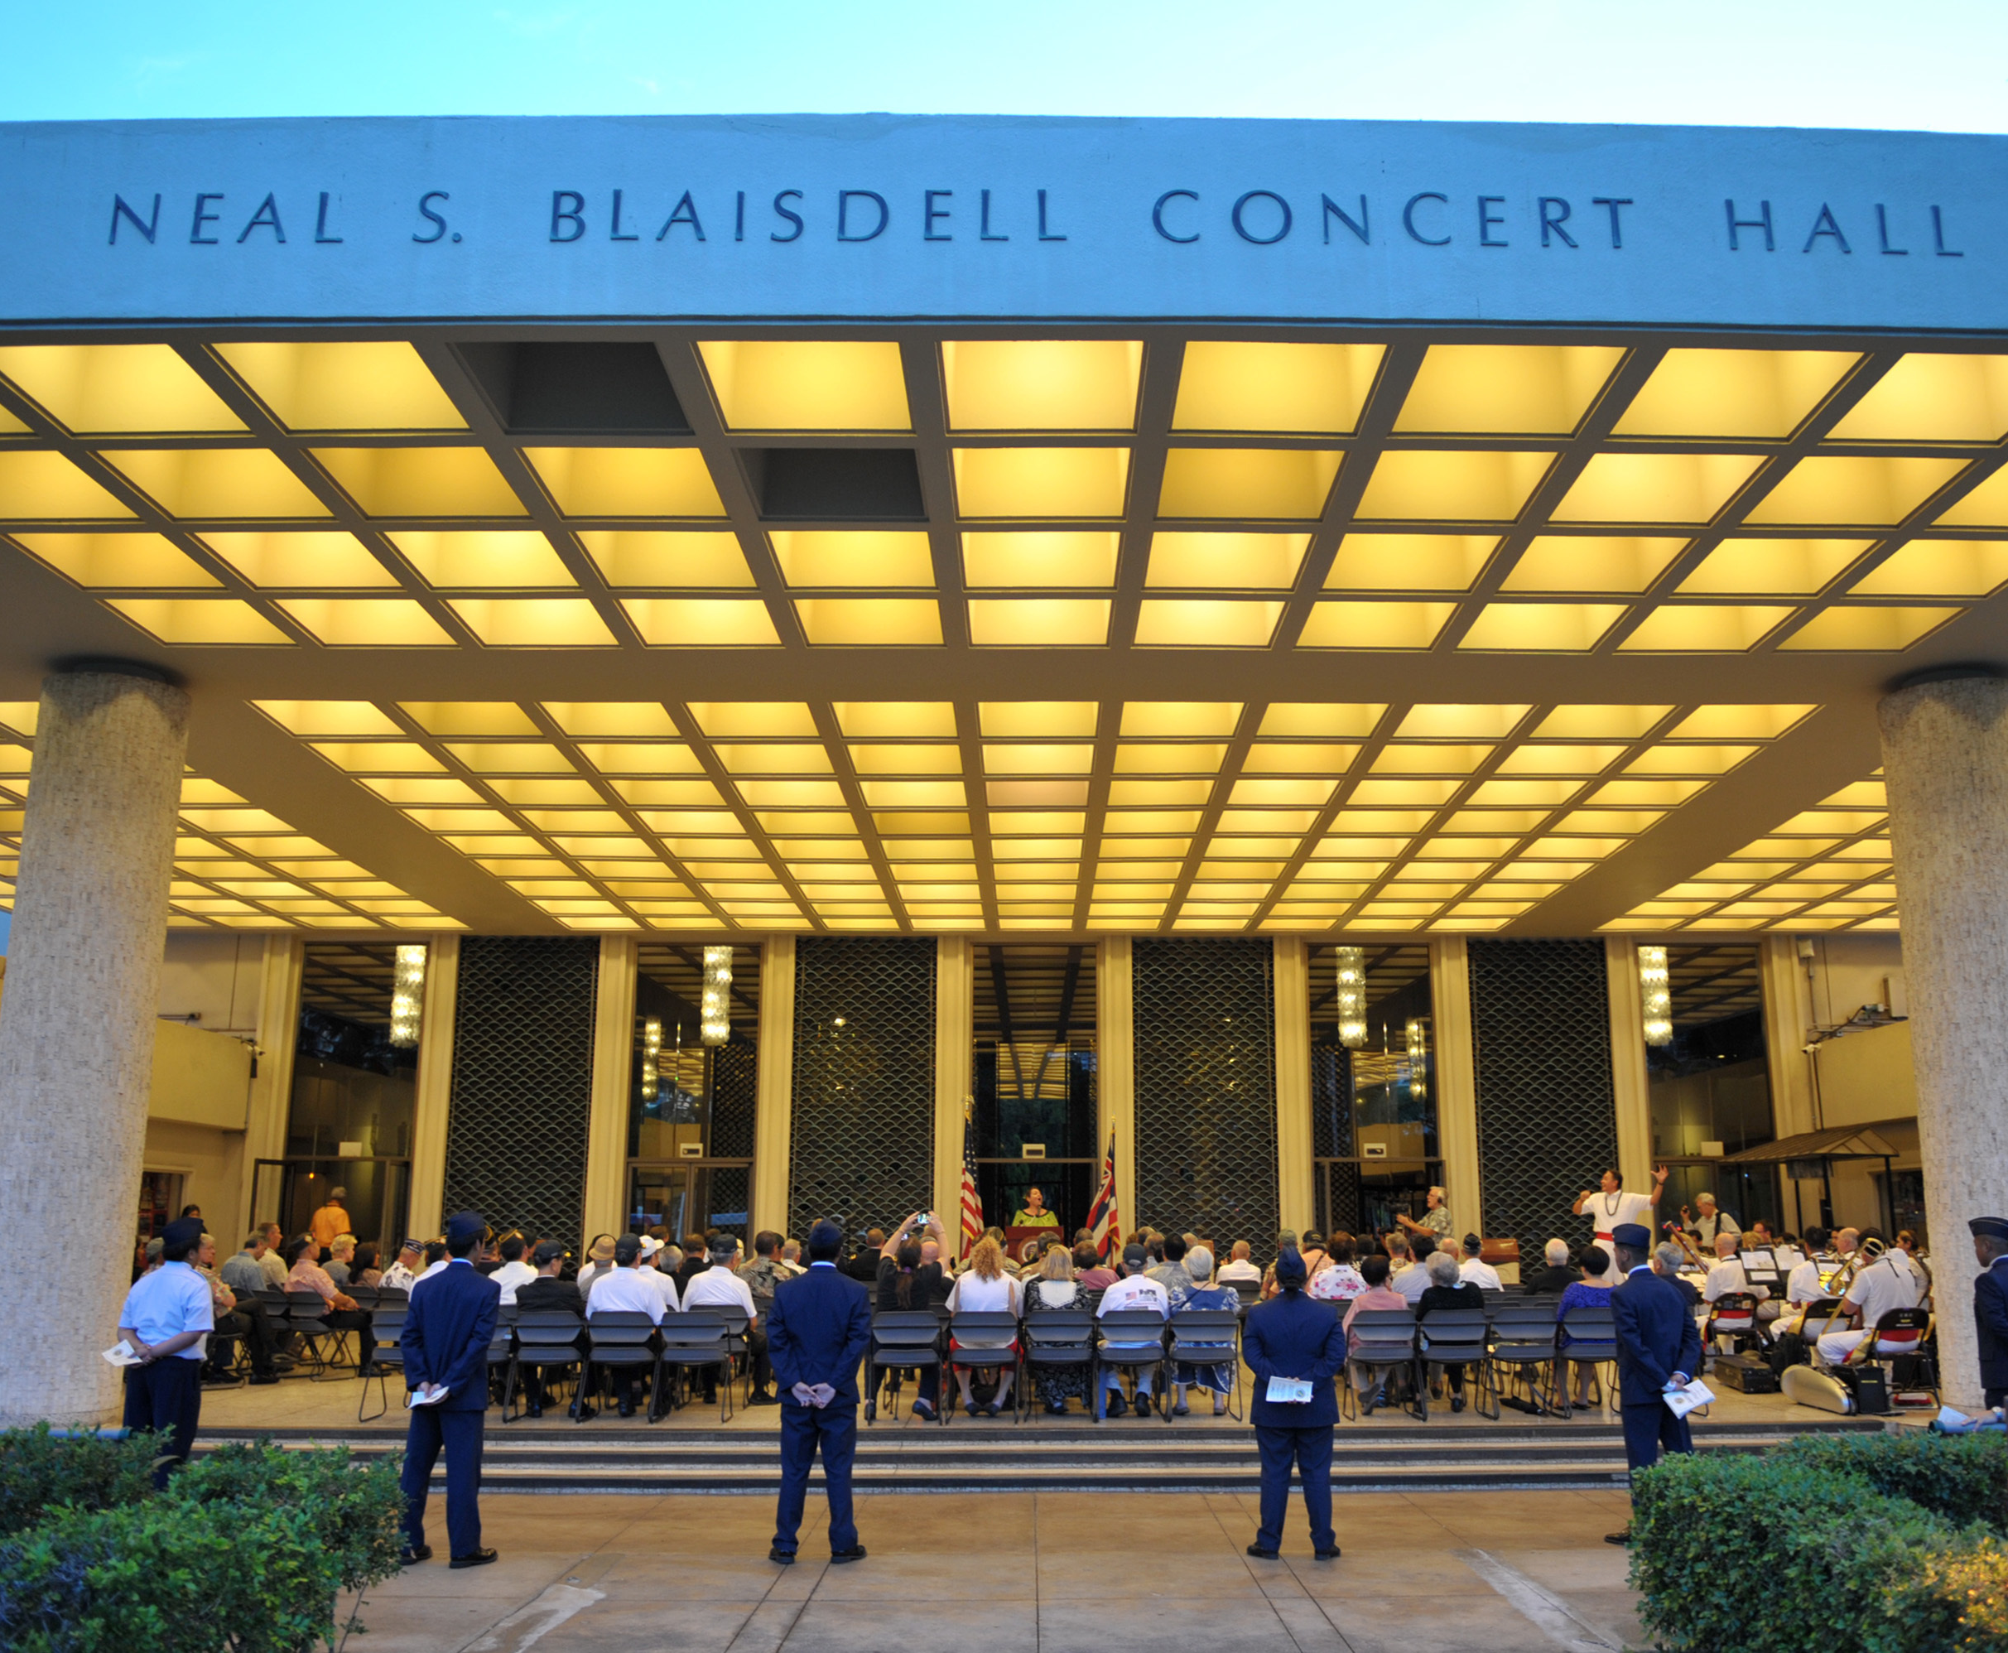
Performing Arts
Diamond Head Theater
Hawaii Theater
John F. Kennedy Theater at the University of Hawaii
Neal S. Blaisdell Center - home to the Honolulu Symphony Orchestra
Royal Hawaiian Band

Slide 11
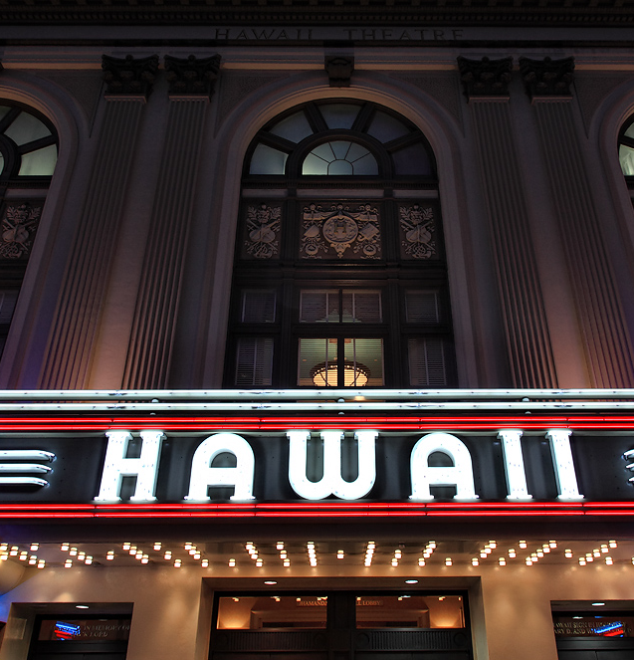
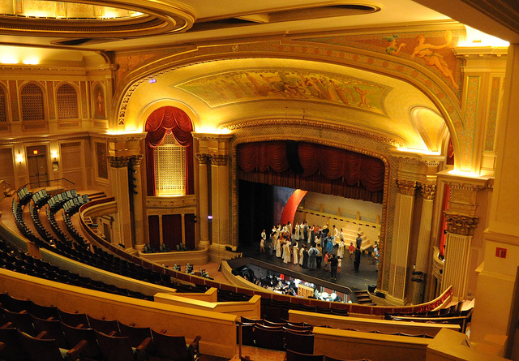
Preforming arts
Hawaii Theater

Slide 12
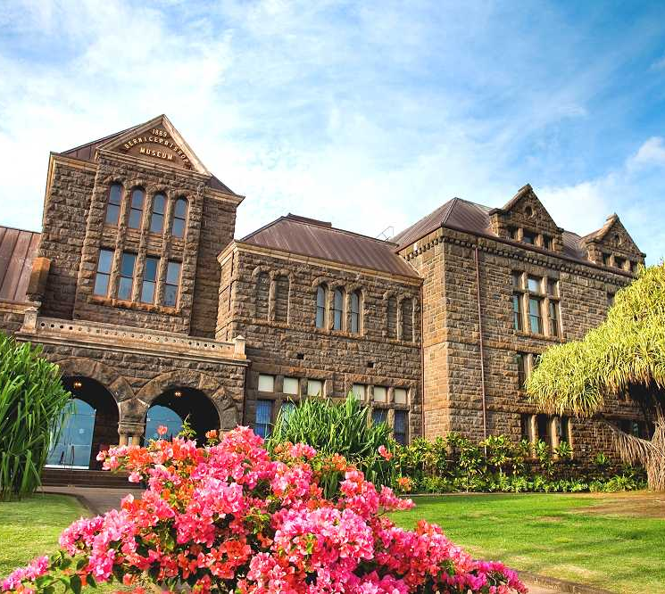
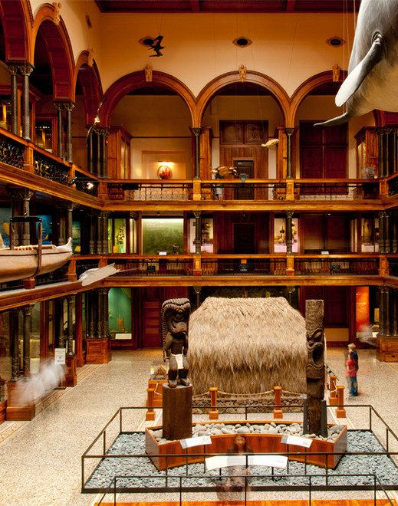
Libraries and Museums
Bishop Museum and Planetarium

Slide 13
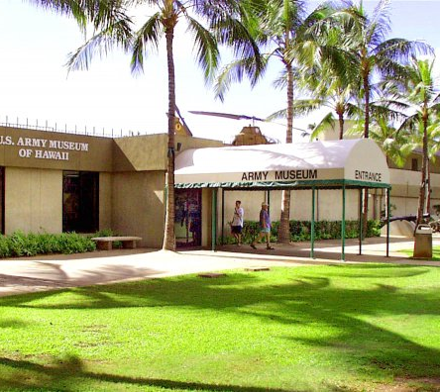
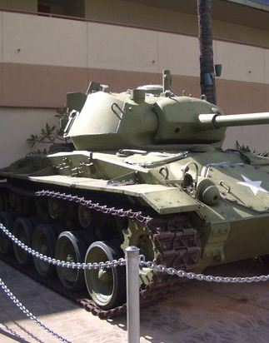
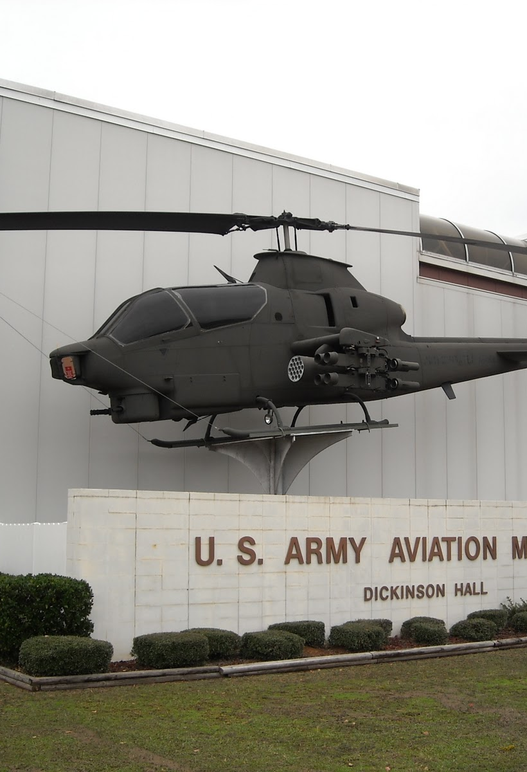
Libraries and Museums
U.S. Army Museum of Hawaii

Slide 14
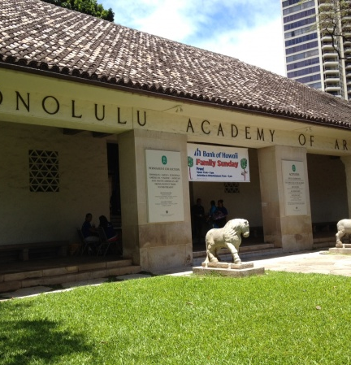
Libraries and Museums
Honolulu Academy of Arts

Slide 15
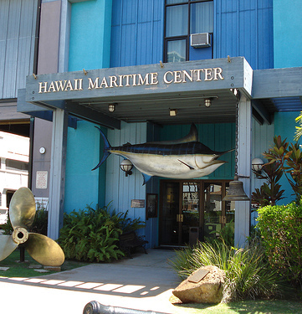
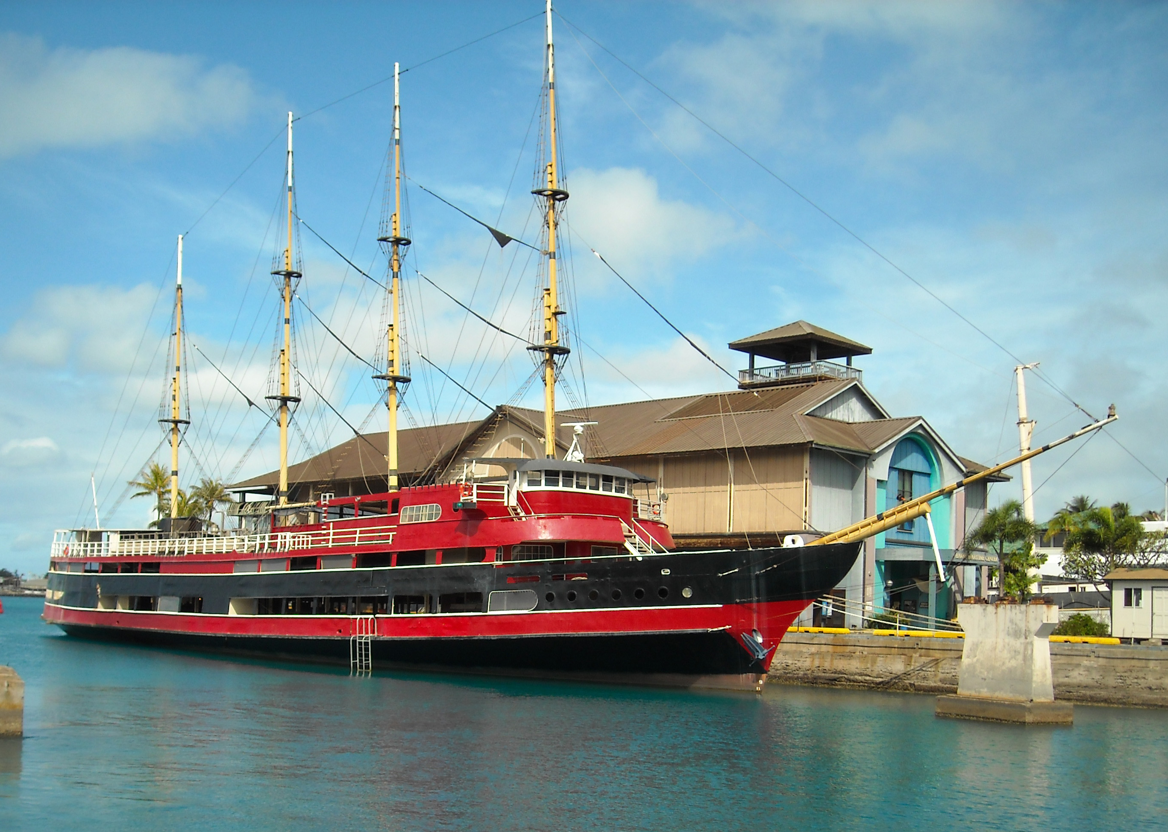
Libraries and Museums
Hawaii Maritime Center

Slide 16
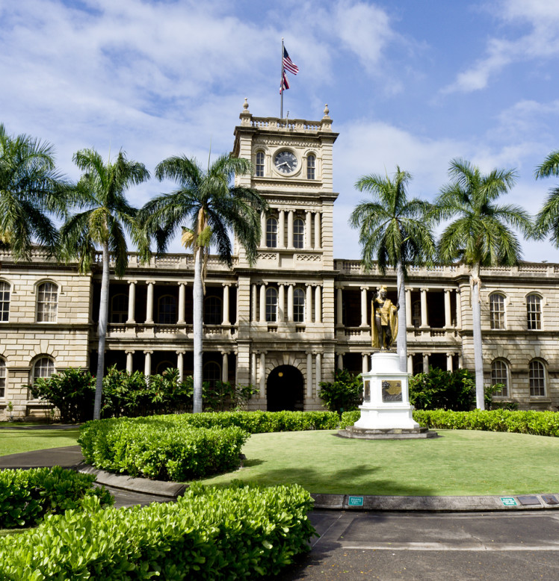
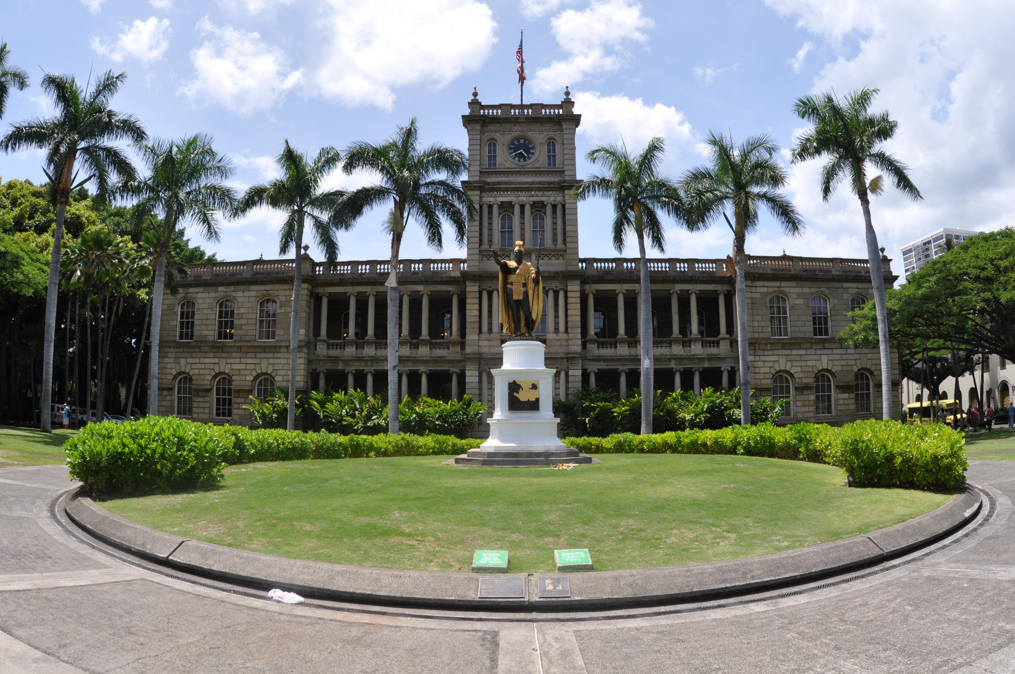
Libraries and Museums
Judiciary History Center

Slide 17
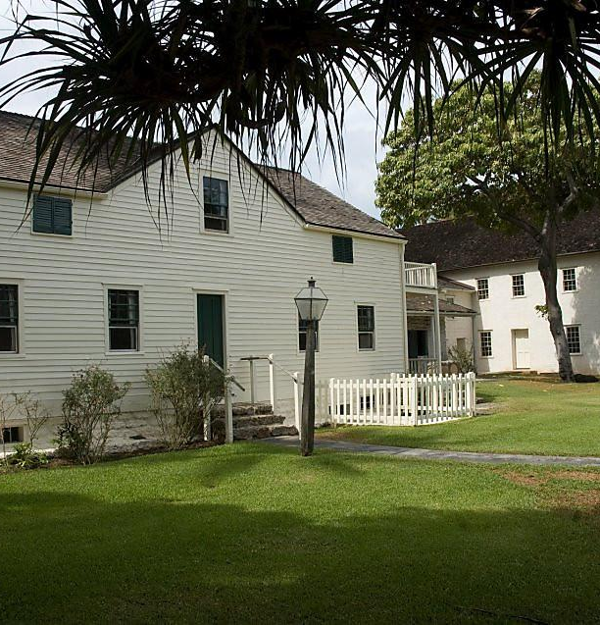
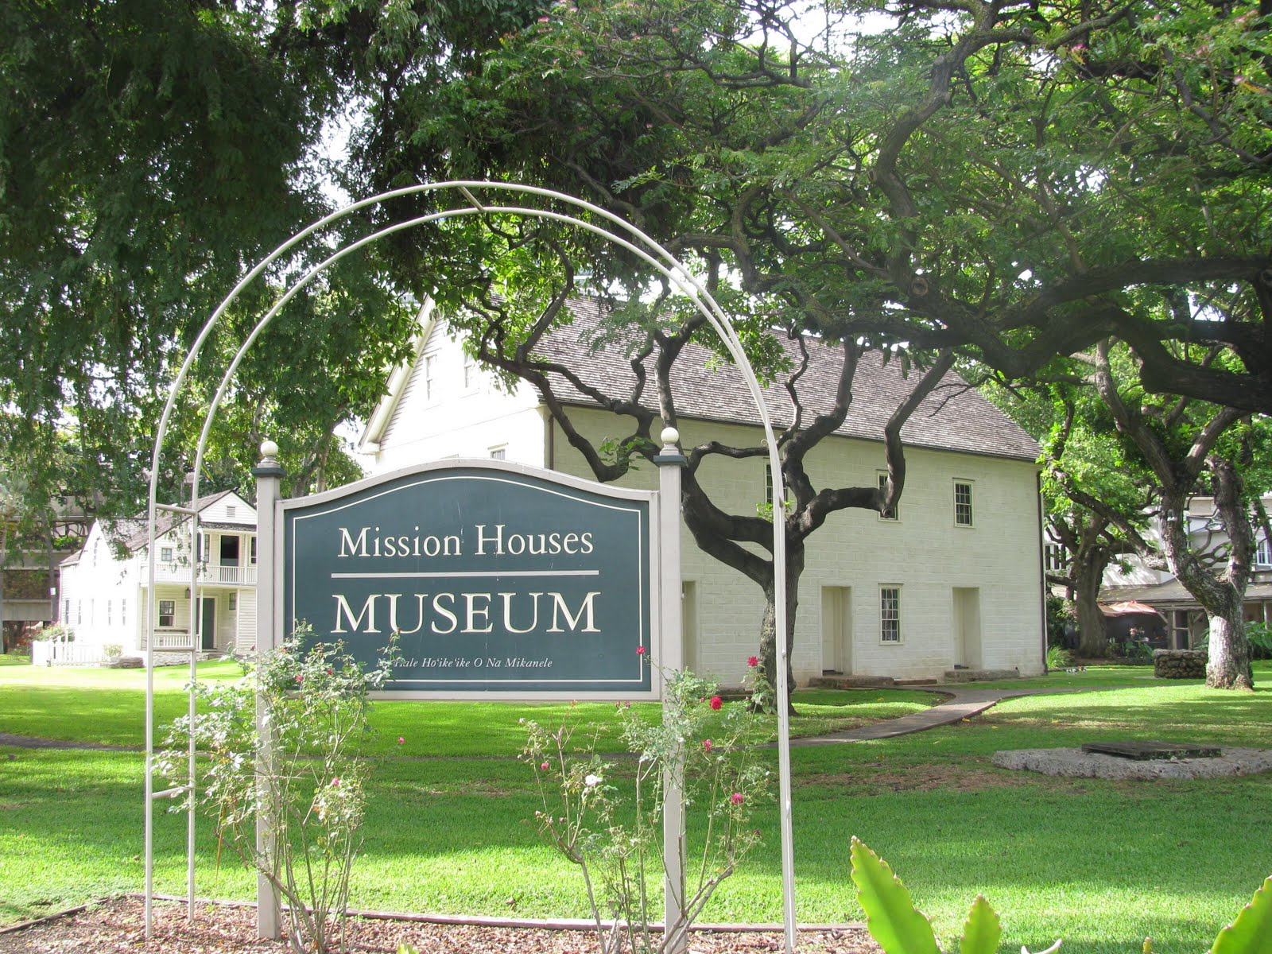
Libraries and Museums
Mission Houses Museum

Slide 18
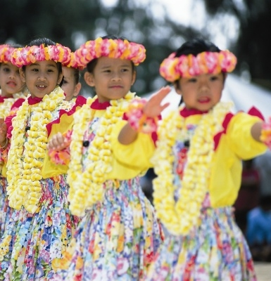
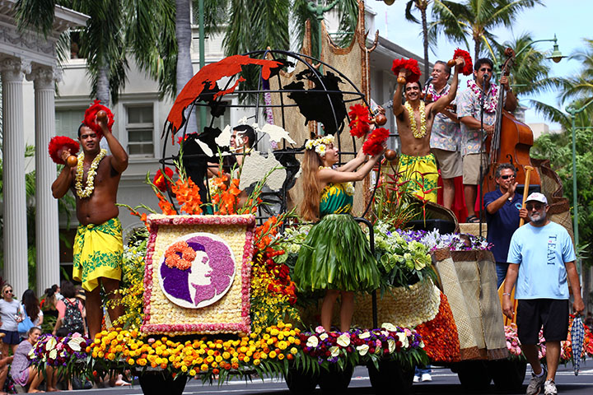
Holidays and Festivals
Aloha Week

Slide 19
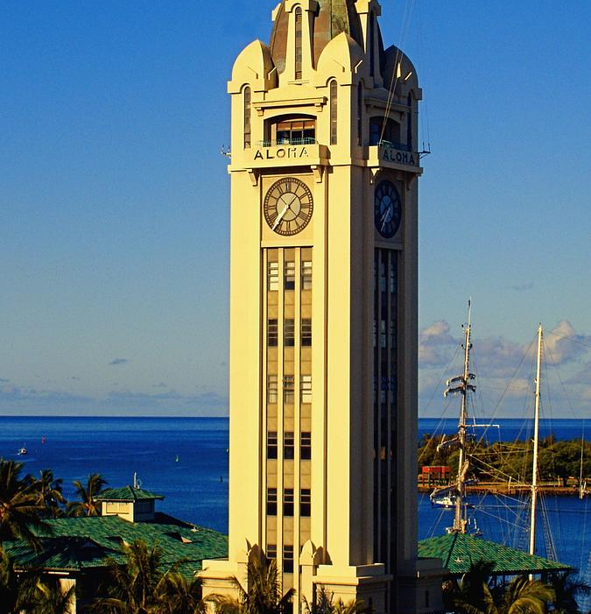
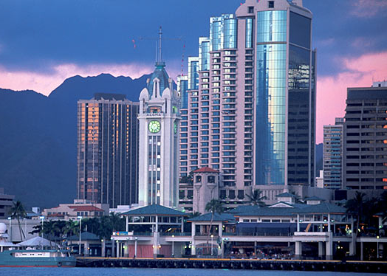
Tourist attractions
Aloha Tower

Slide 20
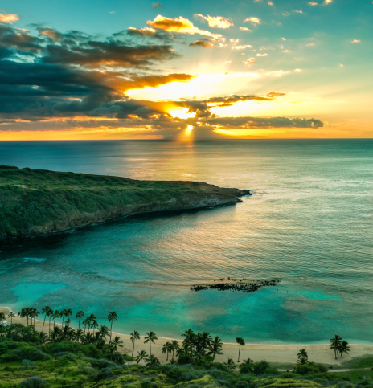
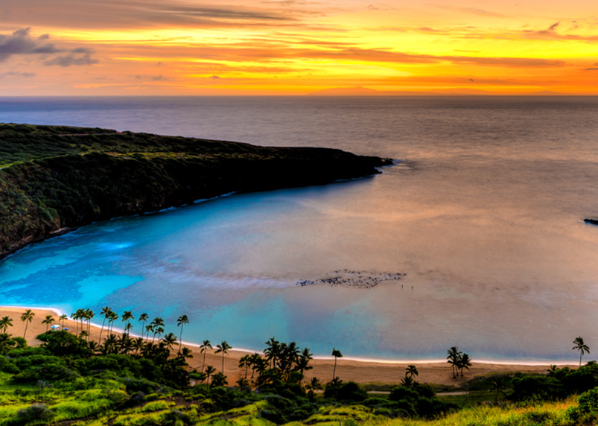
Tourist attractions
Hanauma Bay

Slide 21
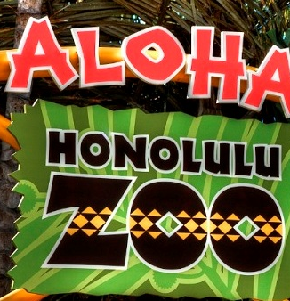
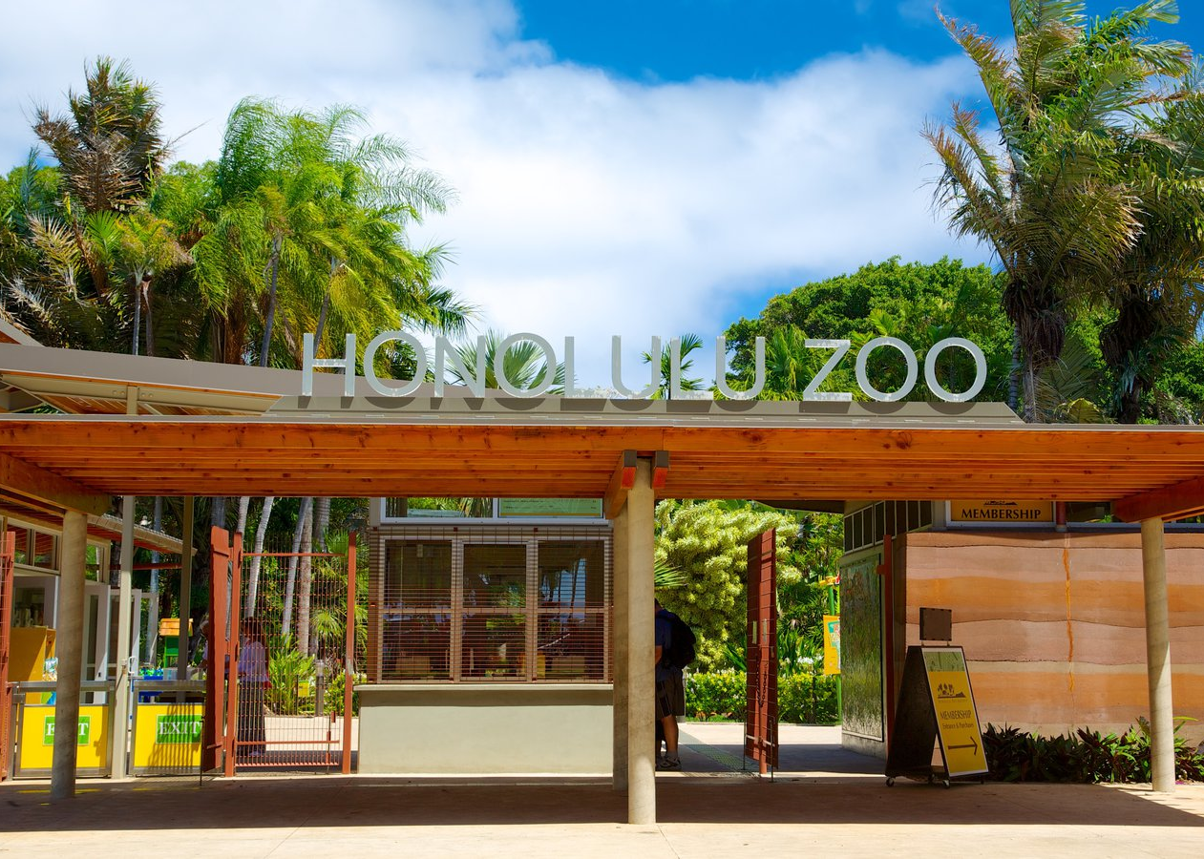
Tourist Attractions
Honolulu Zoo

Slide 22
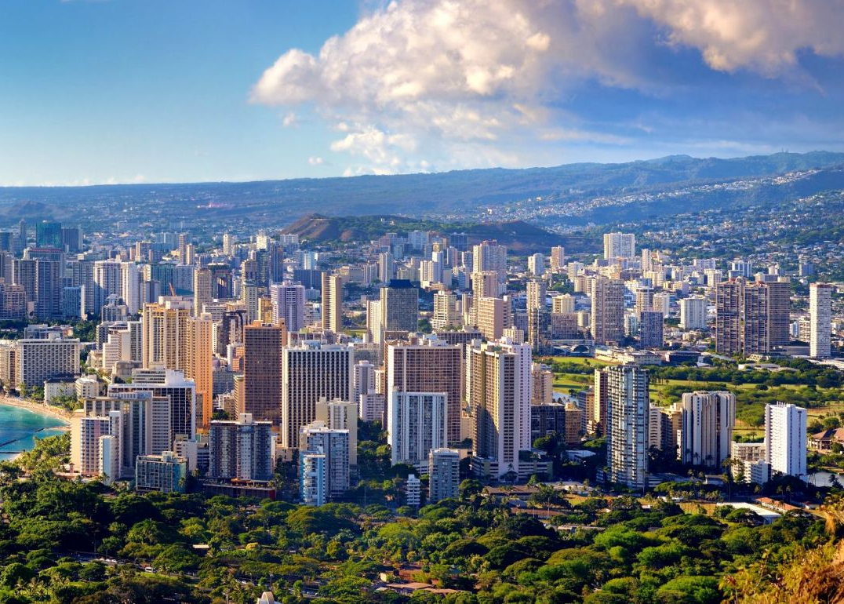
Tourist attractions
Waikiki Beach

Slide 23
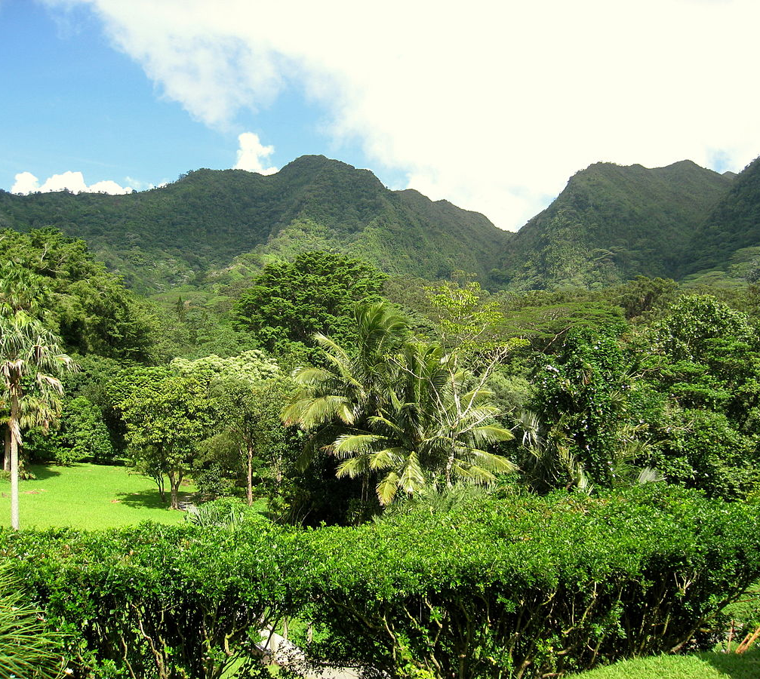
Tourist attractions
Lyon Arboretum

Slide 24
The end

