Slide 1
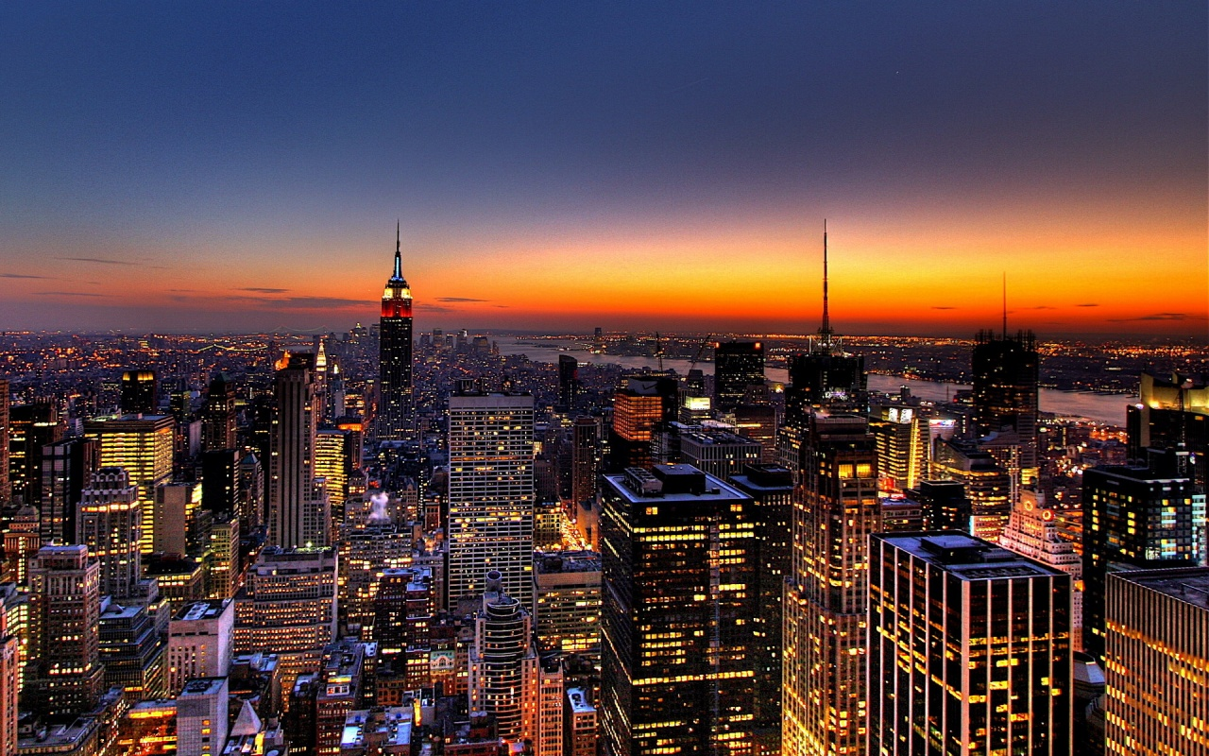
New York City
Štěpánka Bubáková

Slide 2
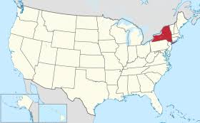
General information
The biggest and the most famous city of the US
NY is most populated town of US-8 milion
Area: 1 214 km²

Slide 3
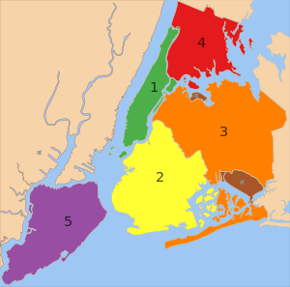
Boroughs
The city is divided into five major parts called boroughs.
1. Manhattan 2. Brooklyn 3. Queens 4. Bronx 5. Staten Island

Slide 4
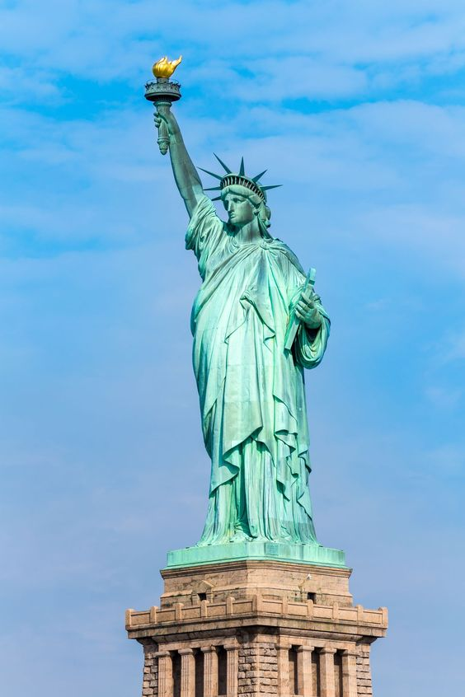
Statue of Liberty

Slide 5
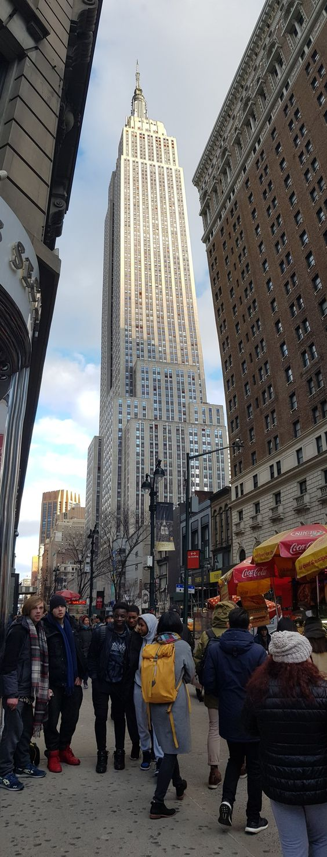
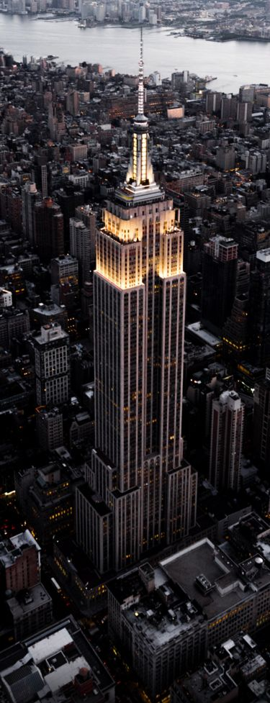
Empire State Building

Slide 6
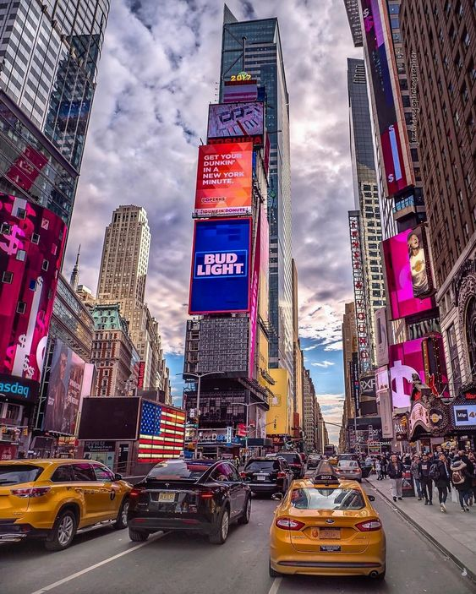
Times Square

Slide 7
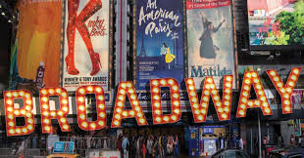
Broadway

Slide 8
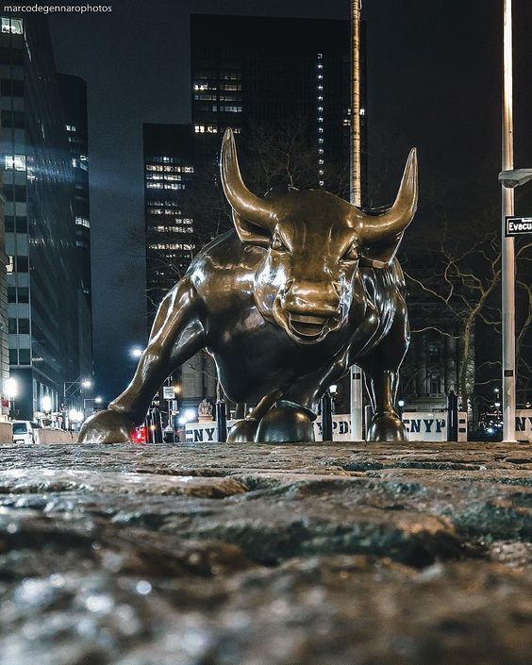
Wall Street

Slide 9
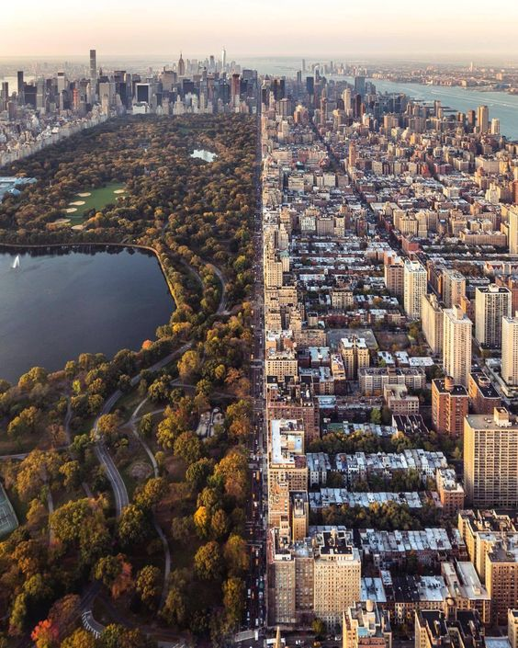
Central Park

Slide 10
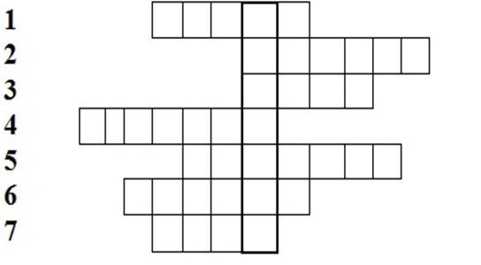
Crossword
1.Part of tht city
2.The tallest building
3.Name of the important street
4.Statue of…..
5.Theatres and cinemas
6.Time…..
7.Place to relax

Slide 11
Crossword-answers

Slide 12
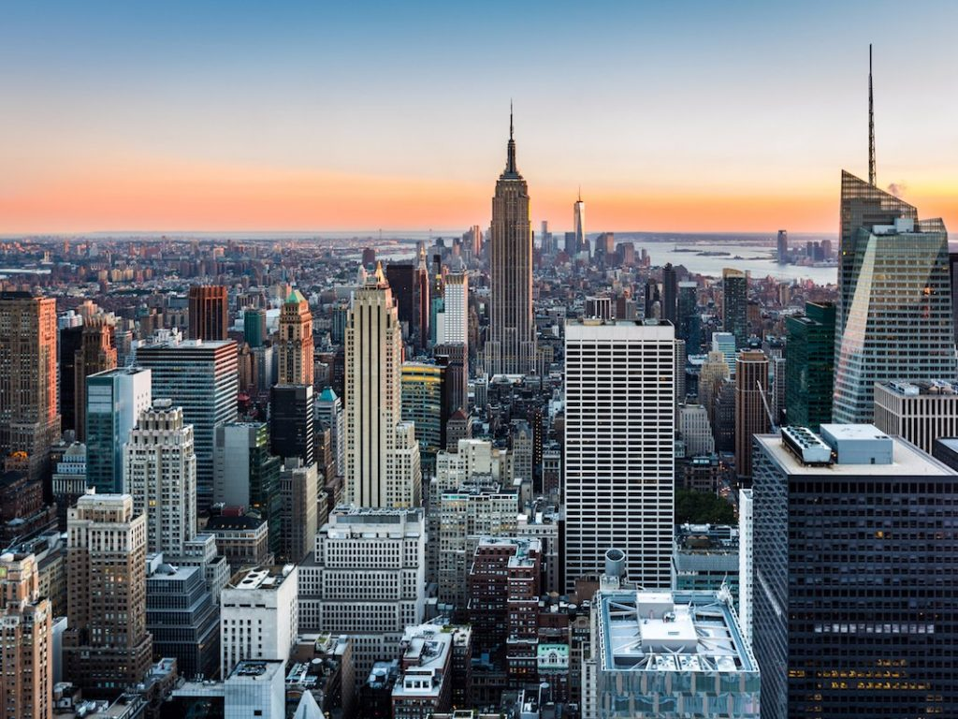
THANK YOU FOR YOUR ATTENTION

