Slide 1
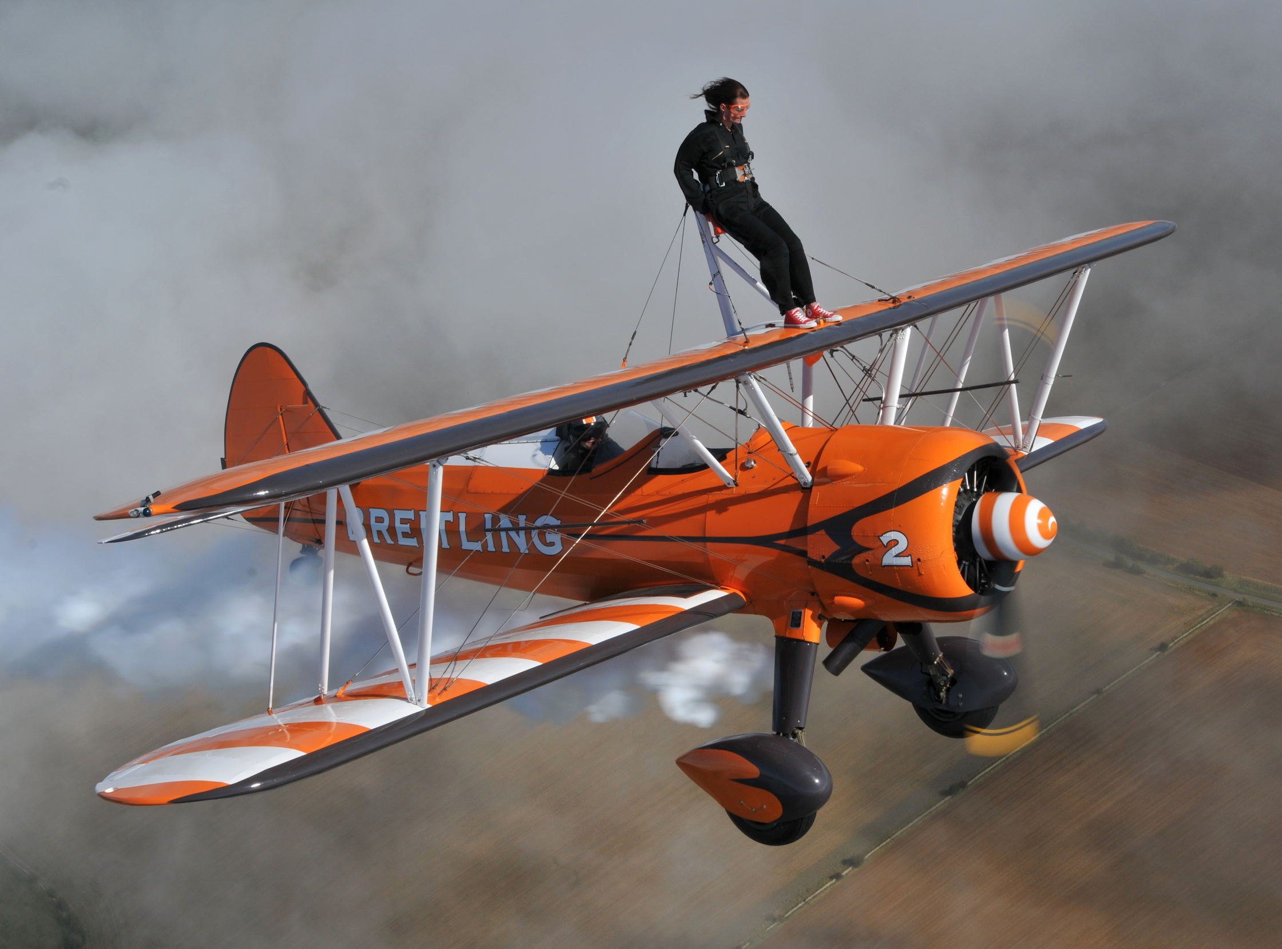
Wing walking
A.H.

Slide 2
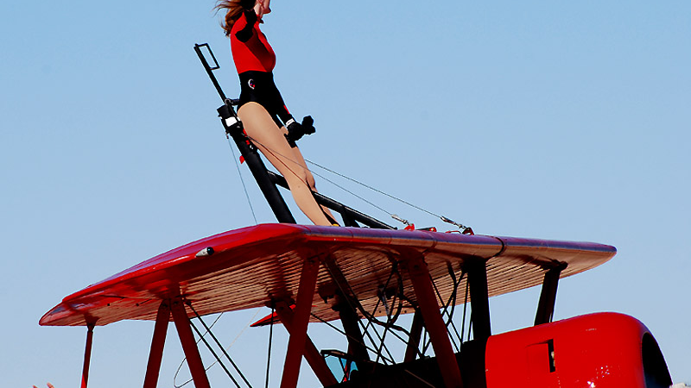
Basic information
it’s the act of moving on the wings of an airplane during flight

Slide 3
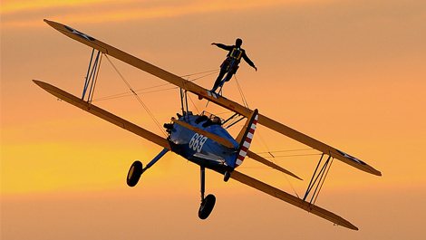
History
The first wing walker:
26-year-old Ormer Locklear
World War I.
climbed out to fix a problem (a mecanical issue)

Slide 4
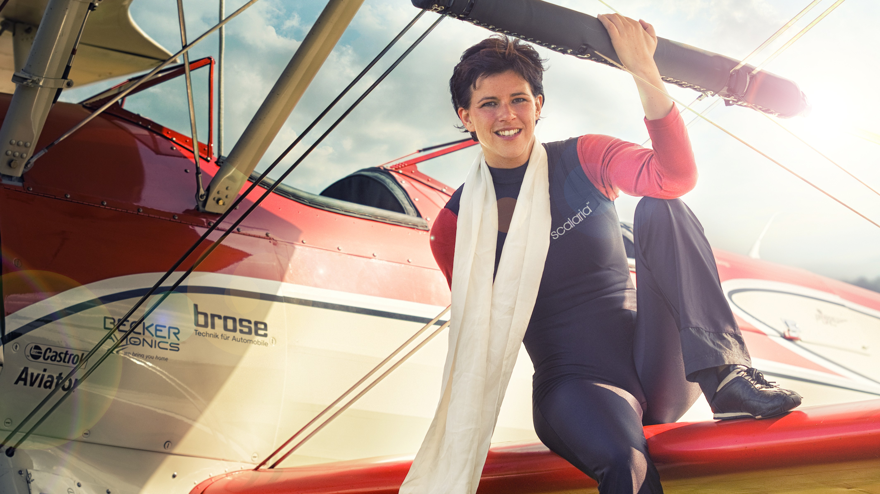
Peggy Walentin
the most famous wing walker
from Germany

Slide 5
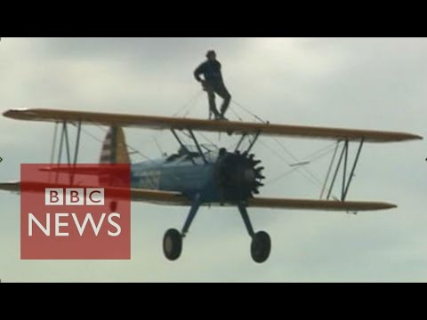
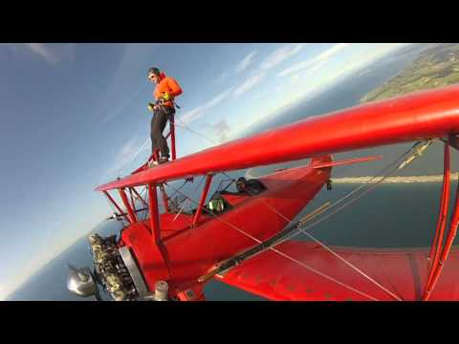
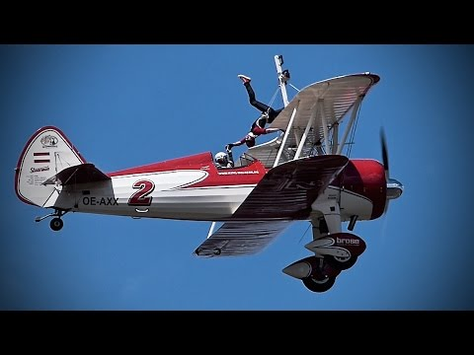
Videos

Slide 6
Thanks for your attention

