Slide 1
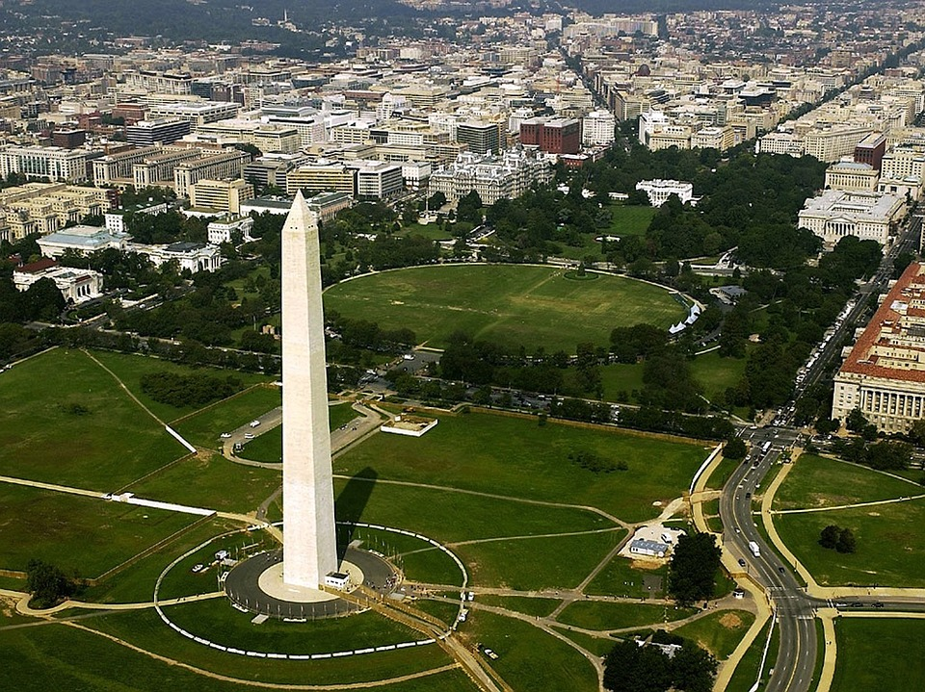
Washington D. C.

Slide 2
Basic facts
Capital of the United States
Located along the Potomac River
The city‘s area was originally taken from the states of Maryland an Virginia.
Around 3,7 mil inhabitants
Washington was named after George Washington
Video - http://www.youtube.com/watch?v=7dilTLvbHxc

Slide 3
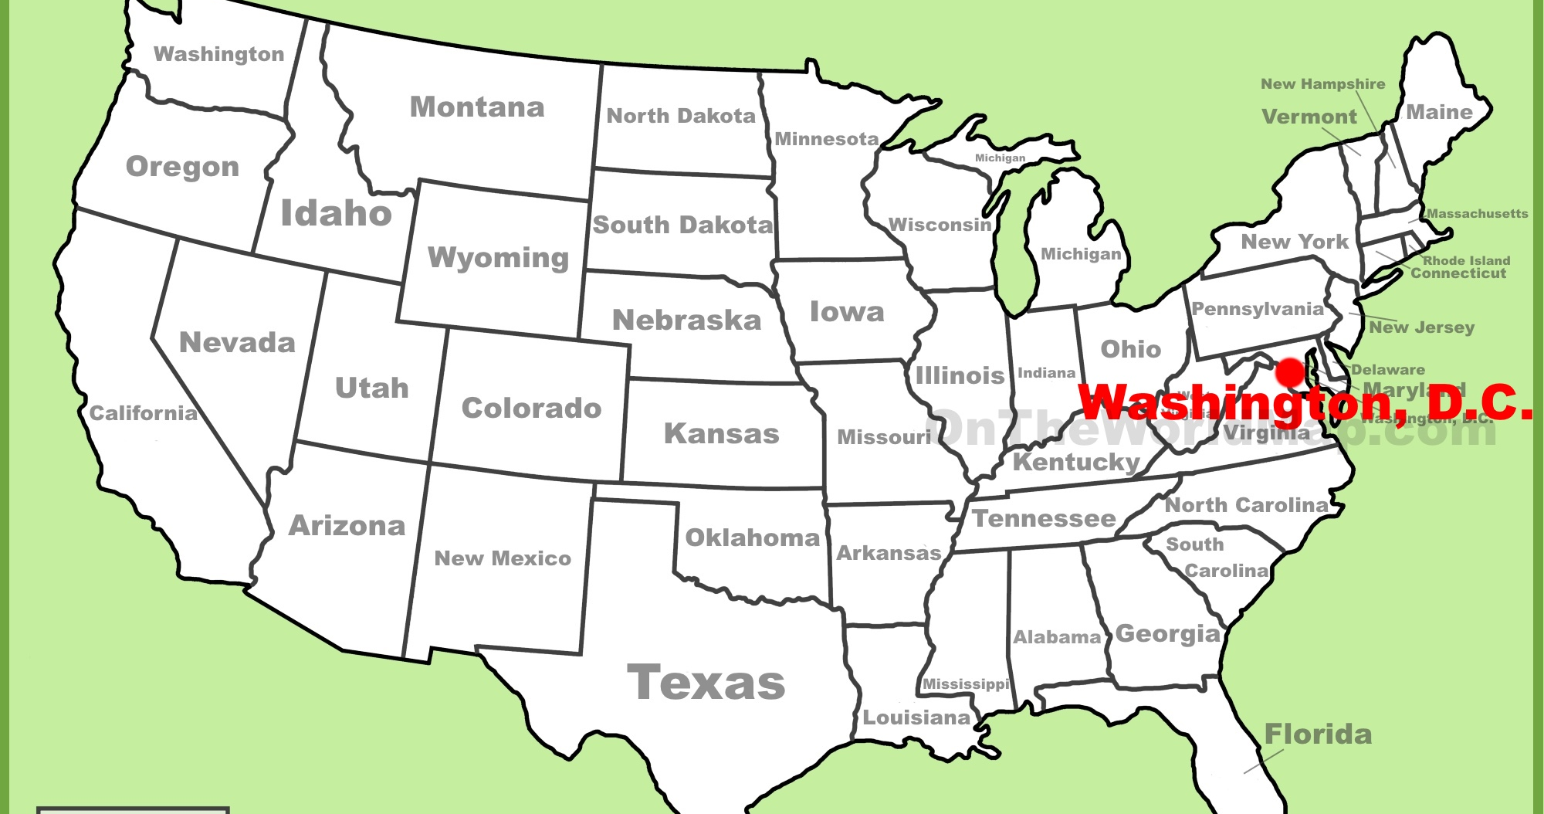

Slide 4
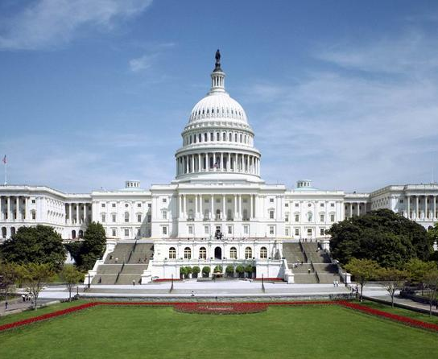
Places of interest
The Capitol - seat of US Congres
Library of Congres – 90mil items
The Supreme Court

Slide 5
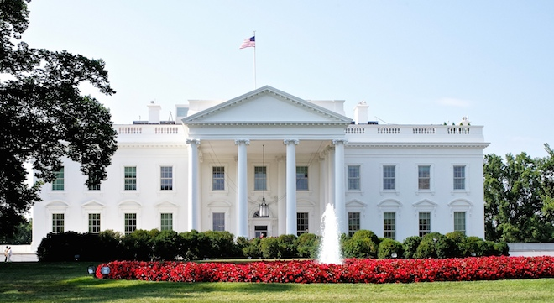
The White House
The Presidents Residence
The home of Americas first families
First floor open to public, second and third floors for President and his family

Slide 6
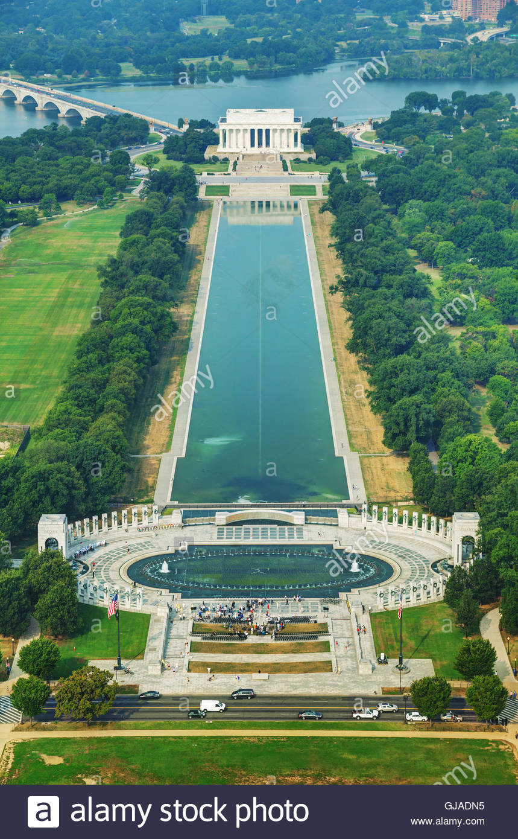
The mall
The mile-long tree-lined street with the view to the Washington monument
Its Americas most visited national park

Slide 7
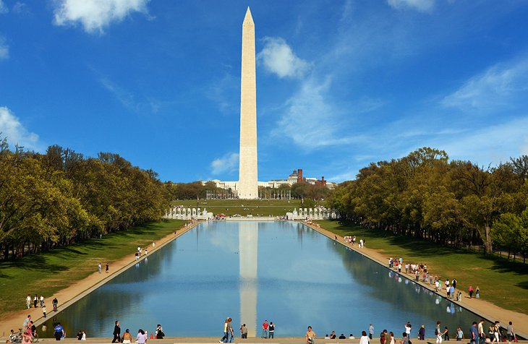
Washington monument
The white marble obelisk in the middle of the Mall
50 flags around

Slide 8
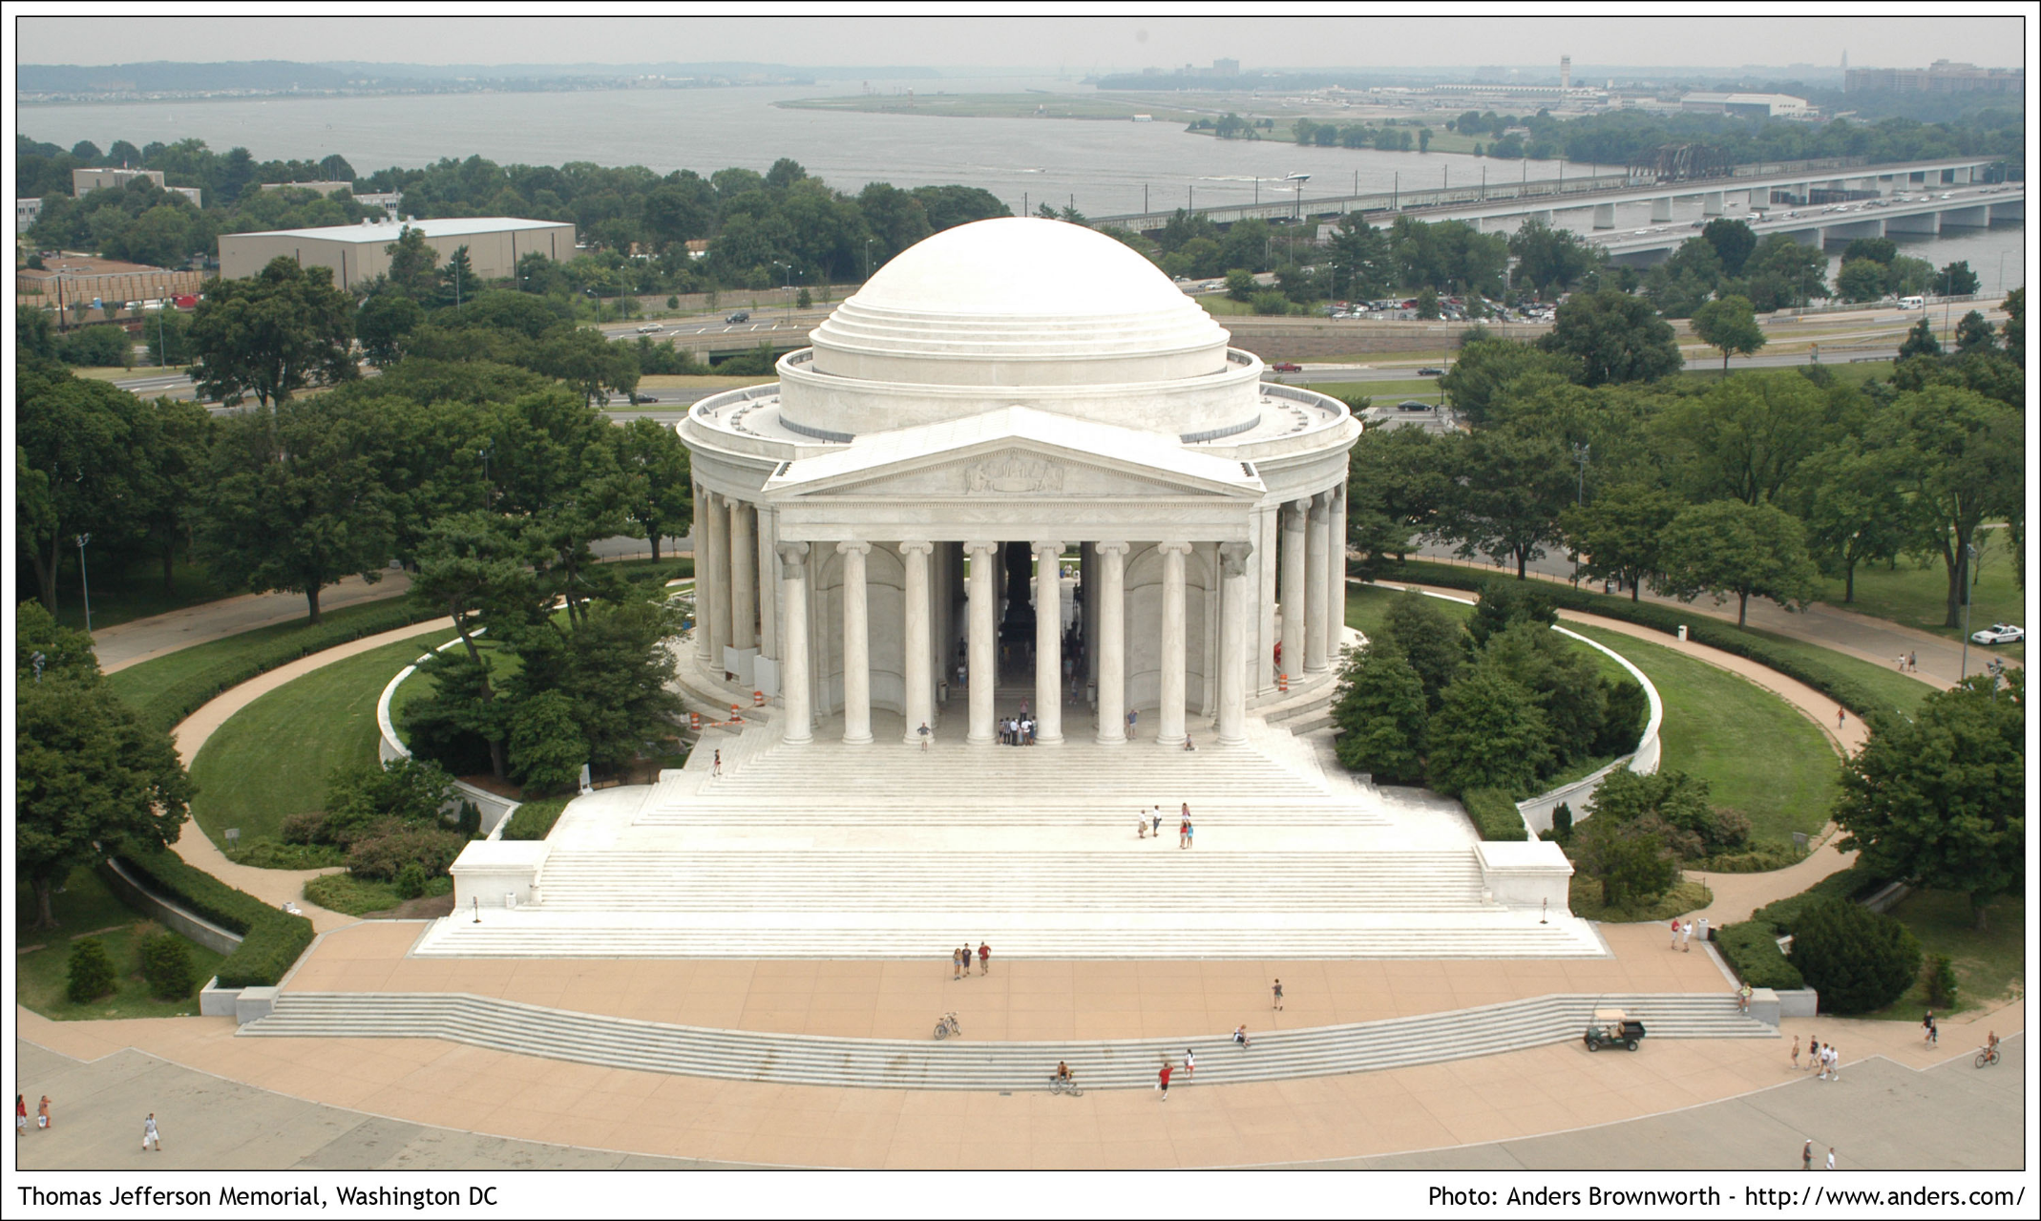
Jefferson Memorial
Commemorates the third US President
Inside a bronze statue of T. Jefferson
Walls are inscribed with Jeffersons writings

Slide 9
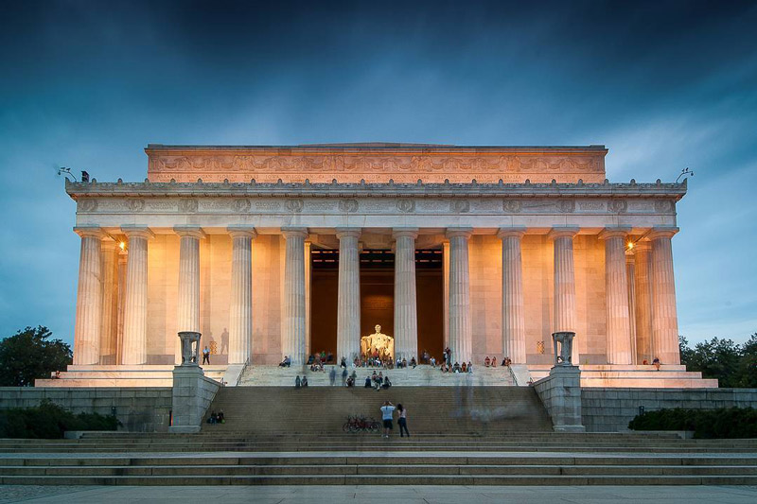
Lincoln Memorial
Commemorates the 16th US President
Inspired by Greek architecture
Marble statue of a seated Lincoln
https://www.youtube.com/watch?v=3vDWWy4CMhE

