Slide 1
TYPOLOGY OF TEMPERAMENTS
BEATRICE

Slide 2
CONTENT
Hippocrates
Galenos (added to Hippocrates findings - modified)
I. P. Pavlov
E. Kretschmer
H. Eysenck (theory of 4 temperaments)
Test of temperament

Slide 3
Hippocrates
First who invented Typology of Temperaments
Medical theory - four bodily fluids affect human personality traits and behaviors.
Divided into 4 categories
1) Sanguis (blood), fire, red, warm
2) Flegma (phlegm), water, white, wet
3) Cholé (bile,gall), air, yellow, cool
4) Melaina cholé (black bile), Earth or soil, black, dry

Slide 4
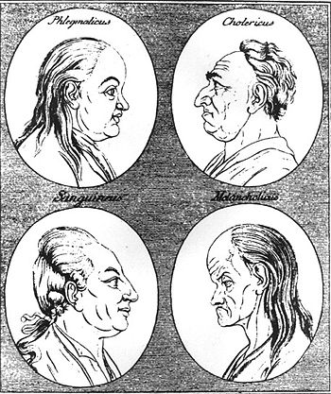
Galenos
He modified Hippocrates’es theory and gave each category a clear name which people use nowadays
1) Sanguine - Sanguis (blood), fire, red, hot
2) Phlegmatic - Flegma (phlegm), water, white, wet
3) Choleric - Cholé (bile,gall), air, yellow, cold
4) Melancholic - Melaina cholé (black bile), Earth or soil, black, dry

Slide 5
I. P. Pavlov
His theory - he believed that temperaments are divided according to the properties of the neural processes
1) Sanquine
Fast, strong, stable
2) Phlegmatic
Slow, strong, stable
3) Choleric
Fast, strong, unstable
4) Melancholic
Slow, weak, unstable

Slide 6
Ernst Kretschmer
He differentiated temperaments upon body figure
1) Pyknic  Choby, fat, stocky
Opened, realistic, friendly, moody (in extreme cases obese may suffer from depressive illness)
2) Asthenic – Leptosomic  Thin, small, weak
Unfriendly, closed, idealistic (in extreme cases struggle with schizophrenia)
3) Athletic  Muscular, large-boned, strong
Sensibility, coolness, cold

Slide 7
Hans Eysenck
Hans Eysenck was born in Germany in 1916. Because of the persecution of jews he fled to England at the age of 18. Here he became a famous psychiatrist. He wrote 75 books, until he died in 1997. Eysenck type personality tests are some of the most used.
Eysenck devoted his life to the study of temperaments. This means that part of the personality, which is rooted in our genes and biological processes. His starting point was the classical Greek four temperaments, phlegmatic, choleric, sanguine and melancholic.
Originally Eysenck characterized an individual's personality on two scales. Introversion - extraversion and stable - unstable. A person may this be introverted and stable, introverted and unstable, extraverted and stable or extraverted and unstable.

Slide 8
Types of temperaments
Sanguine - extrovert and stable
Phlegmatic - introvert and stable
Choleric - extrovert and unstable
Melancholic - introvert and unstable

Slide 9
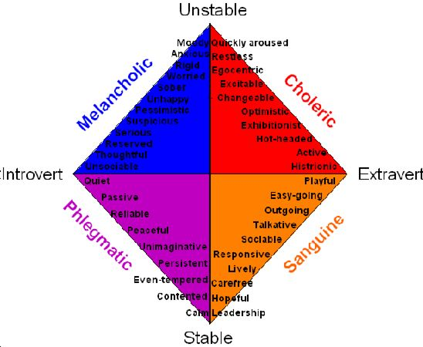

Slide 10
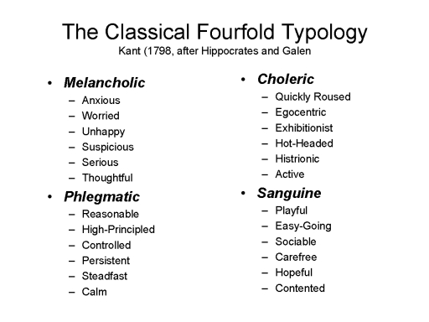

Slide 11
TEST OF TEMPERAMENT
http://personality-testing.info/tests/O4TS/

Slide 12
Any questions ?
Thank You

