Slide 1
TROPICAL RAINFORESTS The Lungs of the Planet
Adriena Redlová 2O14

Slide 2
Content
What is a Tropical Rainforest?
Location
Plants & Animals of Tropical Rainforests
Rainforest People
Summary: Importance & Destruction of TRF

Slide 3
What Makes a Rainforest?
Location: the tropics
Rainfall: 2000 mm of rain per year
Canopy: leafy layer 30 m above the ground
Biodiversity: high level; ½ of the plants and animals found on Earth’s land live in TRF
Symbiotic relationships between species: species in the rainforest often work together

Slide 4
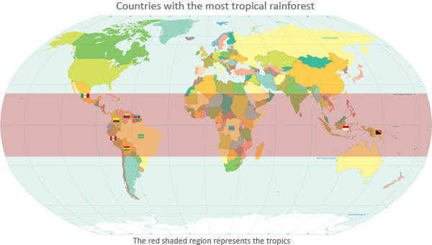
Location

Slide 5
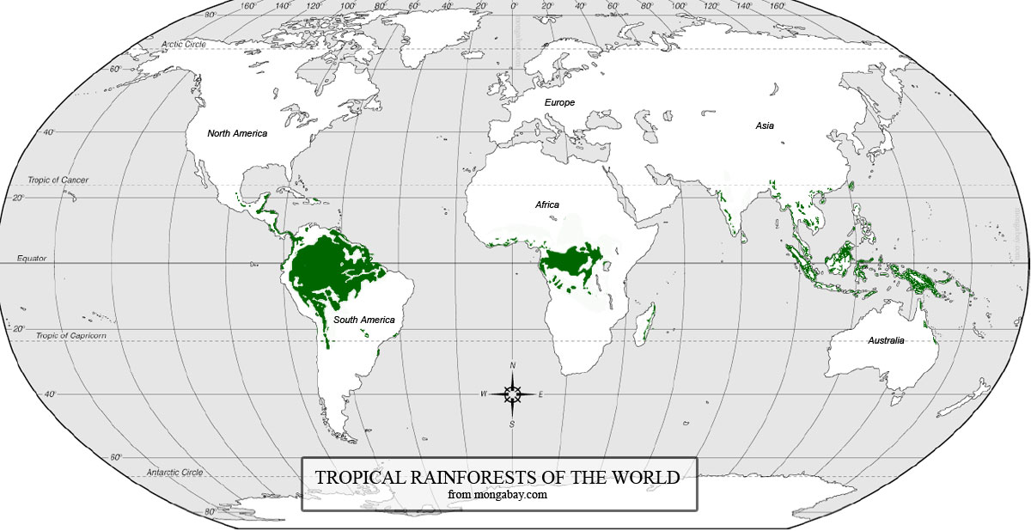
Location

Slide 6
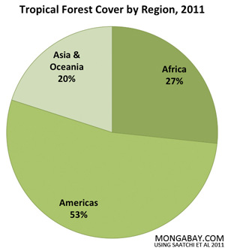

Slide 7
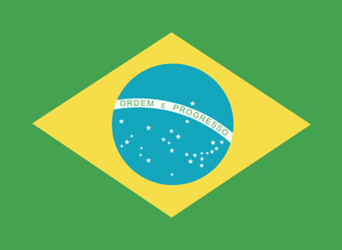
The countries with the largest areas of tropical forest:
Brazil
Democratic Republic of Congo
Indonesia
Peru
Colombia

Slide 8
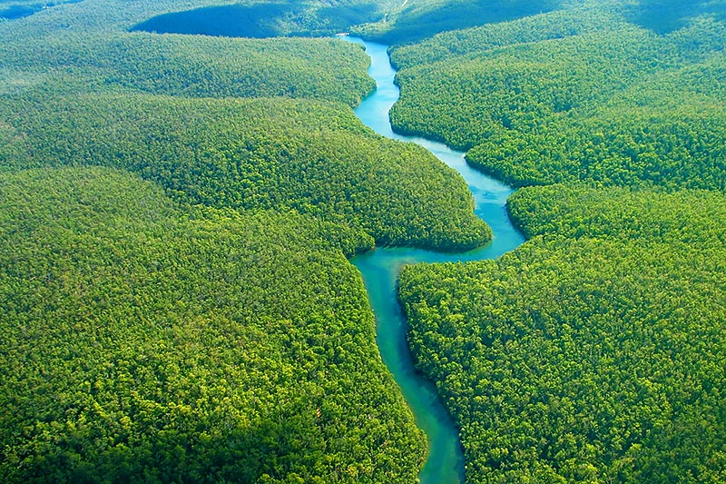
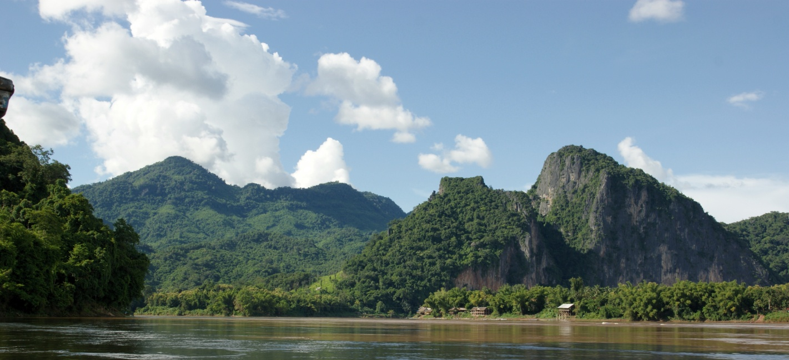
Rainforest Rivers
Amazon
Mekong
Orinoco
Congo

Slide 9
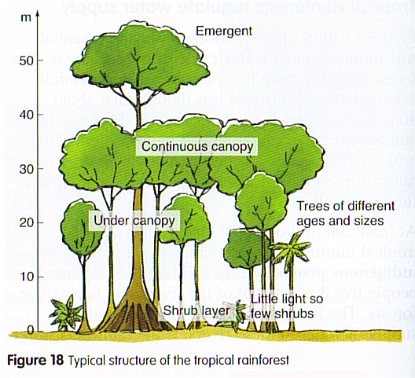
Structure: Vertical Layers
Overstory
Canopy
Understory
Shrub Layer
Forest Floor

Slide 10
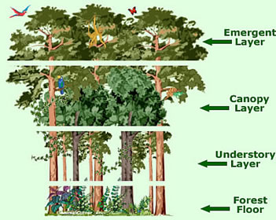
Vertical Layers
The Forest Floor
Canopy
Dark and Humid
Decomposition
“the leafy world“
30 m above the ground
60 – 90% of life in TRF

Slide 11
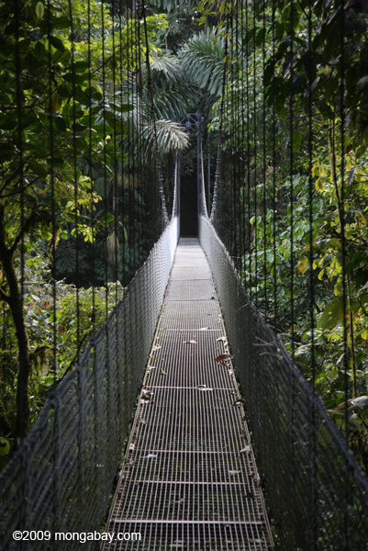
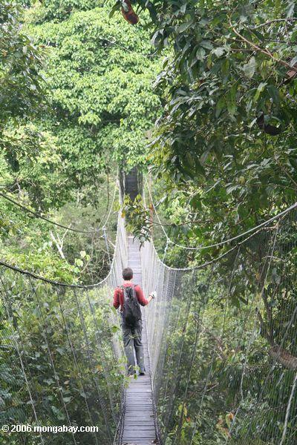
Canopy walkways

Slide 12
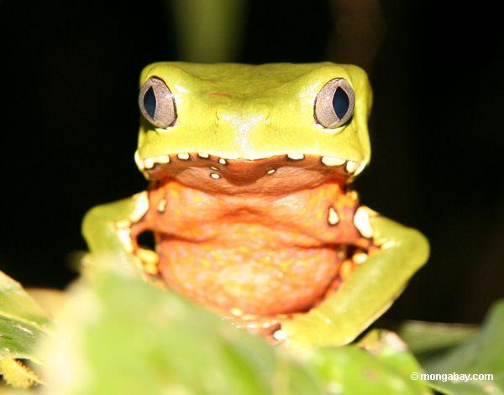
Biodiversity
Biodiversity in numbers
Reasons
Less than 2% of Earth’s surface -> more than 50% of the plants and animals on Earth
US: 81 species of frogs -> Madagascar: 500 species
Area of 2 football fields in a TRF: more than 400 species of trees -> an equal area of forest in the US fewer than 20
Climate (a lot of sunlight -> energy made by photosynthesis)
Canopy (sources of food, shelter and hiding place)

Slide 13
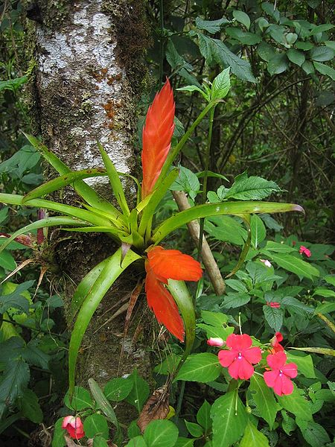
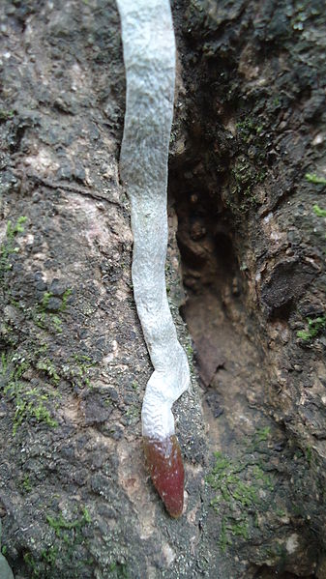
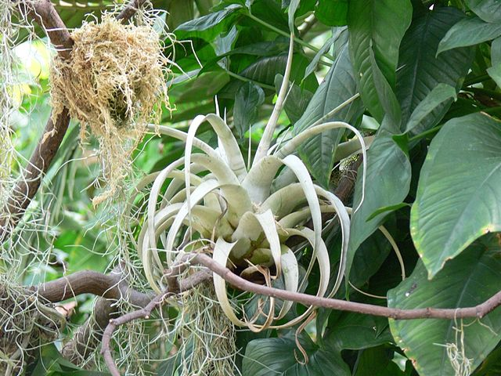
Rainforest Plants
Only few ground plants
Constant battle for access to sunlight -> straight and tall trees
Epiphytes (air-plants): orchids, bromeliads

Slide 14
Trees
Timber: Ebony, Mahogany, Rosewood (palisandr), Balsa Tree, Teak, Cedar
-> high-quality, durable furniture
Diversity -> deforestation
of large areas for timber
Minimal seasonal differencies
-> only indistinct annual rings

Slide 15
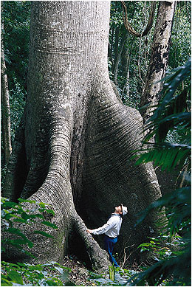
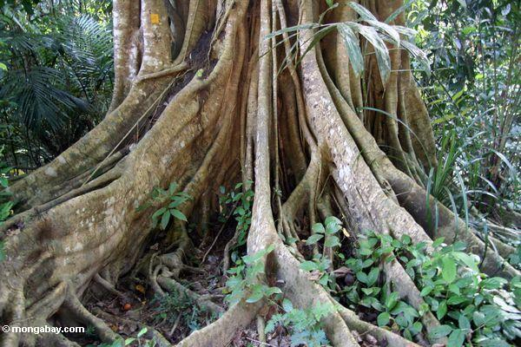
Buttress Roots
Large roots on all sides of a shallowly rooted tree

Slide 16
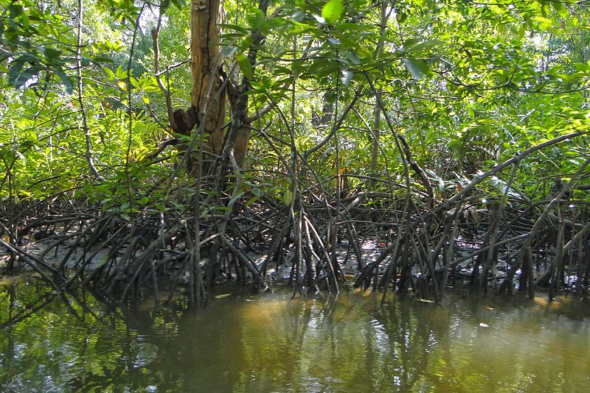
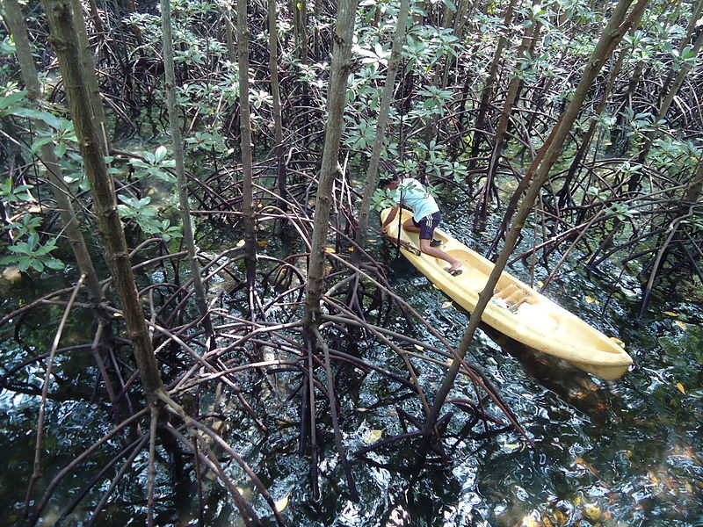
Mangroves
Trees growing in
“brackish water“ = seawater + freshwater mixed in a river
seawater

Slide 17
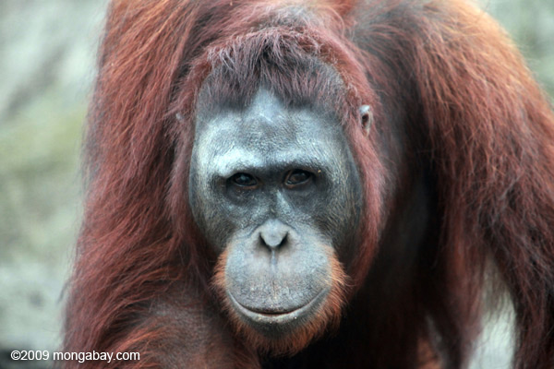
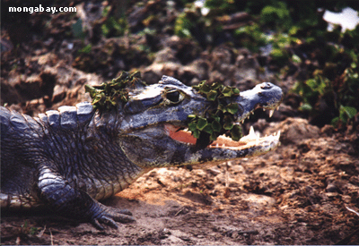
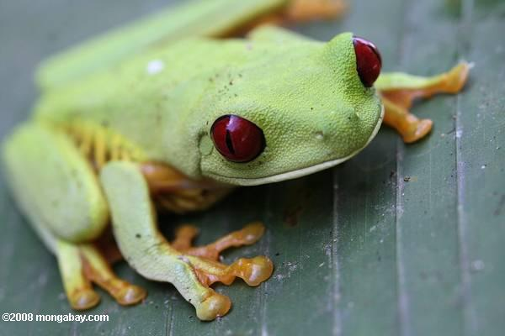
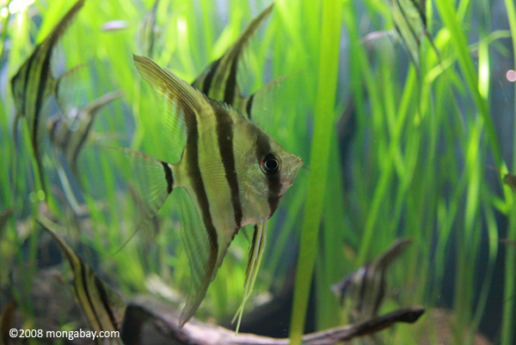
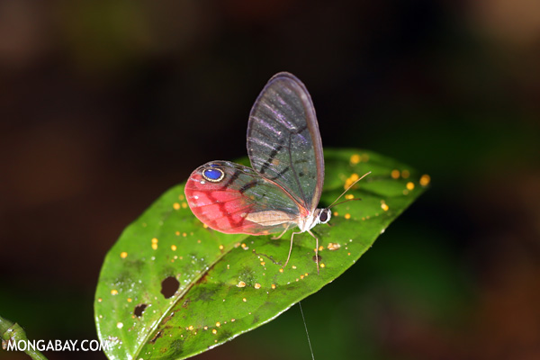
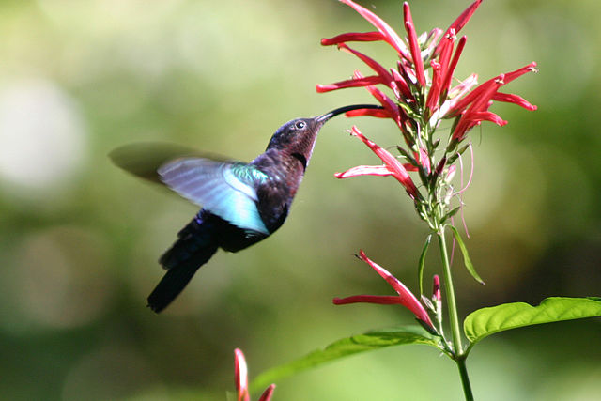
Rainforest Animals
MAMMALS
REPTILES
FISH
BIRDS
AMPHIBIANS
INSECTS

Slide 18
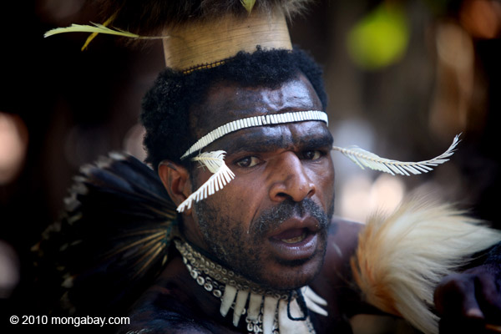
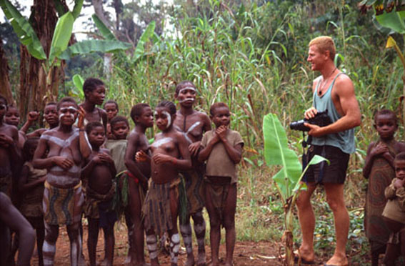
Rainforest people

Slide 19
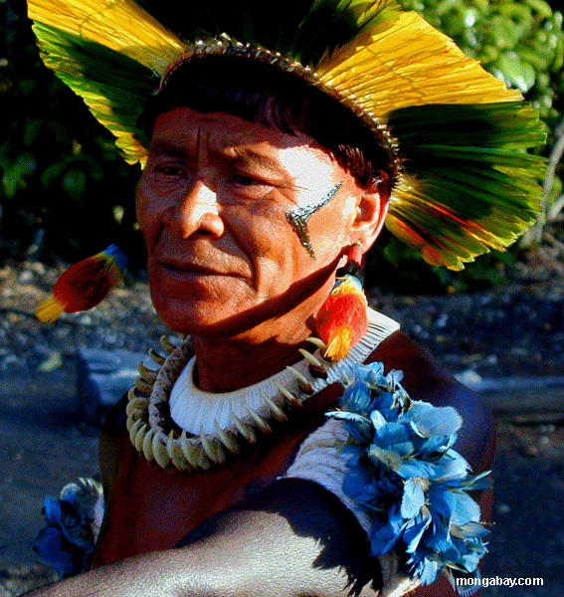
Medicinal Plant Knowledge
Shaman = Medicine man
Knowledge of medicinal plants: incredible healing power
Going “extinct“

Slide 20
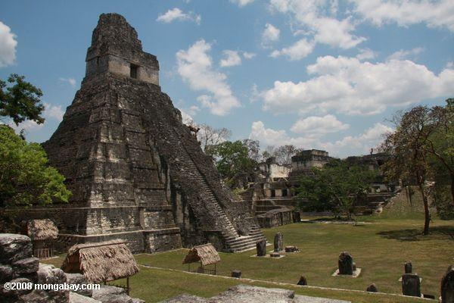
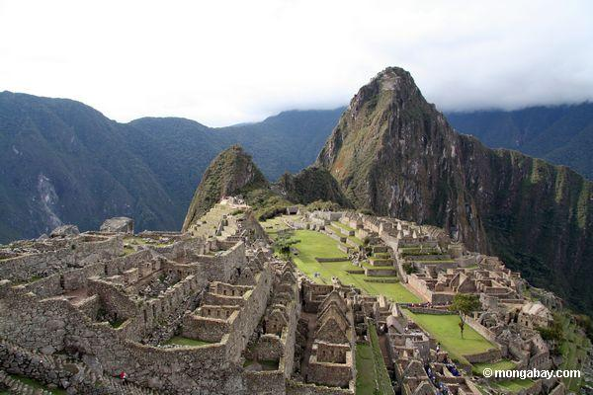
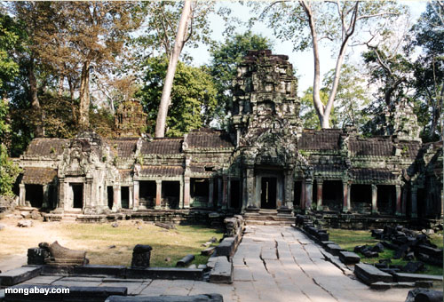
Great Civilizations
Mayas, Incas, Aztecs

Slide 21
The Importance of the Rainforests
Tropical Rainforests:
Stabilize the world’s climate
Provide a home to many plants and animals
Maintain the water cycle
Provide protection against erosion, drought, flood
Are source for medicines, foods, wood, minerals, natural resources and recreation
Are an interesting place to visit!

Slide 22
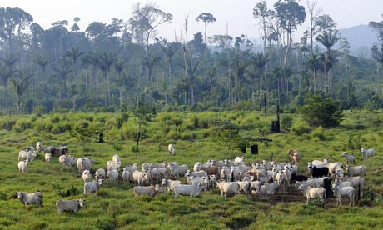
The Destruction of Rainforests
Rainforests are cut down for:
wood for both timber and wood fuel
agriculture for farms
land for poor farmers
land for cattle
pulp for making paper
road construction
minerals and energy

Slide 23
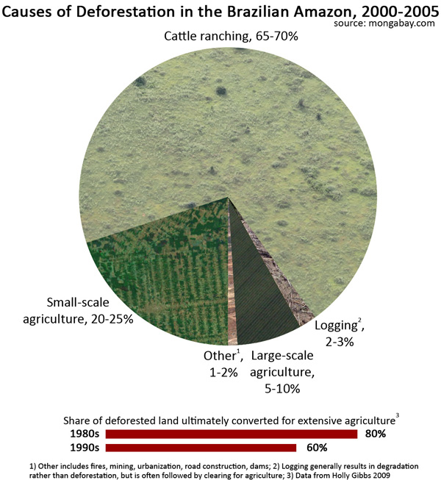

Slide 24
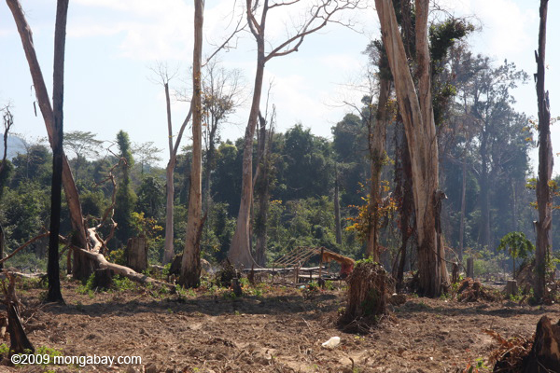
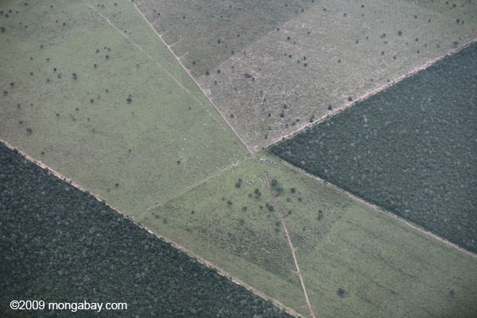
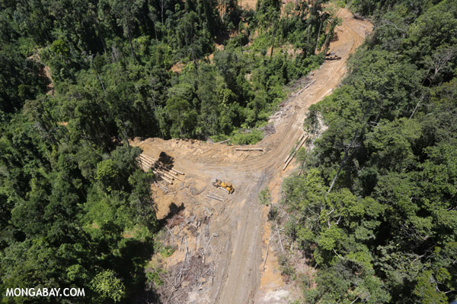
Deforestation

Slide 25
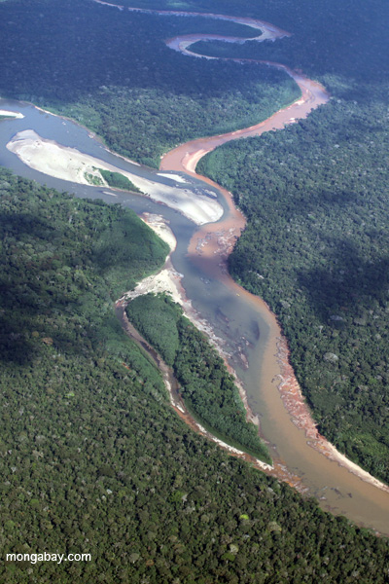
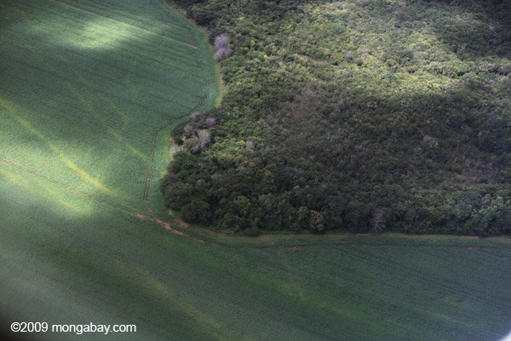

Slide 26
Deforestation
Agriculture
Extraction of minerals and energy
Poor farmers
Agricultural companies
Gold, copper, diamonds, precious metals, gemstones
Oil and gas deposits
Dams
Poverty

Slide 27
Thank you for your attention

