Slide 1
Sylvia Plath [/plæθ/] ( October 27, 1932- February 11, 1963 ) „I shut my eyes and all the world drops dead; I lift my eyes and all is born again.“ -Mad Girl's Love Song

Slide 2
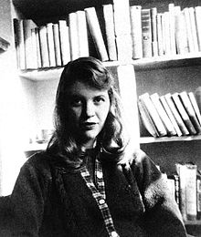
Life (1)
was an American poet, novelist,
and short-story writer
Bradford Senior High School
Smith College
Fulbright scholarship to
study at Newnham College,
Cambridge University

Slide 3
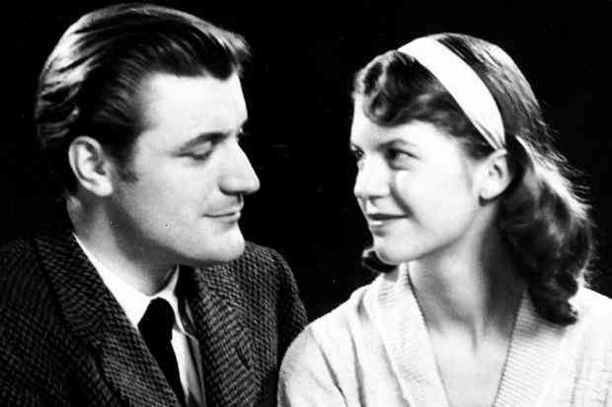
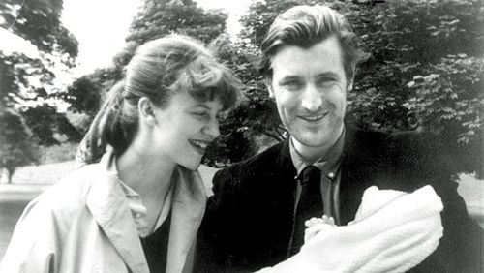
Life (2)
in childhood lived in Boston, Winthrop and Wellesley, MA
suffered from depression
1956- marriage with the English poet Ted Hughes
had two children Frieda and Nicholas

Slide 4
Writing
Prose and novel:
1963- The Bell Jar under the pseudonym "Victoria Lucas„
1975- Letters Home: Correspondence 1950–1963
Poetry:
1960-The Colossus and Other Poems
1965-Ariel
1971-Crossing the Water, Winter Trees
1981-The Collected Poems

Slide 5
Points of interest
Awards:
Glascock Prize (1955)
Pulitzer Prize for Poetry (1982) The Collected Poems
Sylvia's mother was approximately 21 years younger than her husband
loved a Welsh poet Dylan Thomas
"more than life itself"
“Perhaps when we find ourselves wanting everything, it is because we are dangerously close to wanting nothing.”

Slide 6
Resources
http://en.wikipedia.org/wiki/Sylvia_Plath
http://www.poets.org/poetsorg/poet/sylvia-plath
Quotes:
http://www.brainyquote.com/quotes/authors/s/sylvia_plath.html#Y4ZVshhb8Xvoex4H.99
http://www.goodreads.com/author/quotes/4379.Sylvia_Plath
Images: http://41.media.tumblr.com/db2a0d0e8be0c8b36cacd303e6ba700d/tumblr_myns30AwD11rvwnumo1_500.jpg
http://www.brainpickings.org/wp-content/uploads/2013/02/hughesplath.jpg
http://upload.wikimedia.org/wikipedia/en/e/e4/Sylvia_plath.jpg
http://www.literaryladiesguide.com/wp-content/uploads/2012/07/sylvia-plath-1.jpg
http://www.amazon.com/Ariel-Facsimile-Manuscript-Reinstating-Arrangement/dp/0060732601/ref=asap_bc?ie=UTF8
http://ecx.images-amazon.com/images/I/515JNXDM1QL.jpg
http://writingwomendotorg.files.wordpress.com/2013/11/plathhughes2013.jpg

